Slide 1

Alien
Archaeology
Ancient Egypt

Slide 2

Hello! I’m Bob!
I’m an alien from a different planet!
I’ve come to see what it is like on Earth.
You have such strange objects that we don’t have on my planet. And I have no idea what you do with them!

Slide 3

I mean, what is THIS?
What is it?
Where does it live?
How do you use it?
Who uses it?
Notes:
This Photo by Unknown Author is licensed under CC BY-NC

Slide 4
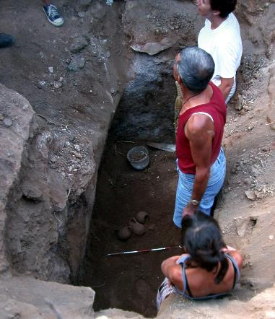
What do Archaeologists do?
Archaeologists dig up the remains of the past.
Sometimes, they don’t know what they have found.
Just like an alien looking at our objects, they have to figure out what it was used for.
"Archaeologists studying Carian tomb in Milas Becin" by Ms. Yasemin Polat is licensed under CC BY-SA 3.0.

Slide 5
The ancient Egyptians
The ancient Egyptian civilisation started around 5000 years ago.
Many of the things they used every day, do not exist today.
Sometimes it can be difficult for archaeologists to work out what they are.

Slide 6

Bob’s Challenge
Bob has found some objects used by the Egyptians.
He has asked you to draw or write what you think they might be or how they are used.

Slide 7
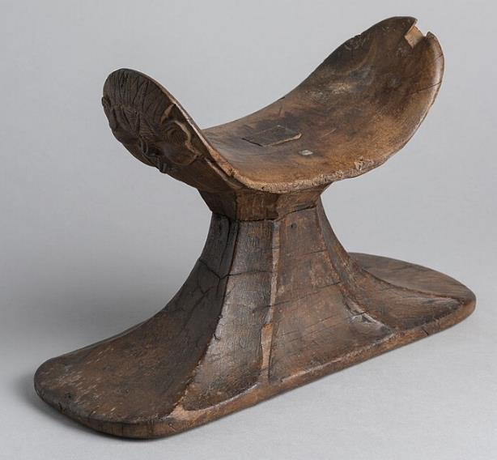
1.

Slide 8
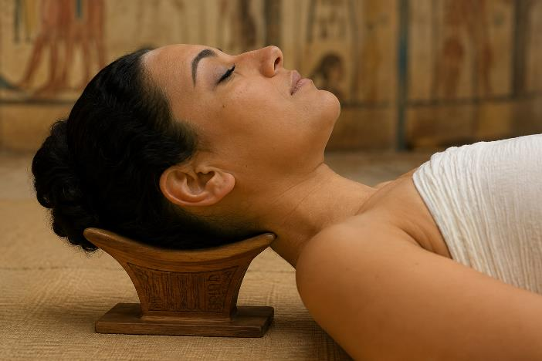
1. It’s a headrest (ancient pillow)!
Notes:
Made with AI

Slide 9
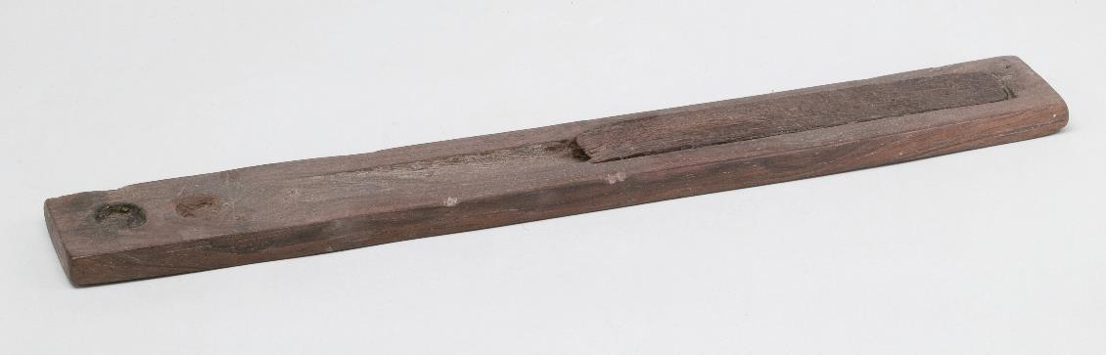
2.

Slide 10
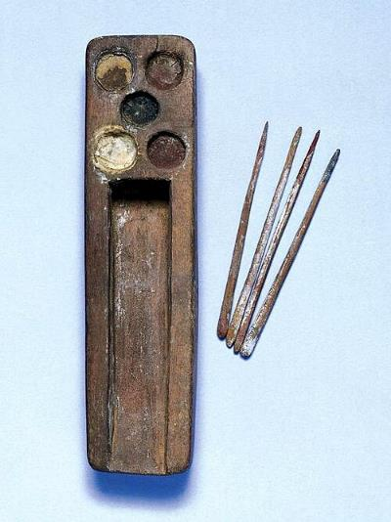
2. It’s a scribe’s palette (pencil case)!
Notes:
Royal Pump Room Museum, CC BY-SA 4.0 <https://creativecommons.org/licenses/by-sa/4.0>, via Wikimedia Commons

Slide 11
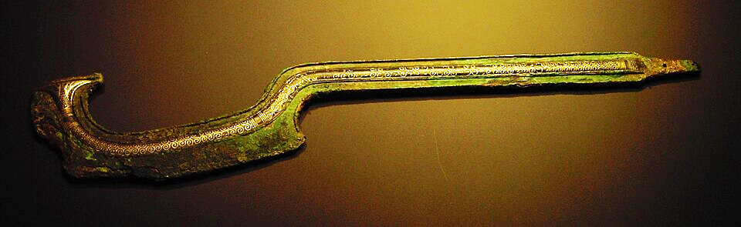
3.
Notes:
"Khopesh" by Dbachmann is licensed under CC BY-SA 3.0.

Slide 12
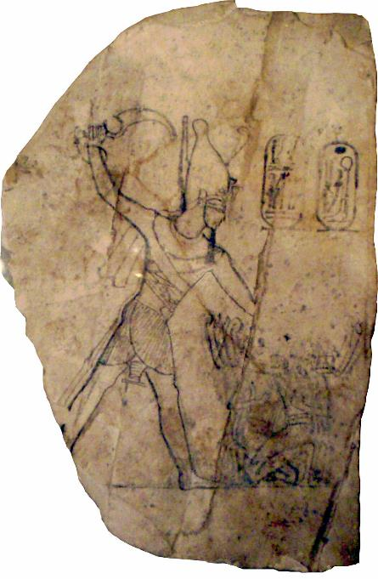
3. It’s a khopesh (sword)!
Notes:
By RamessesIV-SmitingHisEnemiesOnAnOstracon_MuseumOfFineArtsBoston.png: Keith Schengili-Robertsderivative work: JMCC1 (talk) - RamessesIV-SmitingHisEnemiesOnAnOstracon_MuseumOfFineArtsBoston.png, CC BY-SA 2.5, https://commons.wikimedia.org/w/index.php?curid=16174119

Slide 13
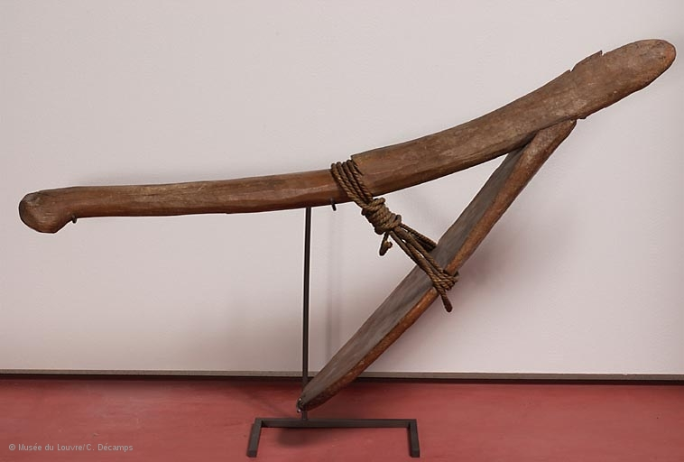
4.

Slide 14
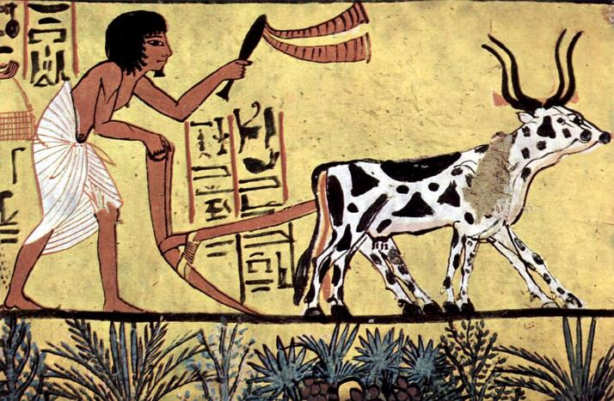
4. It’s a hoe (farming tool)!
Notes:
Deutsch: Maler der Grabkammer des SennudemEnglish: Painter of the burial chamber of Sennedjemالعربية: رسام حجرة دفن سننجم, Public domain, via Wikimedia Commons

Slide 15
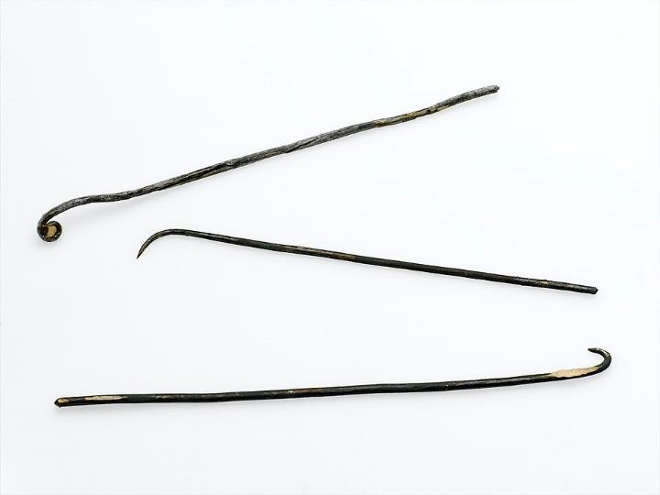
5.
Notes:
See page for author, CC BY 4.0 <https://creativecommons.org/licenses/by/4.0>, via Wikimedia Commons

Slide 16
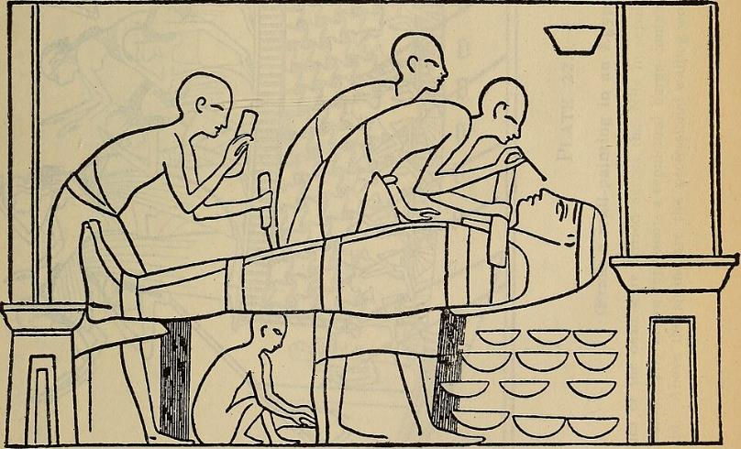
5. They are brain hooks, to remove the brain through the nose.
Notes:
Internet Archive Book Images, No restrictions, via Wikimedia Commons

Slide 17
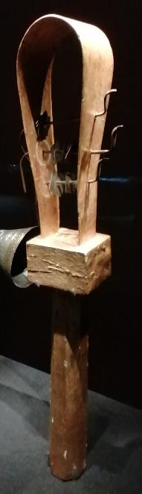
6.
Notes:
Photograph my S.Carnall

Slide 18
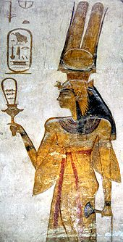
6. It’s a sistrum (musical instrument)!
Notes:
Abu_Simbel_Nefartari_Sistrum.jpg: Laban66derivative work: Oltau, Public domain, via Wikimedia Commons

Slide 19
Thanks everyone!

