Slide 1

Black History Month
Walter Tull
Vocabulary
soldier slave British Empire officer
Footballer carpenter telegram memorial

Slide 2
When was Walter Tull alive?
Today
Walter Tull
1888-1918
AD 1860
AD 1880
AD 1900
AD 1920
AD 1940
AD 1960
AD 1980
AD 2000
AD 2020
= 10 years

Slide 3
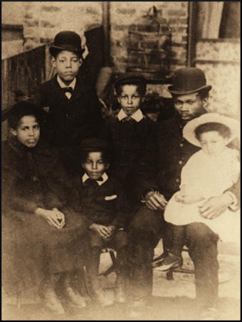
His Family
Dad
Walter Tull was born on 28th April 1888.
He was born in Folkestone, on the south coast of England.
His father was called Daniel and his mother was called Alice.
He had 5 brothers and sisters: Bertha, William, Cecillia, Edward and Elsie.
Walter
© Finlayson Family Archive

Slide 4
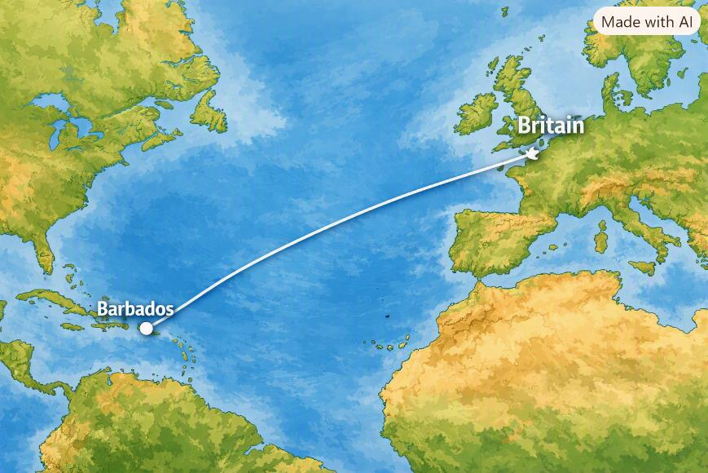
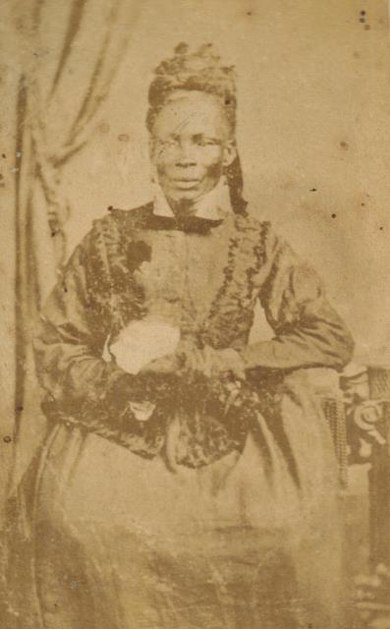
Where did Walter’s Dad come from?
Daniel Tull, Walter's dad, came from Barbados.
Walter's grandmother had been born a slave on Barbados.
Daniel moved to Britain in 1876 to look for work.
© Finlayson Family Archive

Slide 5
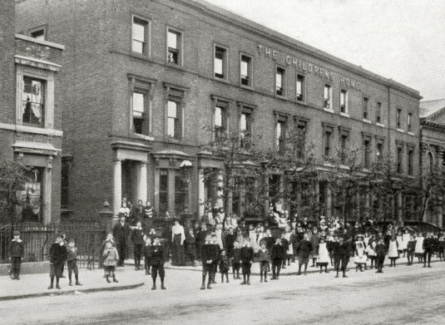
Early life for Walter
When Walter was 5 years old his mother, Alice ,died.
Two years later his father, Daniel, died too.
Walter and his brother Edward were sent to live in a children's home in London.
Bonner Road Children’s Home © Peter Higginbotham

Slide 6
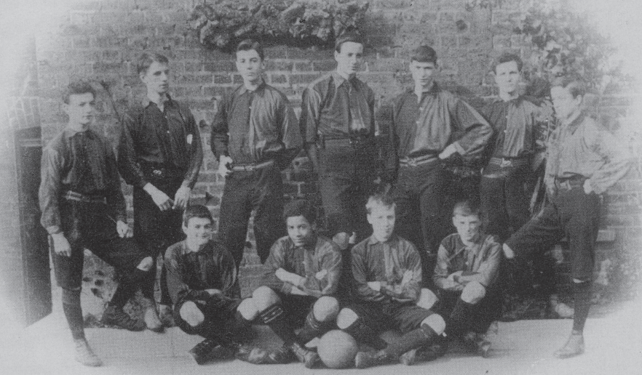
Walter and Football
The Bonner Road Children's Home Football Team
Walter liked to play football.
He played for the football team at the children's home.
He was so good he got asked to play for the local team, Clapton.
Can you spot Walter in the photo?

Slide 7
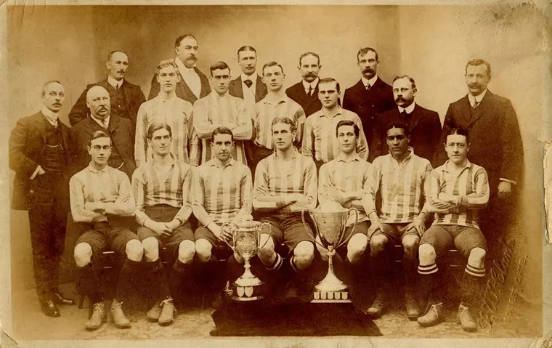

Walter played many games for Clapton and helped them win the FA Amateur Challenge Cup in 1908.
During the game, they won 6-0, with Walter scoring some of those goals.

Slide 8

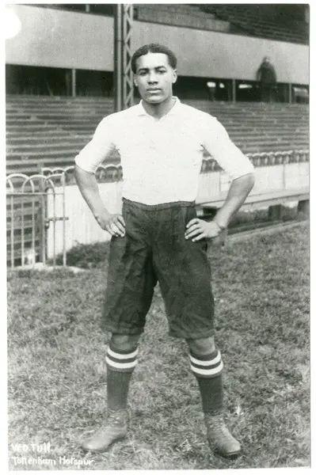
In 1909, Walter joined Tottenham Hotspur FC.
Walter was the first Black footballer to play for Tottenham Hotspur and only the third black man to play professional football in Britain.

Slide 9
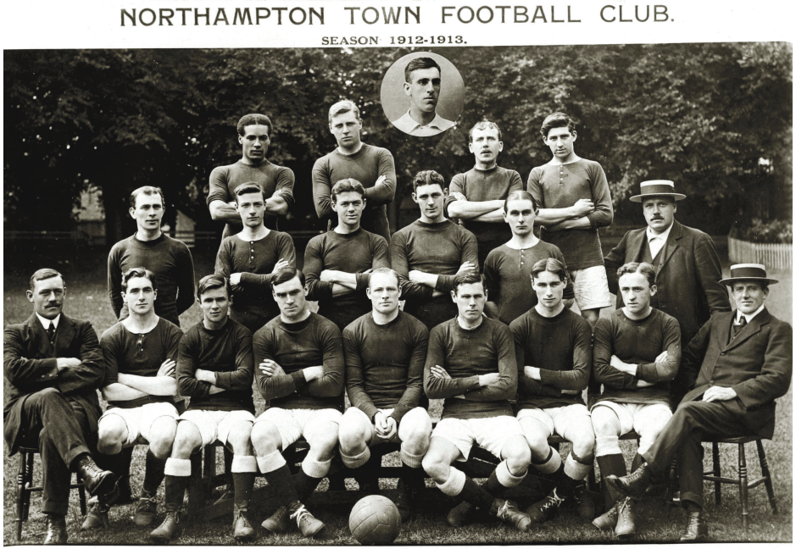

Sadly, Walter had to deal with people calling him horrible names, just because he was Black. In the end, he had to move to a different football club, Northampton Town FC. After playing 110 games with Northampton, he decided to move to Rangers in Glasgow in 1914. But war broke out.

Slide 10
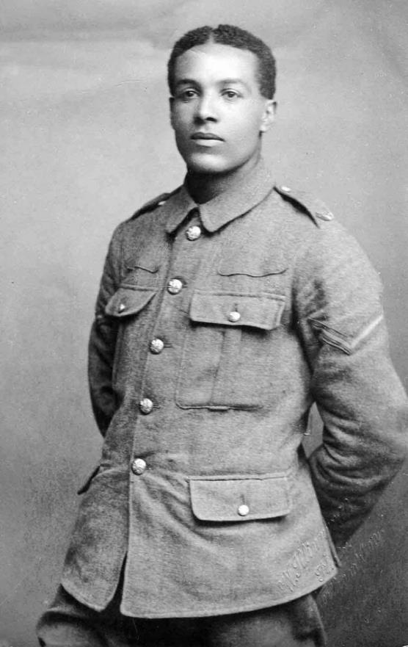
Walter the Soldier
In 1914, war broke out and Walter decides to join the army.
He joined the 17th Battalion of the Middlesex Regiment. This was also known as the Footballer's Battalion as all the soldiers were footballers.
© Northampton Town FC

Slide 11
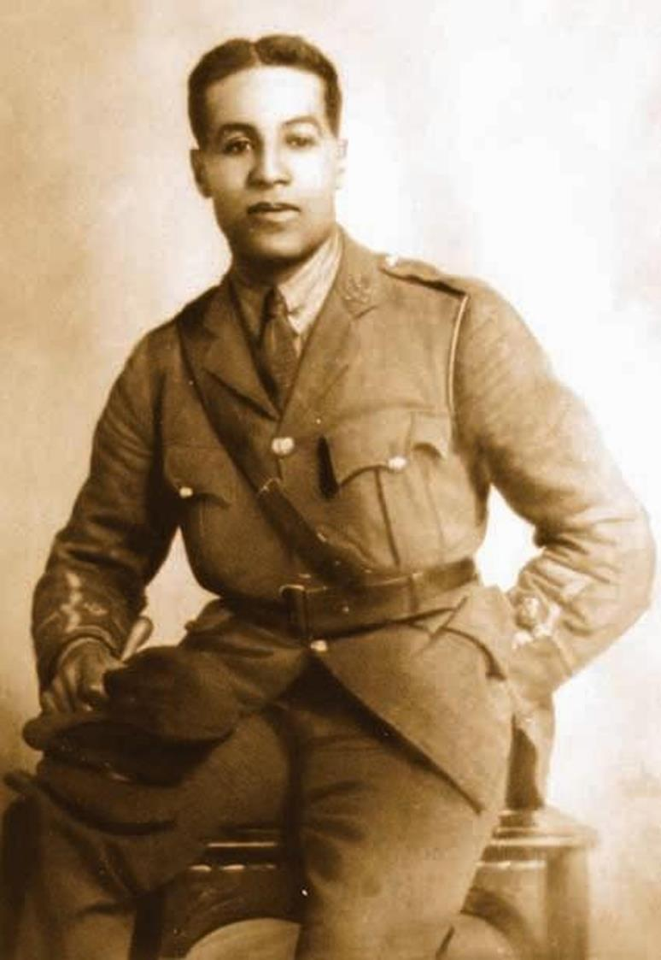
He was such a good soldier he promoted to Lance Corporal in 1915.
In 1916, Walter and the rest of the regiment take part in the Battle of the Somme in France.
This was a terrible battle and many lives were lost. Only 79 of the 400 men in Walter's regiment survived.

Slide 12
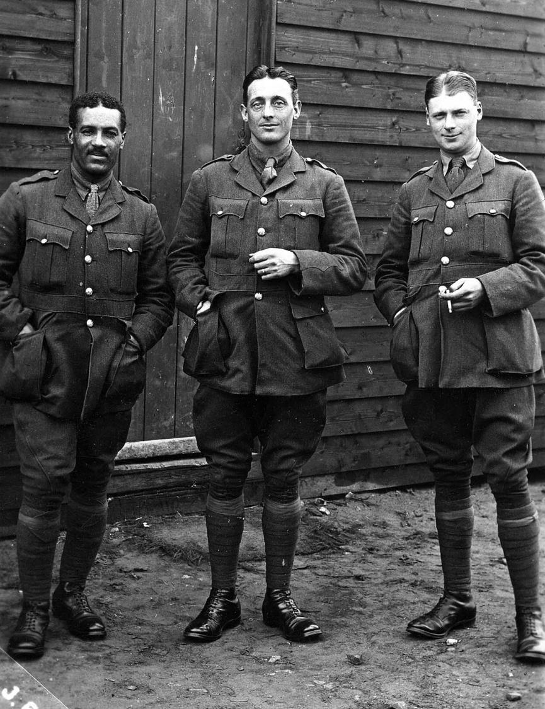
Walter was a good soldier and soon became an officer.
An officer in the army is a person who leads other men into battle.
He was the first Black officer to lead white soldiers in the British Army.
© Finlayson Family Archive

Slide 13
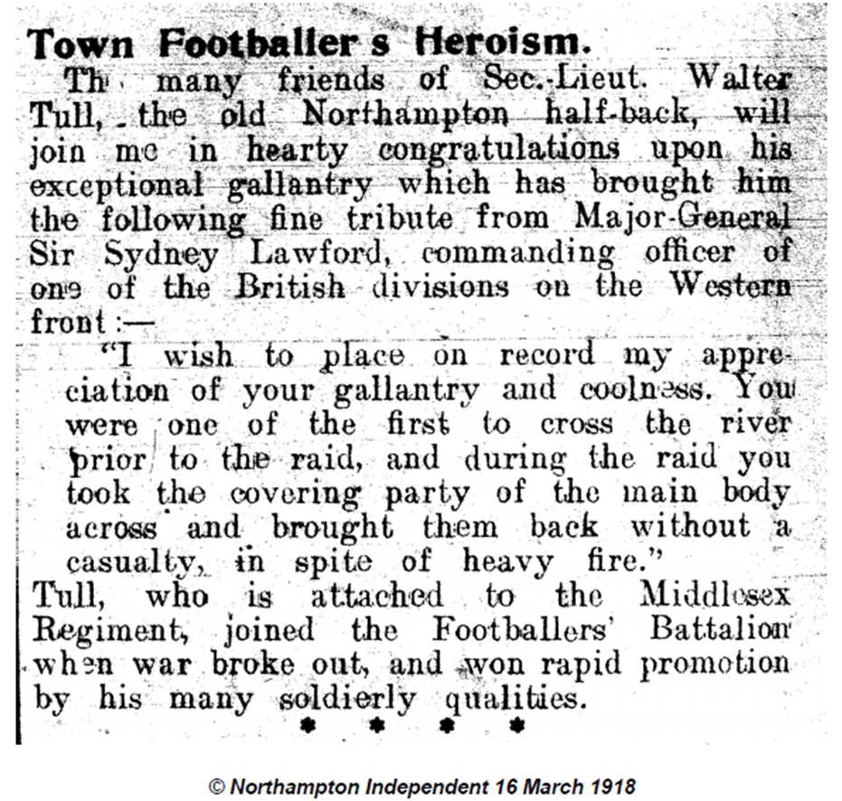
Walter was in the newspaper for his 'gallantry and coolness' while in battle.

Slide 14
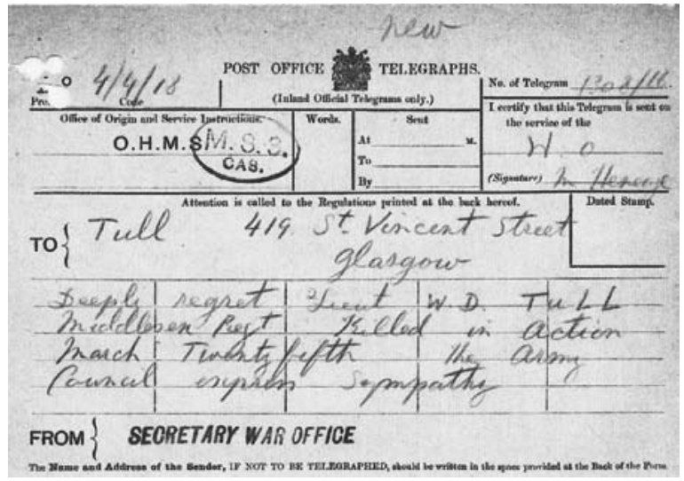
On 25th March 1918, Walter was leading his men into battle, when he was shot and killed. He was 29 years old.
A telegram was sent to his brother Edward, informing him of his death.
It reads: 'Deeply regret Lieut. W.D. Tull Middlesex Regt Killed in action March Twenty fifth. The army council express sympathy.'

Slide 15
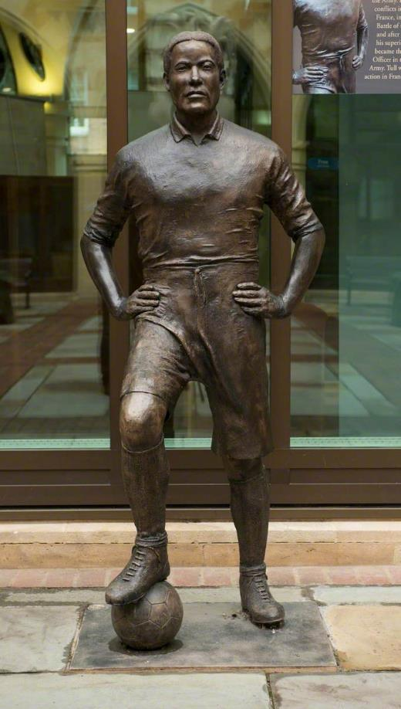

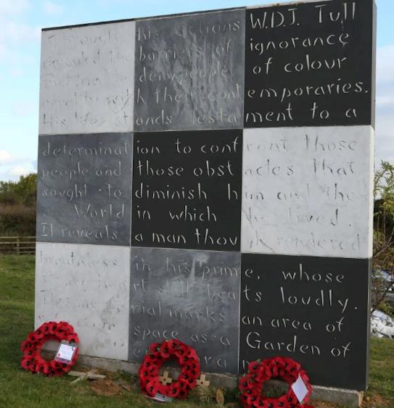
How Walter is Remembered
His name is carved on a memorial close to where he died in France.
A full-sized sculpture of Walter is now on display outside Northampton Guildhall.
A memorial wall has been built outside of Sixfields Stadium, Northampton FC.
© Richard Austin & West Northamptonshire Council

Slide 16
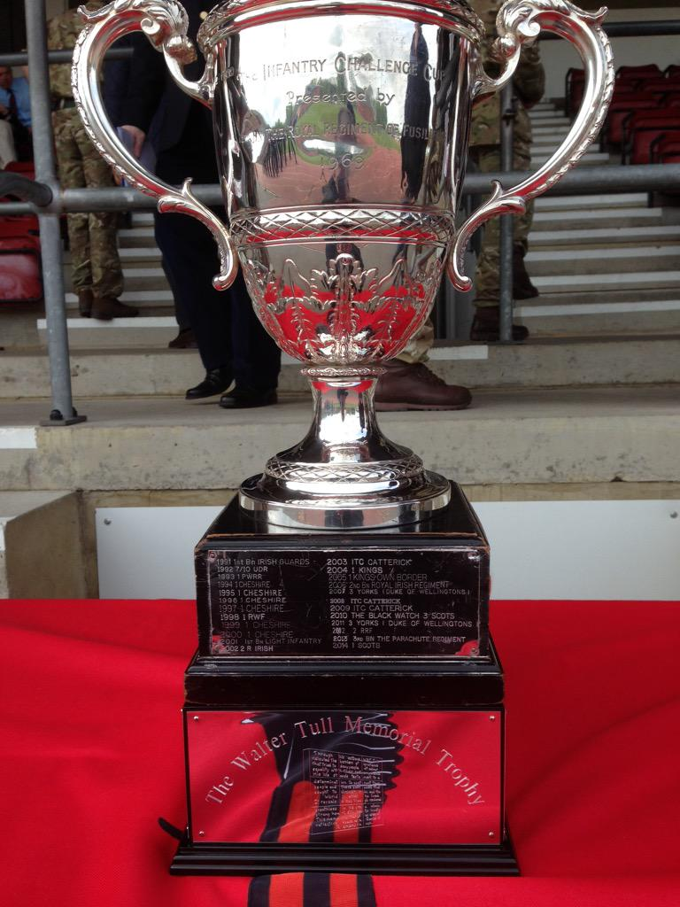
The Walter Tull Memorial Cup is a football trophy that is played between Tottenham Hotspur and Rangers.
These are both teams that Walter played for.
It was last played in July 2022. Tottenham won 2:1.

Slide 17
Why should we remember him?
Walter Tull was one of the first Black footballers in English Football.
He was he first Black officer in the British Army.
He died to help protect the country.
His commanding officer Major Poole said he should have been awarded the Military Cross (Army medal), but he was never given one. They can be given to someone who has died.
Do you think he deserves the medal?

Slide 18
Suggested Activities
Create a timeline of Walter’s life.
Design a medal for Walter.
Compare football kit from Walter’s time to today.

