Slide 1

Alien
Archaeology
The Stone Age

Slide 2

Hello! I’m Bob!
I’m an alien from a different planet!
I’ve come to see what it is like on Earth.
You have such strange objects that we don’t have on my planet. And I have no idea what you do with them!

Slide 3

I mean, what is THIS?
What is it?
Where does it live?
How do you use it?
Who uses it?
Notes:
This Photo by Unknown Author is licensed under CC BY-NC

Slide 4
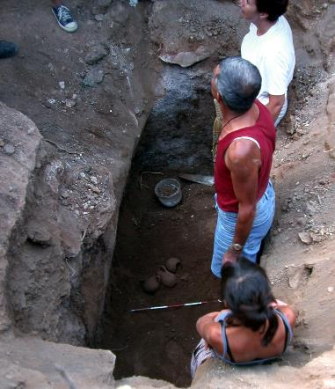
What do Archaeologists do?
Archaeologists dig up the remains of the past.
Sometimes, they don’t know what they have found.
Just like an alien looking at our objects, they have to figure out what it was used for.
"Archaeologists studying Carian tomb in Milas Becin" by Ms. Yasemin Polat is licensed under CC BY-SA 3.0.

Slide 5
The Stone Age
The Stone Age started about 250,000BC until about 2200BC.
Many of the things they used every day, do not exist today.
Sometimes it can be difficult for archaeologists to work out what they are.

Slide 6

Bob’s Challenge
Bob has found some objects from the Stone Age.
He has asked you to draw or write what you think they might be or how they are used.

Slide 7
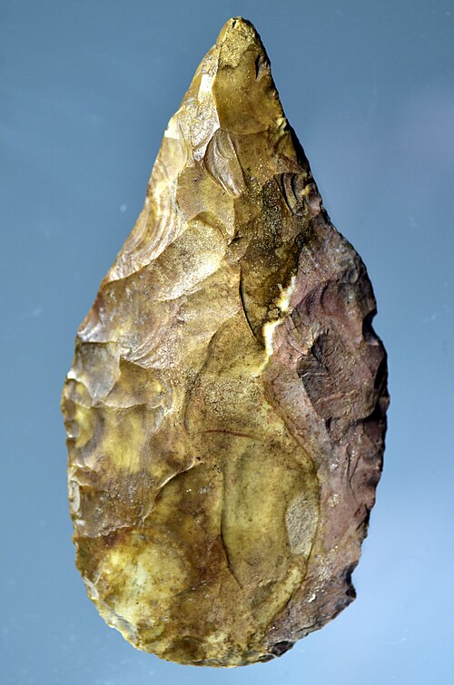
1.
Notes:
Osama Shukir Muhammed Amin FRCP(Glasg), CC BY-SA 4.0 <https://creativecommons.org/licenses/by-sa/4.0>, via Wikimedia Commons

Slide 8
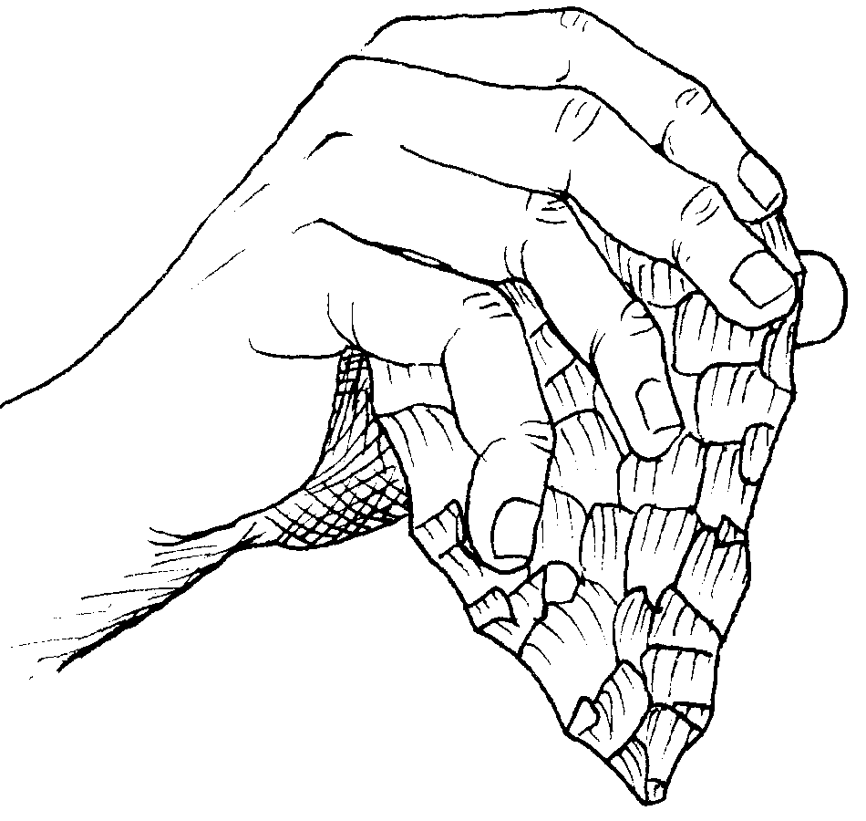
1. It’s a stone hand axe!
Notes:
José-Manuel Benito Álvarez (España) —> Locutus Borg, Public domain, via Wikimedia Commons

Slide 9
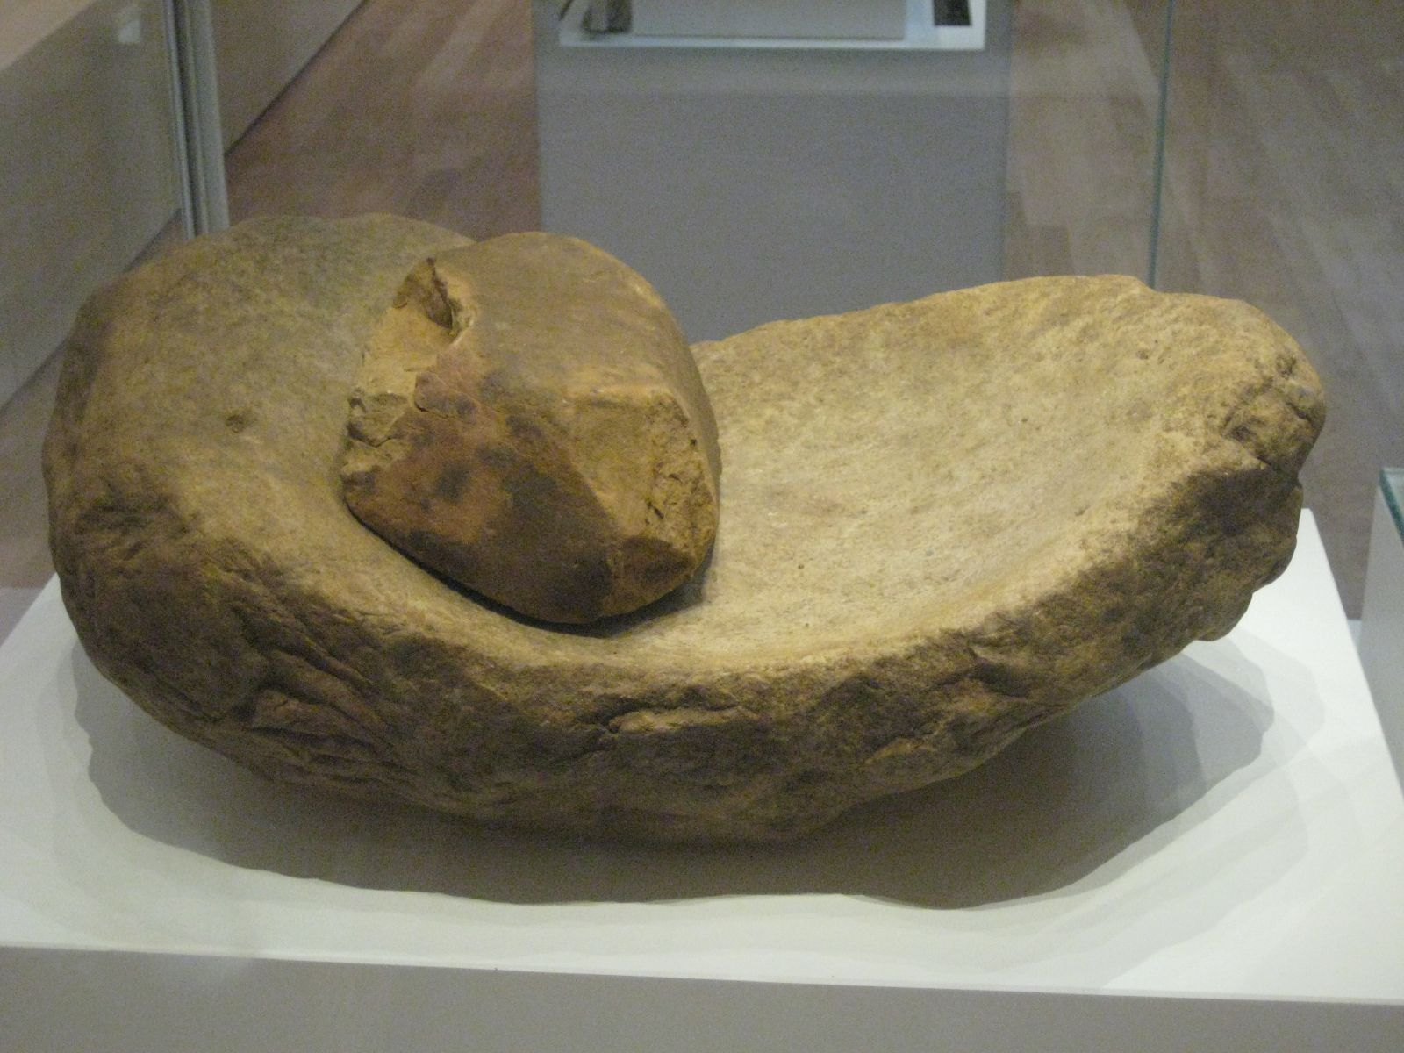
2.
Notes:
"Saddle Quern and Rubbing Stone" by Claire H. is licensed under CC BY-SA 2.0.

Slide 10
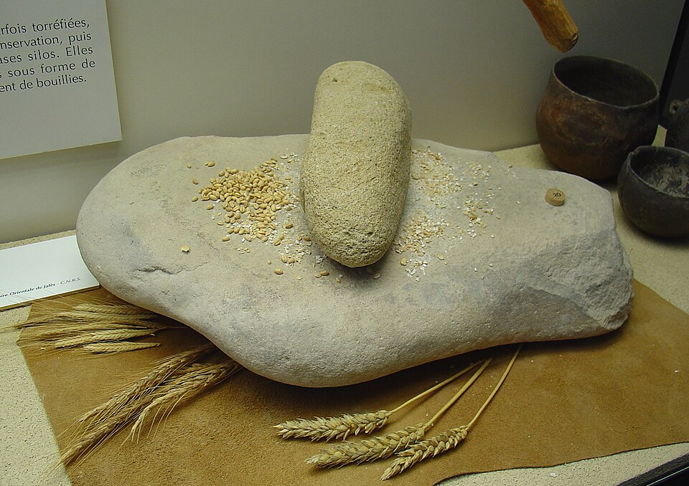
2. It’s a quern (for making flour)!
Notes:
Yelkrokoyade, CC BY-SA 3.0 <https://creativecommons.org/licenses/by-sa/3.0>, via Wikimedia Commons

Slide 11
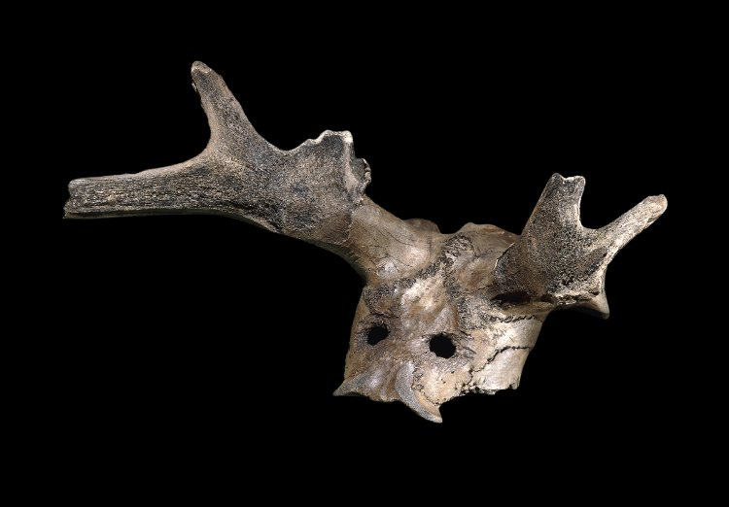
3.
Notes:
© The Trustees of the British Museum. Shared under a Creative Commons Attribution-NonCommercial-ShareAlike 4.0 International (CC BY-NC-SA 4.0) licence.

Slide 12
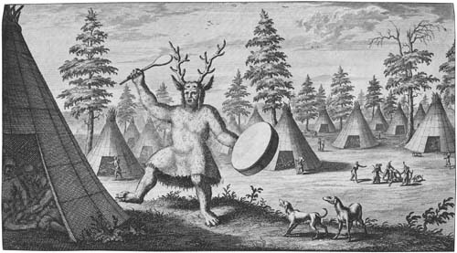
3. It’s a skull headdress (but not sure of the purpose).

Slide 13
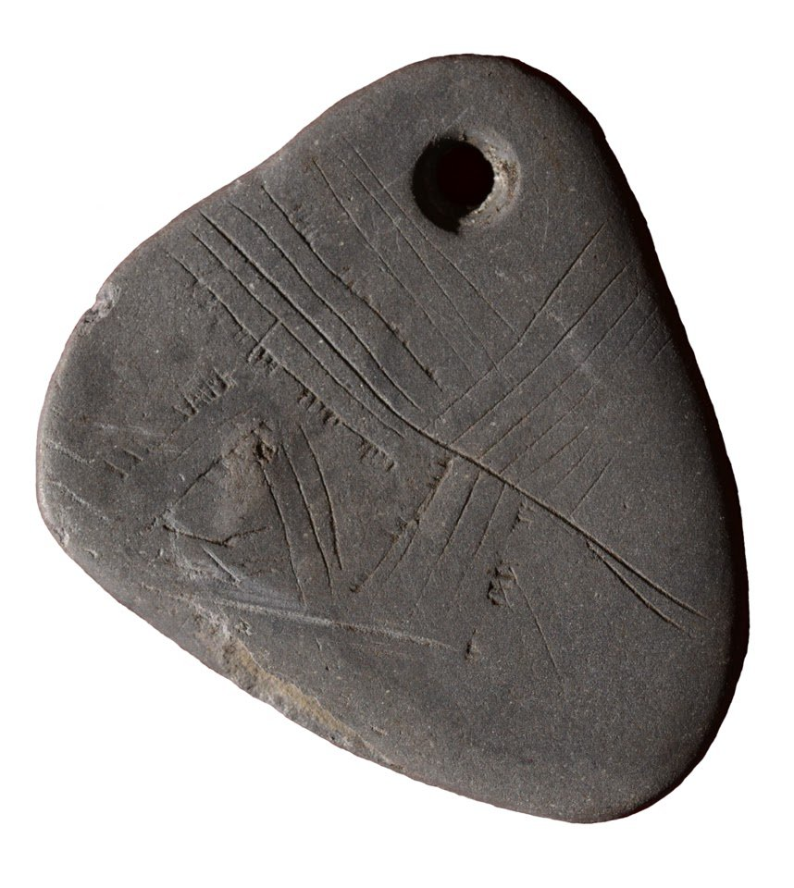
4.
Notes:
The Portable Antiquities Scheme/ The Trustees of the British Museum, CC BY-SA 4.0 <https://creativecommons.org/licenses/by-sa/4.0>, via Wikimedia Commons

Slide 14
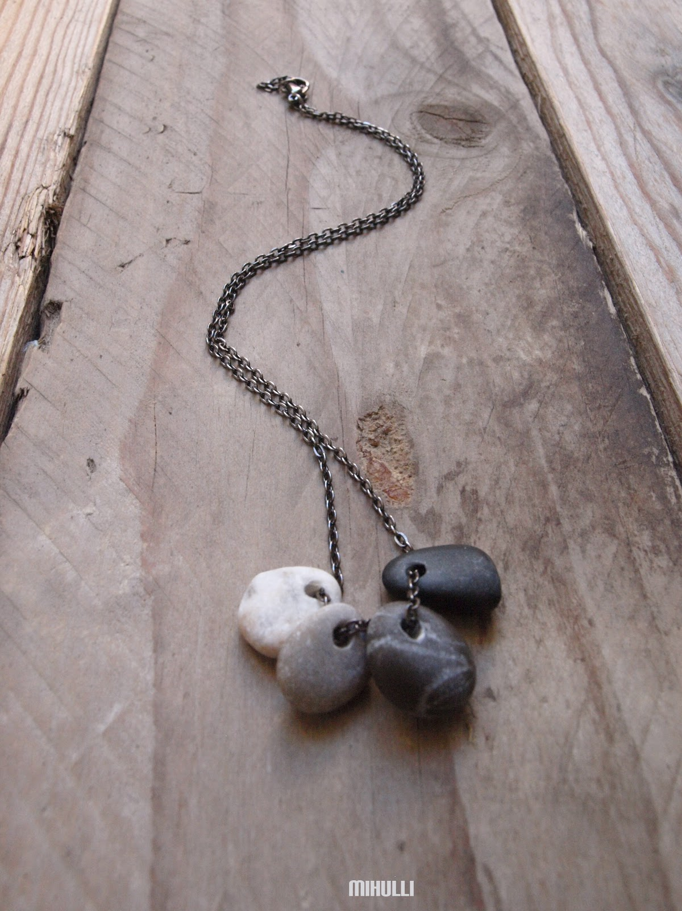
4. It’s a stone pendant (necklace).
Notes:
This Photo by Unknown Author is licensed under CC BY-NC-ND

Slide 15
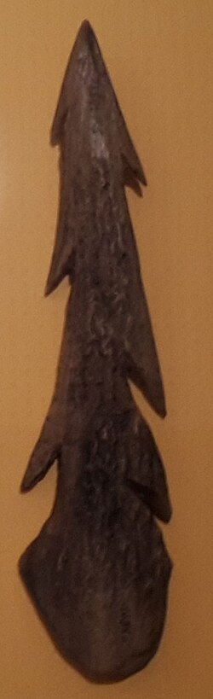
5.

Slide 16
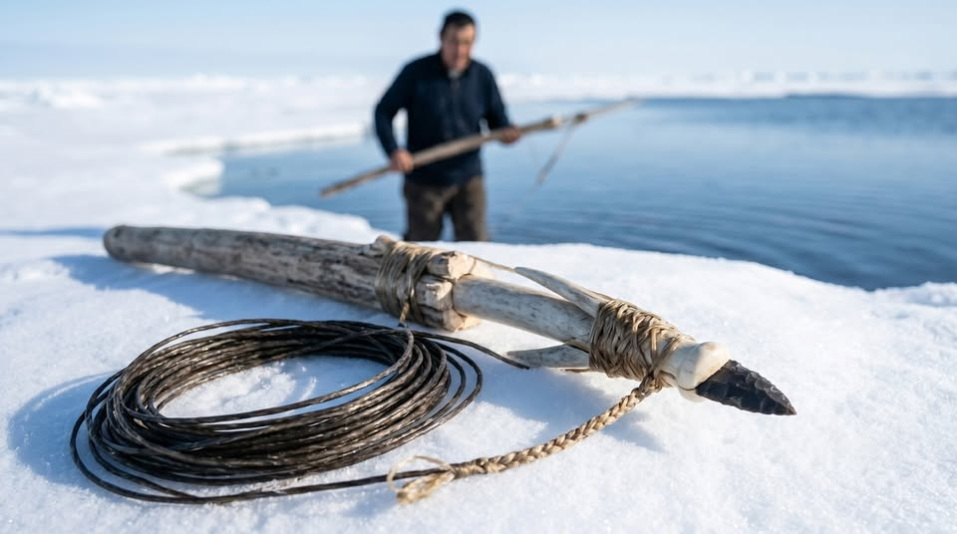
5. It’s an antler harpoon for fishing.

Slide 17
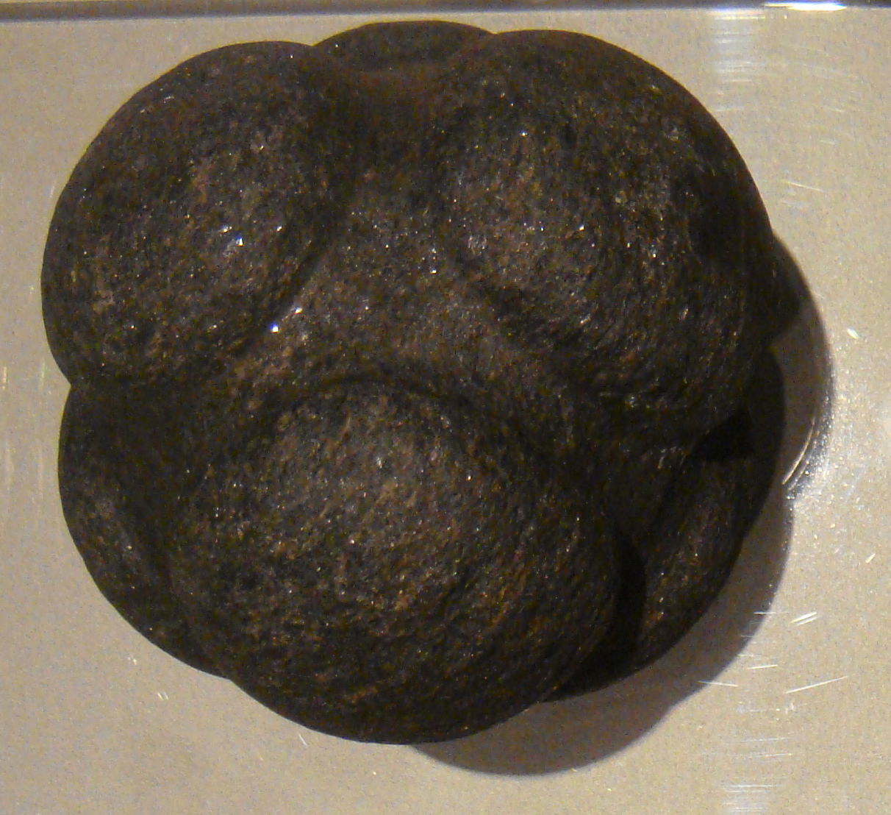
6.
Notes:
"Human Prehistory in the Kelvingrove carved stone ball Alford" by Nachosan is licensed under CC BY-SA 3.0.

Slide 18
6. Carved Stone Ball
Er…. We don’t know what this is for either!
It’s a mystery!

Slide 19
Thanks everyone!

