Slide 1

Black History Month
Mary Seacole
Vocabulary
Nurse soldier treatment
autobiography war cholera

Slide 2
When was Mary Seacole alive?
Today
Mary Seacole
1805-1881
AD 1800
AD 1820
AD 1840
AD 1860
AD 1880
AD 1900
AD 1920
AD 1940
AD 1960
AD 1980
AD 2000
AD 2020

Slide 3
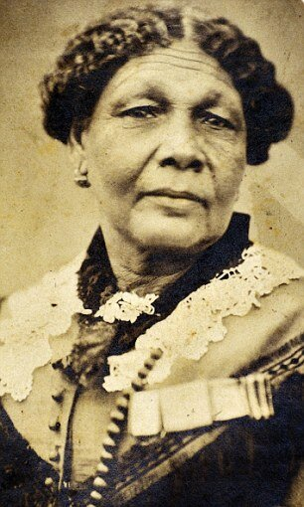
This is Mary Seacole.
She was a nurse.

Slide 4
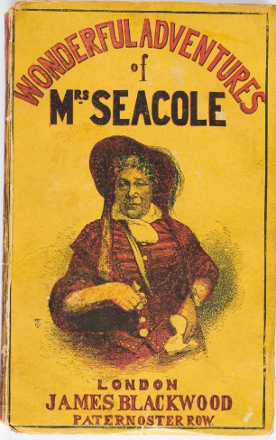
We know about Mary Seacole's life because she wrote a book about her life (autobiography).
© London Museum

Slide 5
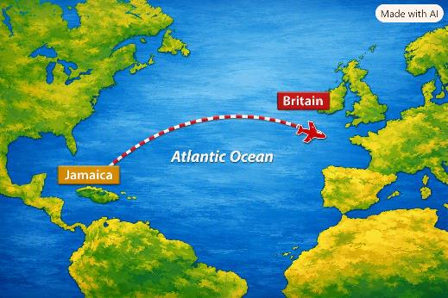
Mary was born in Jamaica in 1805.
Her father was called James Grant and was an officer in the British Army.
Her mother had been born in Jamaica. She ran a boarding house (like a hotel) and used to treat people who were ill.

Slide 6
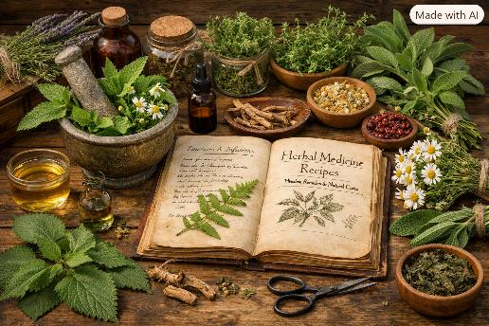
Growing up, Mary learnt a lot about helping sick and injured soldiers who came to stay in her mother's hotel. She even practiced medicine on her dolls.
Her mother was known as a 'doctress' and used herbs and plants to make medicines.
Today we would call Mary and her mother nurses.

Slide 7
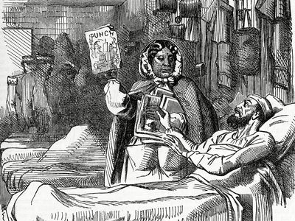
In 1850, Jamaica had an outbreak of a disease called cholera. It killed thousands of people. Mary used to treat people with cholera in the hotel.
Mary also got married to a man called Edwin Seacole. They were only married a few years before he became sick and died.
© Mary Seacole, cartoon in Punch magazine, May 30, 1857.

Slide 8
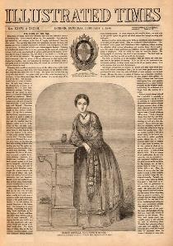
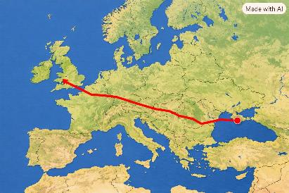
In 1853, the Crimean War broke out.
Mary read in the newspaper about the hospital in Scutari, Turkey where British nurses were based. They needed more nurses.
This was the hospital where Florence Nightingale was working. Although, Mary was told that Florence Nightingale didn’t need her help.
Mary decided to go anyway and use her nursing skills to help anyone who needed help.

Slide 9
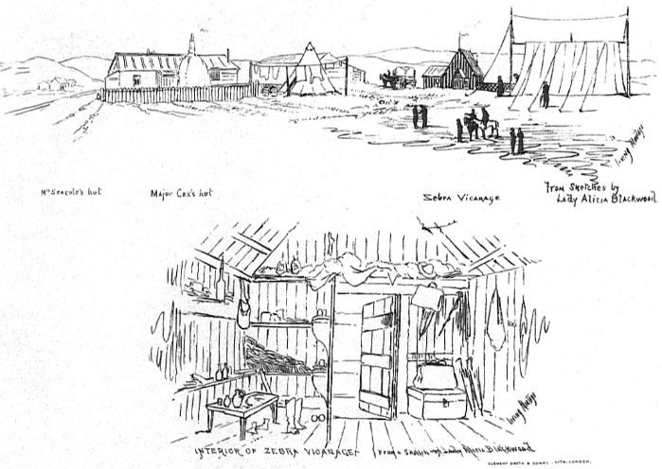
When Mary got to the Crimea, she decided to build her own hotel and hospital, just like her mother's. She called it the British Hotel.
Her hotel was only a few miles from the battlefield.

Slide 10
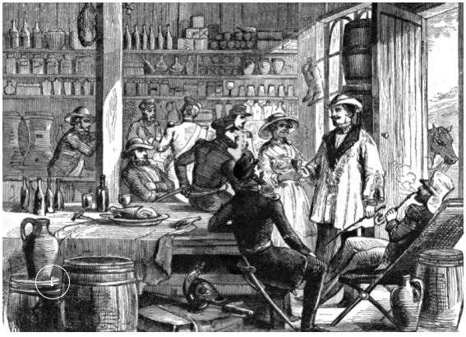
Mary created a place where soldiers could go if they were injured, cold and hungry and she would look after them.
The soldiers started calling her Mother Seacole.
artist Julian Portch for the Illustrated Times and published in September 1855 © Look and Learn

Slide 11
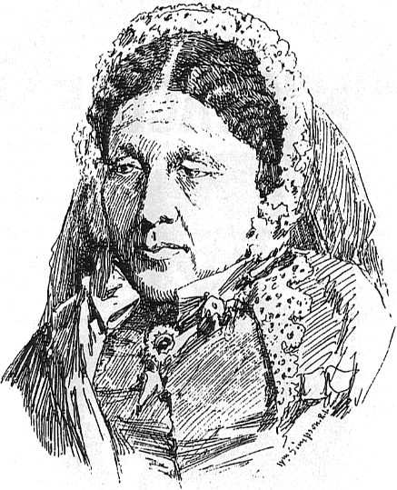
The war ended in 1856.
The soldiers all left. This meant that no-one needed the British Hotel any more.
Mary found herself losing all her money, and had just enough to get to London.

Slide 12
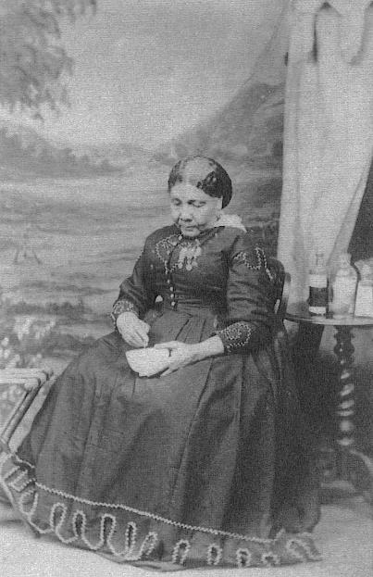
Mary was poor and struggling.
Those who she helped in the Crimea now wanted to help her.
They raise money for her and even held a festival in her honour.
Later she wrote her autobiography.

Slide 13
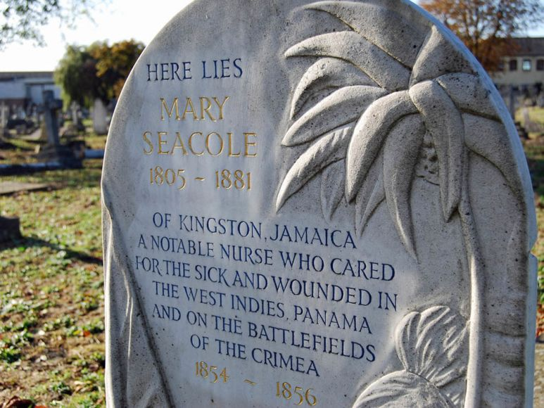
Mary Seacole died in 1881.
© The Mary Seacole Trust

Slide 14
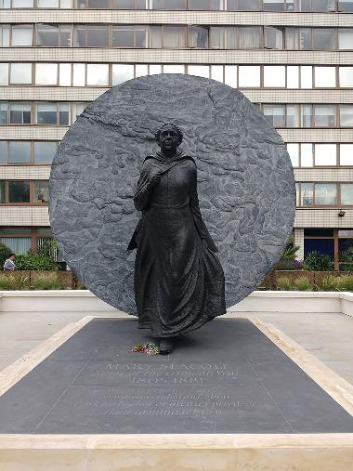
How do we remember Mary Seacole?
We remember Mary because she wanted to help people and she didn't let people stop her.
Mary did not think the colour of her skin made a difference to how she could help people.
Today, there is a statue of Mary outside a hospital in London.

Slide 15
Suggested Activities
Create a timeline of Mary’s life.
Compare Mary Seacole and Florence Nightingale.
Design a memorial for Mary.
Compare nursing in Mary’s time to today.

