Slide 1

Black History Month
The Windrush Generation
Vocabulary
migrant colonies discrimination scandal
empire racism deportation

Slide 2
When was the Windrush Generation?
Windrush Generation
1948-1970
Today
200 BC
100 BC
AD 1
AD 100
AD 200
AD 300
AD 400
AD 500
AD 600
AD 700
AD 800
AD 900
AD 1000
AD 1100
AD 1200
AD 1300
AD 1400
AD 1500
AD 1600
AD 1700
AD 1800
AD 1900
AD 2000

Slide 3
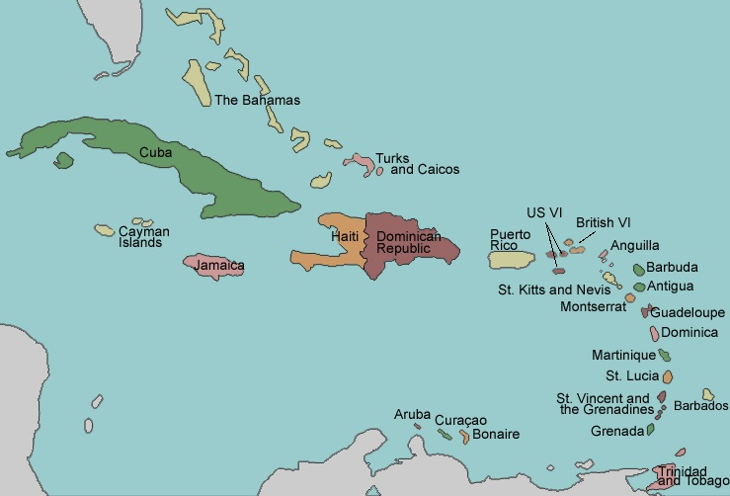
Background
The British Empire in the 1600s stretched across the globe and included the islands in the Caribbean. These were called the West Indies.
Anguilla,
the Cayman Islands,
Turks and Caicos Islands,
Montserrat,
the British Virgin Islands,
Antigua and Barbuda,
The Bahamas,
Barbados,
Dominica,
Grenada,
Jamaica,
Saint Kitts and Nevis,
Saint Lucia,
Saint Vincent and the Grenadines,
Trinidad and Tobago.

Slide 4
What is an empire?
An empire is a large group of countries or lands ruled by a single supreme leader or government.
Watch this video to explain what an empire is.
https://www.youtube.com/watch?v=t0_WPxfF8K0
BBC Teach via YouTube

Slide 5
World War Two
When war broke out in 1939, Britain and its colonies went to war. This included men and women from the Caribbean islands. Approximately 16,000 Caribbean people volunteered and joined the British Armed Forces (mostly the RAF).

Slide 6
After the war
After the war ended, there was a shortage of workers in Britain to help rebuild the country. The British government decided to encourage people from other British colonies to migrate to the UK. The British Nationality Act was passed in 1948, which gave everyone who lived in the UK, or any of the British colonies around the world, the same rights to live and work in the UK.

Slide 7
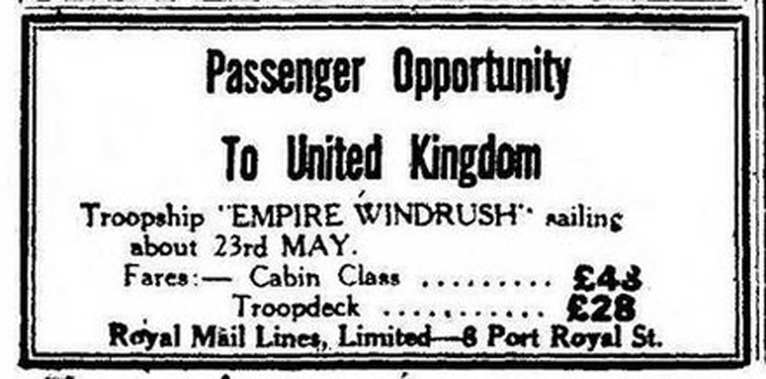
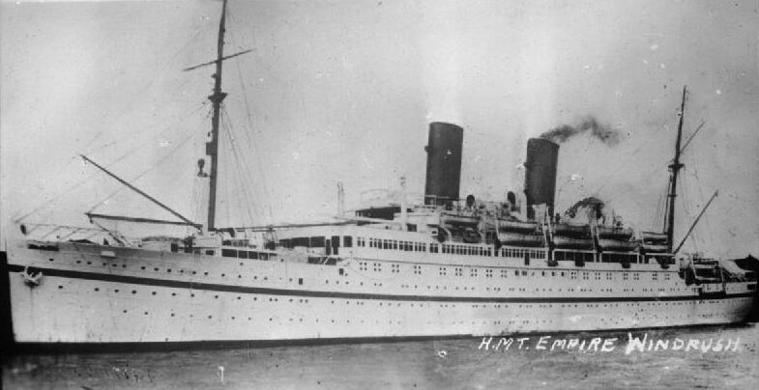
Why it is called the Windrush Generation?
An advert was placed in the newspapers in Jamaica, Trinidad and Tobago and other islands.
The first of these ships was the MV Empire Windrush which left Jamaica on 23rd May 1948. About 500 people were onboard, and coming to Britain for a better life.
© IWM

Slide 8
What was it like for those who came to Britain?
These migrants found that Britain was very different to where they had come from.
Watch this video about what people said about the move to Britain.
Please scroll down to find the right video.
https://www.bbc.co.uk/newsround/43793769

Slide 9
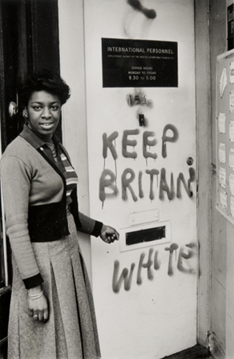
Sadly, they were faced with racism and discrimination. They were not allowed to do certain jobs, they were not allowed to live in certain places, nor were their children welcomed in their new classrooms.
In fact, it was NOT illegal to discriminate against someone because of their race.
© Neil Kenlock, ‘Keep Britain white’, 1972

Slide 10
Here are some interviews with different people who are part of the Windrush Generation about their experiences.

Slide 11
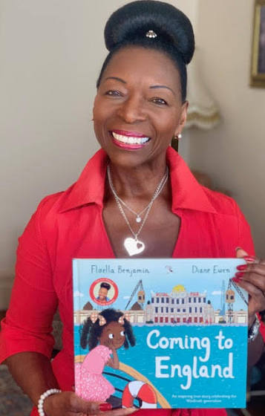
Floella Benjamin
Floella Benjamin is a TV presenter, actor, author and politician.
She was born in Trinidad and Tobago and moved to England in the 1960s.
She has written several books about her experiences growing up as a black girl in Britain.
In 2010, she was made a member of the House of Lords and is known as Baroness Benjamin of Beckenham.
https://www.bbc.co.uk/newsround/43793769
© Floella Benjamin

Slide 12
Eubert Crosby
Born in 1928 in Trenchtown, Jamaica, Eubert came to the UK when he was 19 years old.
What did you know about the UK beforehand?
‘Not a lot. Only that you could come here and get a job. You have to understand that all we wanted was just to get a job.’
Did you leave family behind in Jamaica?
‘I had a little boy before I left Jamaica but I sent for him and he came here. And I sent for my girlfriend and I married her.
Why did you decide to come to the UK?
‘People from Jamaica used to go to the United States to do farm work. But I couldn’t go because I failed the tests. Coming to England, I wasn’t gonna fail nothing. I raised the money and jumped on the boat to London. It’s the best thing I’ve ever done in my life. I’m glad I’ve never gone back – I’ve got ten acres of land in Jamaica, with bananas and grapefruit growing on there. But I’m living a very nice life here. People say Jamaica’s got sun and England’s cold, but you can’t live on sun.’

Slide 13
Alford Gardner
Listen to Alford Gardner talk about his journey on the Windrush and his life in Britain.
https://youtu.be/Pl50rpV9Tdw?si=39ZXnz11S3BXLTYx

Slide 14
Cinrel Tomlin
Born in 1926 in Jamaica, Cinrel came to the UK when he was 25 years old.
How did you hear about coming to the UK?
‘The opportunity was printed in the paper. They booked your passage and that’s how I ended up here.'
How many people were on the boat with you?
‘About 60 of us. We got on a ship from Jamaica to Southampton then a train to London. They said they had plenty of jobs. But they didn’t like you because of the colour of your skin. So they didn’t give you the job.’
How did that make you feel?
‘If a man don’t want you to exist because of the colour of your skin, it makes you feel very bad. I didn’t think of class or colour before I came here. Where I come from, we have nothing like that. But over here it’s different.'

Slide 15
2017 Scandal
In 2017, there was a scandal after it emerged that some of those who had come across on the Windrush (or similar ships) and their children were being deported back to the Caribbean.
This has caused outrage within the British-Caribbean community. The Prime Minister at the time, Theresa May, had to formally apologise to those who had been or were threatened with deportation.
https://www.youtube.com/watch?v=kfy1mDdNtEQ

Slide 16
Task:
Create your own advert to entice people to come to Britain.
You must include:
o Ship name: Empire Windrush
o Date: 23rd May 1948
o Fares: Cabin Class = £48, Troop deck = £28

Slide 17
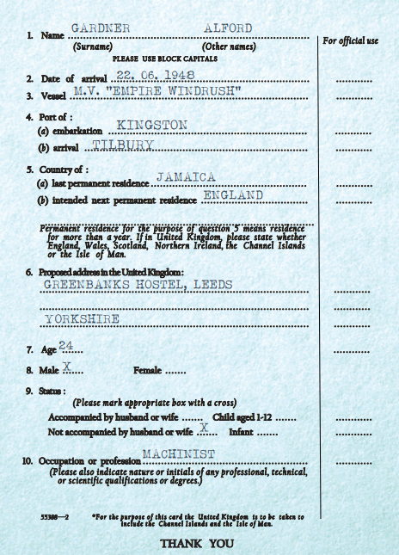
Task:
This is a passenger card from the Empire Windrush.
It shows details about each passenger on board the ship.
Answer these questions about your passenger:
1. What country were they from?
2. How old were they?
3. What job did they have?
4. Where in the UK did they live?
https://www.gold.ac.uk/windrush/passenger-list/

Slide 18
Task:
You are going to create a poster/leaflet/factfile/comic strip about the Windrush Generation. You can use any of the resources available.
You must include information about:
o The Empire Windrush ship
o The experiences of people in Britain
o The 2017 Scandal.

