Slide 1

Black History Month
The Bristol Bus Boycott
Vocabulary
Boycott Migration
Discrimination Racism

Slide 2
When was the Bristol Bus Boycott?
Bristol Bus Boycott
1963
Today
200 BC
100 BC
AD 1
AD 100
AD 200
AD 300
AD 400
AD 500
AD 600
AD 700
AD 800
AD 900
AD 1000
AD 1100
AD 1200
AD 1300
AD 1400
AD 1500
AD 1600
AD 1700
AD 1800
AD 1900
AD 2000

Slide 3
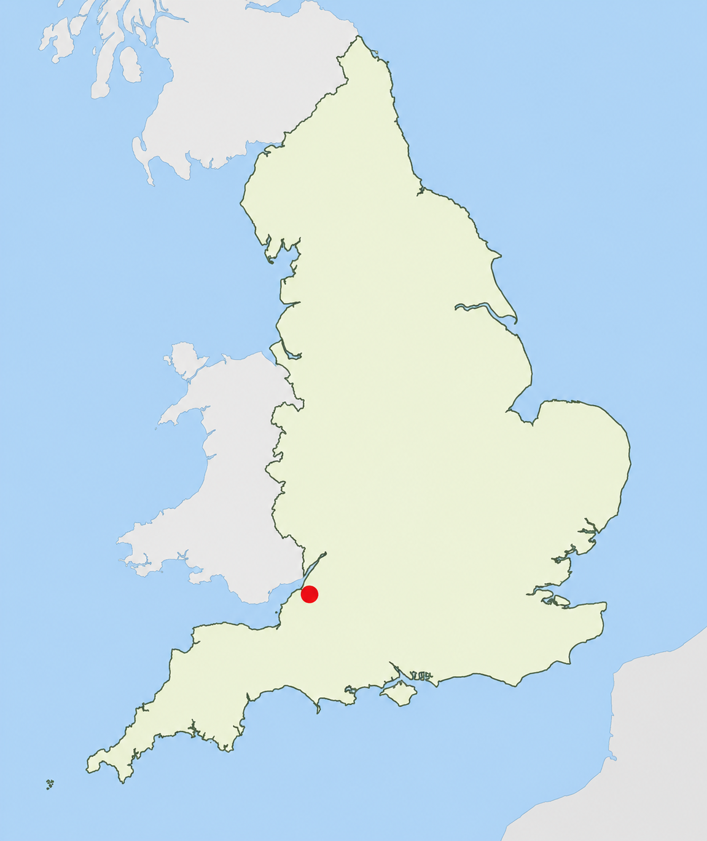
Background
Bristol is a city in England that has been a busy port for hundreds of year.
After the end of World War Two in 1945, many people migrated to the UK to help rebuild Britain. This included people from the West Indies (the Caribbean). This resulted in a large community of people from the West Indies settling in Bristol.
Bristol

Slide 4
The Windrush
People from all over the British Empire were invited to come to Britain to help rebuild it after the war. This invitation became part of law in 1948 with the British Nationality Act.
The first of these arrived on the ship MV Empire Windrush on 22nd June 1948. It brought people from Jamaica, Trinidad and Tobago and other islands.

Slide 5
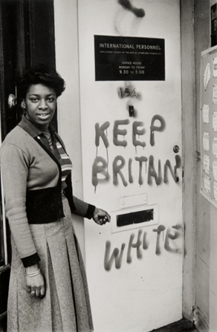
What was Britain like for those who came here?
In Britain at that time, it was not illegal to discriminate against someone because of the colour of their skin.
Bristol had a large West Indian community in 1960s. Many of them struggled to find housing, had low-paid jobs and were regularly on the receiving end of racism.
© Neil Kenlock, ‘Keep Britain white’, 1972

Slide 6
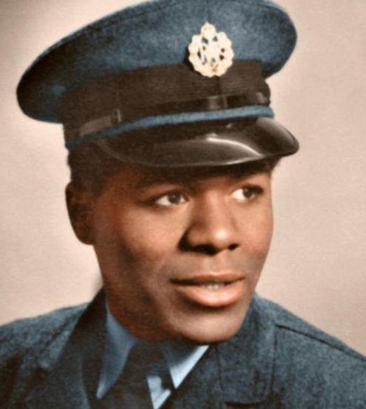
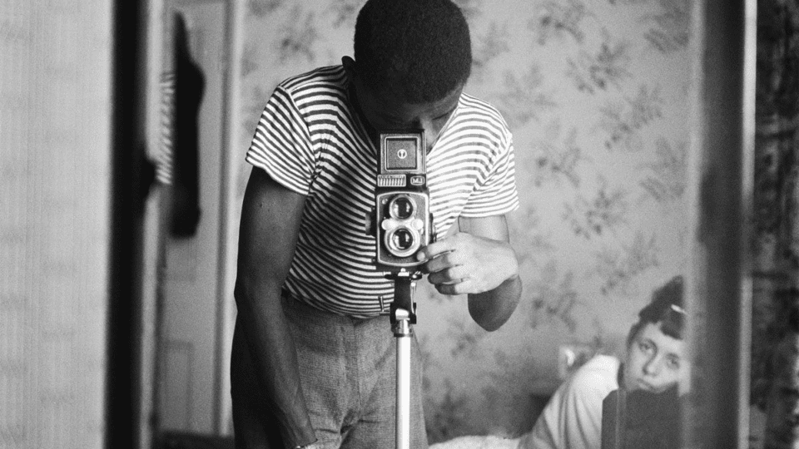
Many people suffered from discrimination.
"When I returned to London in 1947, I became aware of racial prejudice when I was called names because of my colour and had bricks and bottles thrown at me." Paul Stevenson
© Fumi Stephenson
“England changed me from a smiling little boy into the resilient person I am now. There were a lot of bullies. I had to defend myself everyday. I had to learn their ways of being. The things that made me different were the things I got rid of first.” Armet Francis
© Armet Francis
Hear Roy Hackett talk about his life in Bristol in the 1960s.
https://www.youtube.com/watch?v=KUjZkmxnWV8&t=35s

Slide 7
What happened in Bristol in 1963?
The situation came to a head when a man called Guy Bailey applied for a job as a bus conductor (the person who collects tickets) on the Bristol Omnibus Company in 1963.
He was asked to come for an interview, and when he arrived, he was told to leave as he won't be getting a job. The reason: he was black.

Slide 8
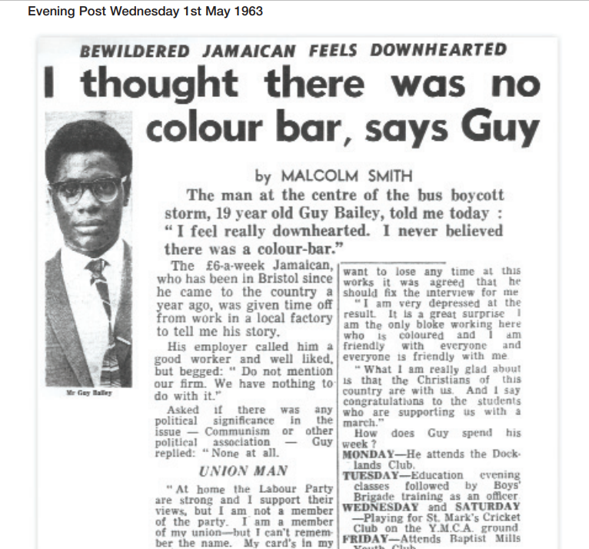

Slide 9
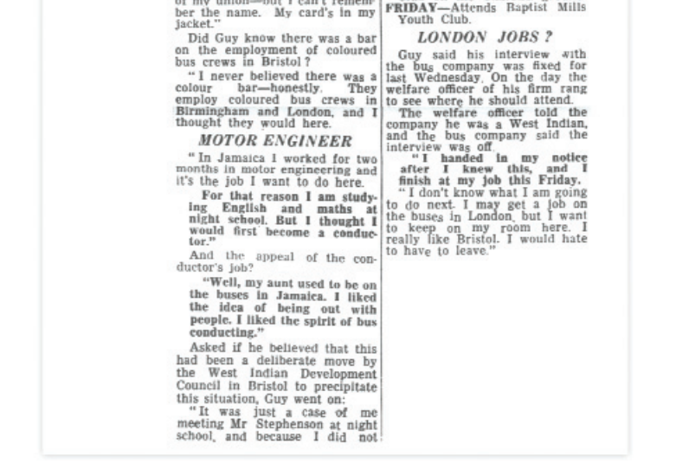

Slide 10
What was the Bristol Bus Boycott?
After this failed interview, Guy Bailey told people in the community about it and how he was refused because of his skin colour and nationality. This outraged people.
To protest against the way the bus company had treated Guy, they organised a boycott - where no-one would use the buses and would walk or bike instead. The boycott started on 29th April 1963.
https://www.bbc.co.uk/teach/class-clips-video/articles/z9k4g7h

Slide 11
What was the result?
After 121 days, the Bristol Omnibus Company changed their rules. On 28 August, Ian Patey (company manager) declared a change in policy at the Bristol Omnibus Company. There would now be “complete integration” on the buses, “without regard to race, colour or creed”.
The boycott had succeeded. The colour bar was gone.

Slide 12
What impact did this have on the rest of the UK?
It had wider ramifications for the people of Britain.
One of the supporters of the Boycott was the Labour Leader, Harold Wilson. At a rally in London in 1963, Wilson stated that he was, “glad that so many Bristolians are supporting the [boycott] campaign… we wish them every success”.
In 1964, he became Prime Minister of Britain and one of the reforms he made was to introduce the Race Relations Act (1965 & updated in 1968). This made it illegal to "refuse housing, employment, or public services to a person on the grounds of colour, race, ethnic or national origins."

Slide 13
Why is this important today?
Even today, there is still discrimination against Black, Asian and other ethnic groups in the UK.
In 2020, a world wide protest was started after a black man died when he was arrested in the US. This sparked the Black Lives Matter (BLM) campaign.
In Bristol, people took out their frustration on a statue of Edward Colston, a former slave owner from Bristol. He had donated money to the city in the 1690s to build schools and hospitals. However, he had earned the money through the buying and selling of slaves through the Trans-Atlantic Slave Trade.

Slide 14
Suggested Activities
Create protest banners/placards about the colour bar and the boycott.
Design a memorial plaque.
Write a letter to the bus company.
Have a class discussion.

