Slide 1

Alien
Archaeology
Ancient Greece

Slide 2
Hello! I’m Bob!
I’m an alien from a different planet!
I’ve come to see what it is like on Earth.
You have such strange objects that we don’t have on my planet. And I have no idea what you do with them!

Slide 3

I mean, what is THIS?
What is it?
Where does it live?
How do you use it?
Who uses it?

Slide 4
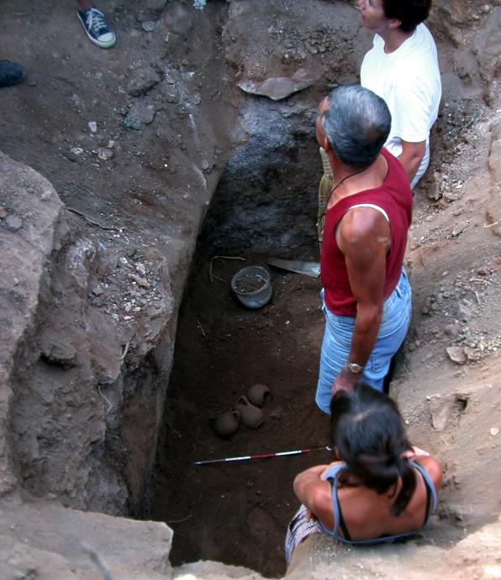
What do Archaeologists do?
Archaeologists dig up the remains of the past.
Sometimes, they don’t know what they have found.
Just like an alien looking at our objects, they have to figure out what it was used for.
"Archaeologists studying Carian tomb in Milas Becin" by Ms. Yasemin Polat is licensed under CC BY-SA 3.0.

Slide 5
The Ancient Greeks
The Ancient Greeks lived over 2000 years ago.
Many of the things they used every day, do not exist today.
Sometimes it can be difficult for archaeologists to work out what they are.

Slide 6

Bob’s Challenge
Bob has found some objects from ancient Greece.
He has asked you to draw or write what you think they might be or how they are used.

Slide 7
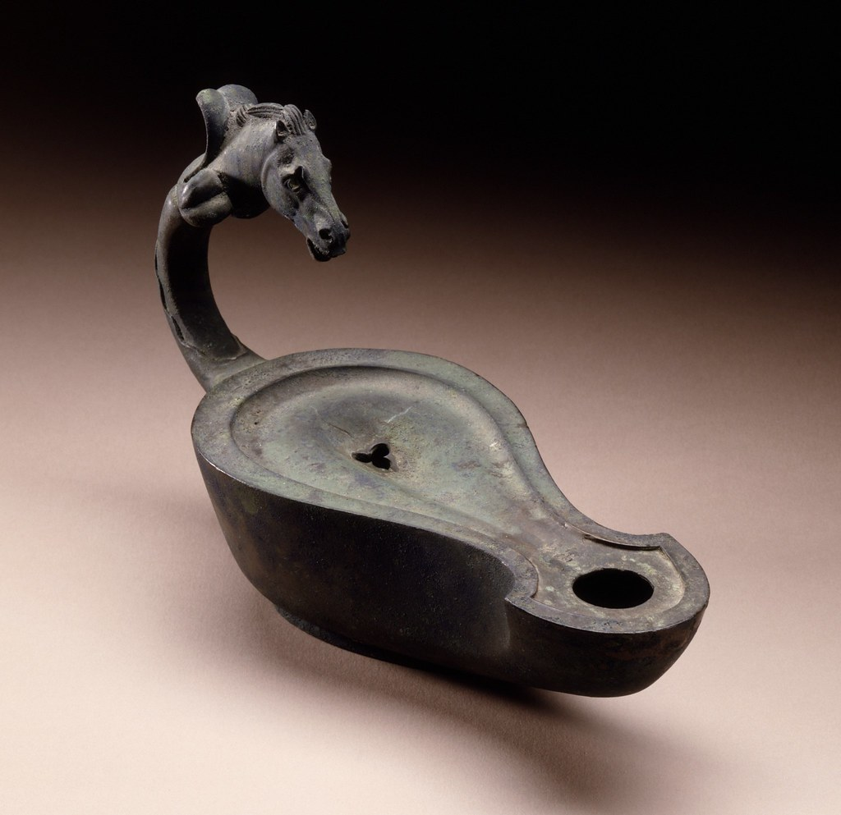
1.
Notes:
"Lamp with Handle in the Form of a Horse's Head LACMA AC1992.152.32" by Fæ is licensed under CC BY 2.0.

Slide 8
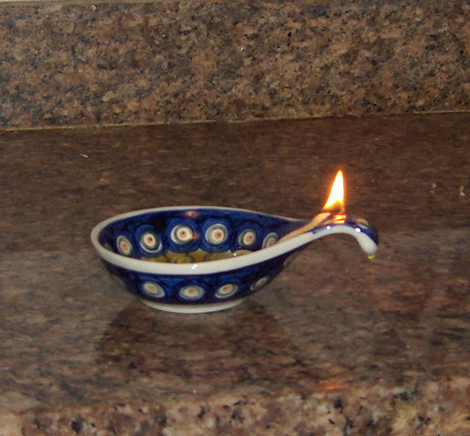
1. It’s an oil lamp!
Notes:
"burning oil lamp" by Joanna Bourne is licensed under CC BY 2.0.

Slide 9
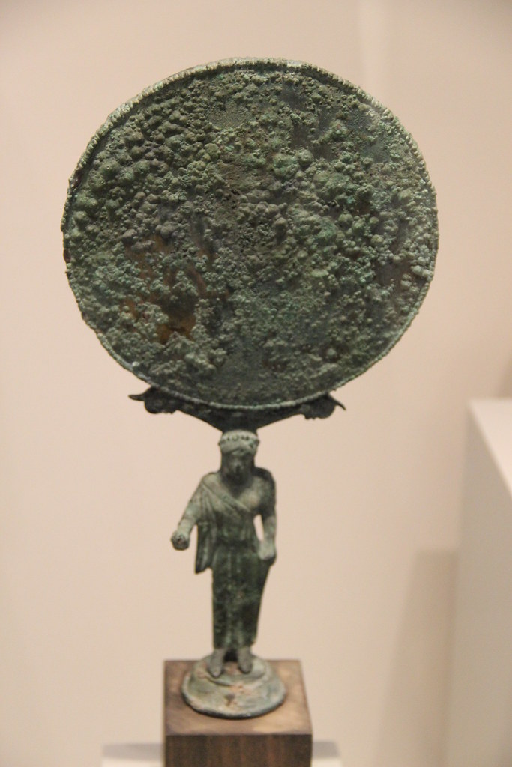
2.
Notes:
"Ancient Greece Bronze Mirror" by Gary Lee Todd, Ph.D. is marked with CC0 1.0.

Slide 10
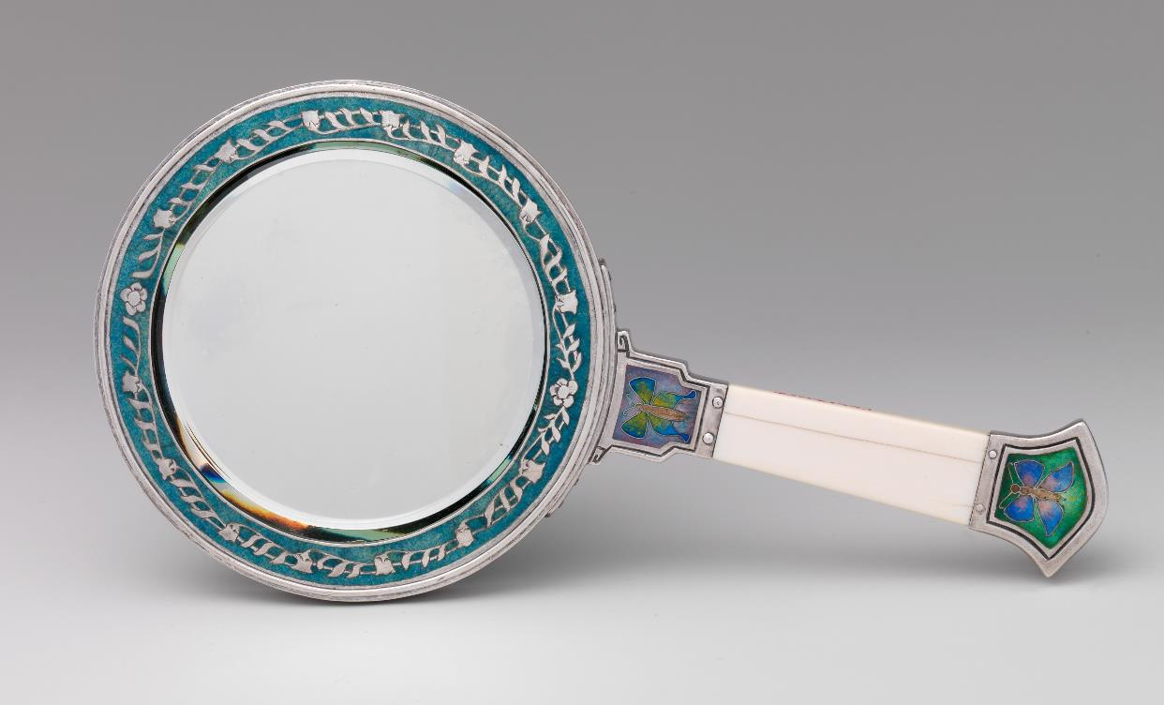
2. It’s a hand mirror!
Notes:
"<div class='fn'> Hand mirror</div>" by Creator:Eda Lord Dixon is marked with CC0 1.0.

Slide 11
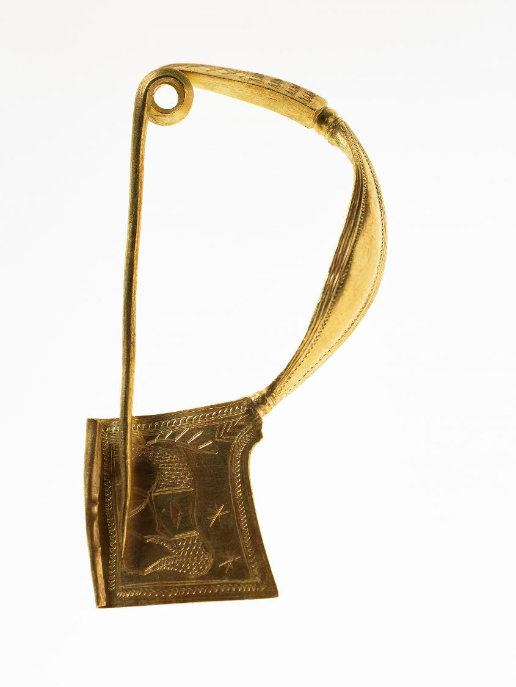
3.
Notes:
© The Trustees of the British Museum. Shared under a Creative Commons Attribution-NonCommercial-ShareAlike 4.0 International (CC BY-NC-SA 4.0) licence.

Slide 12
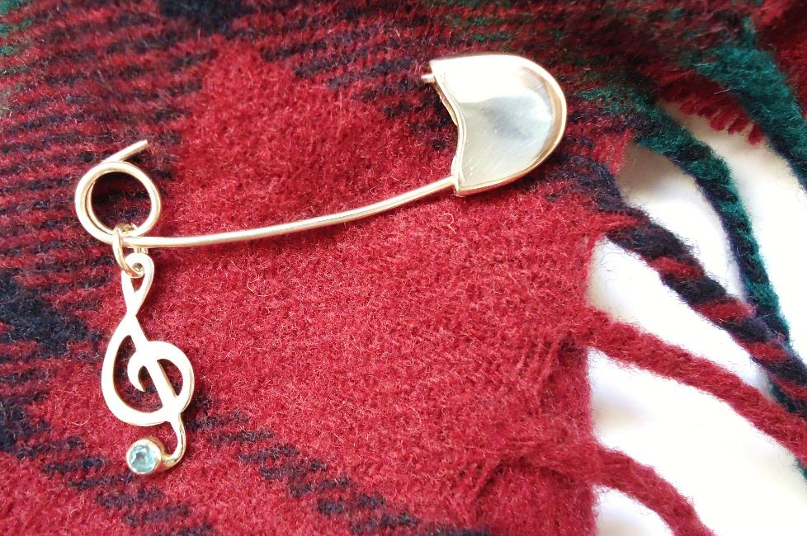
3. It’s a fibula (brooch – like a safety pin)

Slide 13
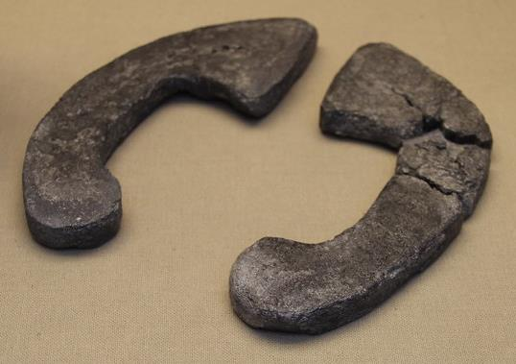
4.
Notes:
"Etruscan Lead Jumping Weights, c. 5th Century BC" by Gary Lee Todd, Ph.D. is marked with CC0 1.0.

Slide 14
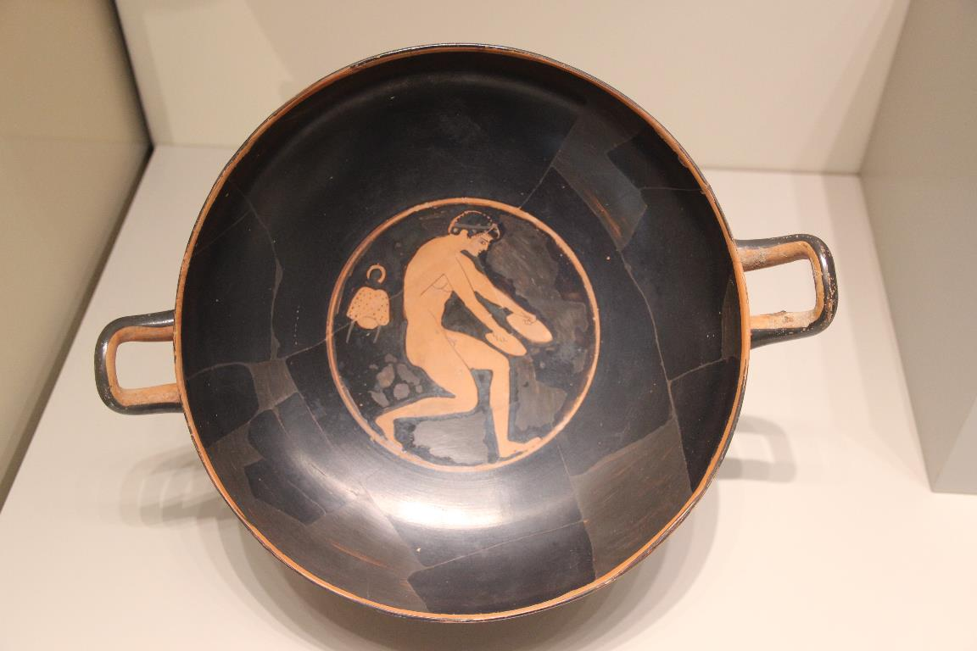
4. Jumping Weight
Notes:
"Attic Red-figure Ceramic Kylix Long jumper with jumping weights; painted by Berlin Painter, c. 510-500 BC; found in Tarquinia, Etruria (28454436650)" by Gary Todd from Xinzheng, China is marked with CC0 1.0.

Slide 15
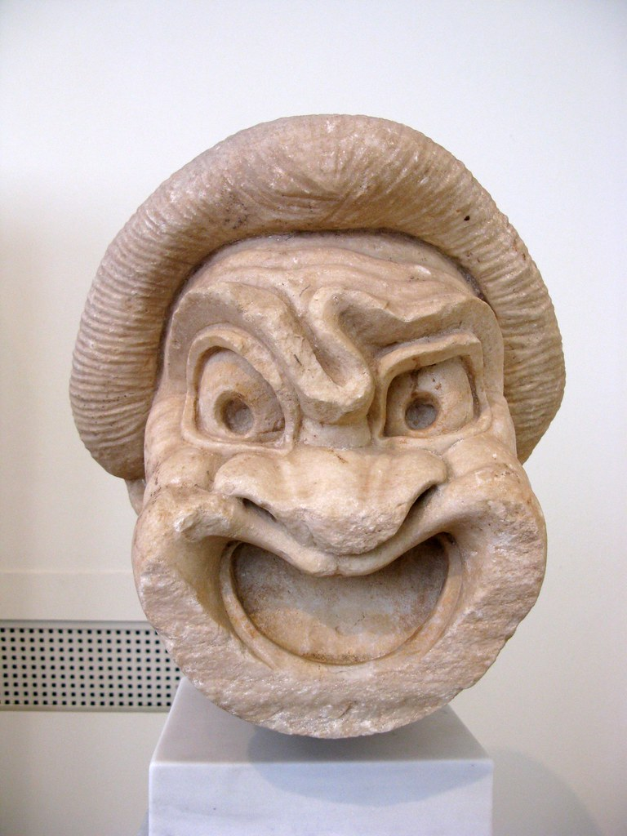
5.
Notes:
"Theatre mask. Pentelic marble." by Tilemahos Efthimiadis is licensed under CC BY 2.0.

Slide 16
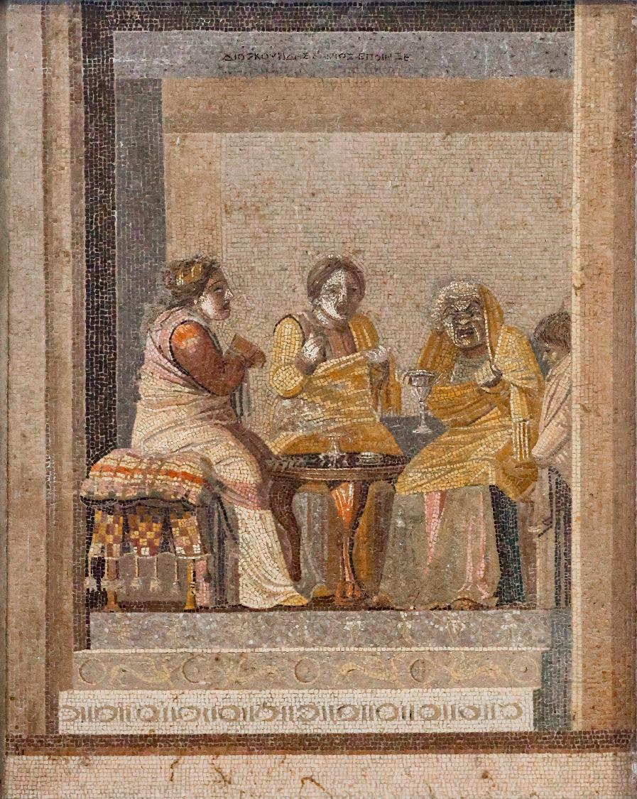
5. Theatre Mask
Notes:
By Chappsnet - Own work, CC BY-SA 4.0, https://commons.wikimedia.org/w/index.php?curid=175589772

Slide 17
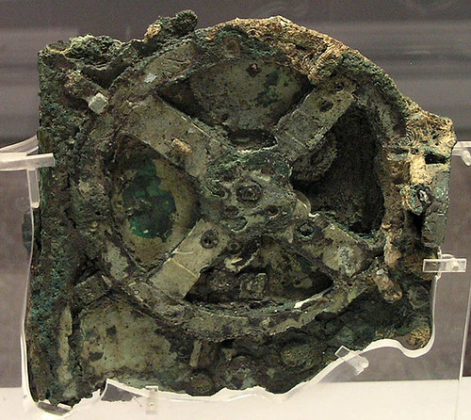
6.
Notes:
"Antikythera zodiac" by zeevveez is licensed under CC BY 2.0.

Slide 18
6. The Antikythera mechanism
Er…. We don’t know what this is either!
It’s a mystery!

Slide 19

Thanks everyone!

