Slide 1
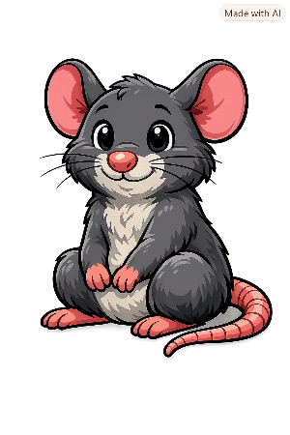
Old and New
Florence Nightingale

Slide 2
Hello I’m Pele!
My family and I have been found all over the world and throughout history.
I’ve noticed that some of the things you use today, were used in the past.

Slide 3
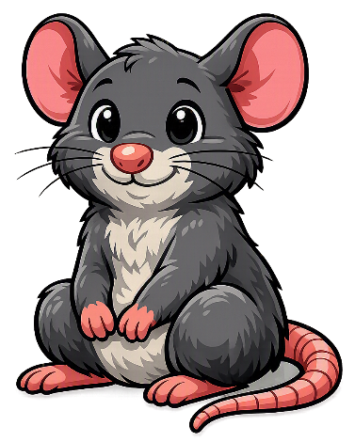
Pele’s Challenge
Can you match the picture of the object used by Florence Nightingale to the one we use today?

Slide 4
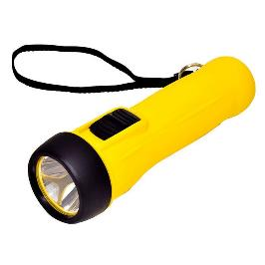
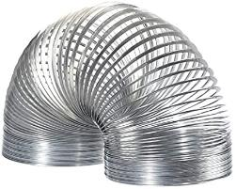
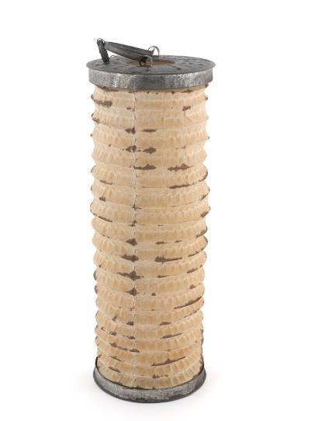
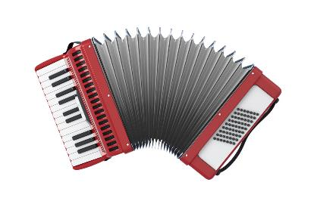
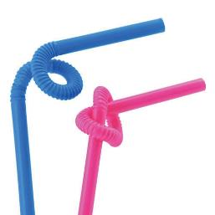
Florence Nightingale
today
1.
2.
3.
4.
© National Army Museum

Slide 5
Florence Nightingale
today
1.
2.
3.
4.
It’s a paper lantern (torch).
© National Army Museum

Slide 6
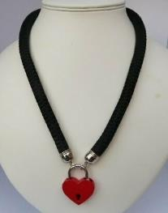
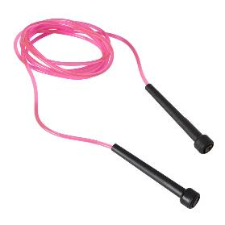
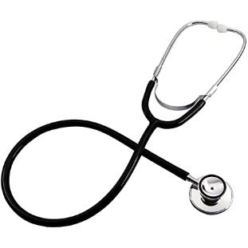
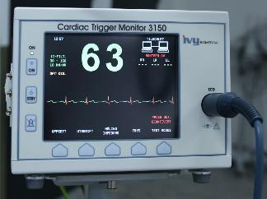
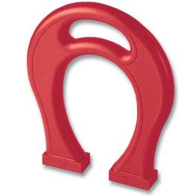
Florence Nightingale
today
1.
2.
3.
4.

Slide 7
Florence Nightingale
today
1.
2.
3.
4.
It’s a Stethoscope (to check your heart).

Slide 8
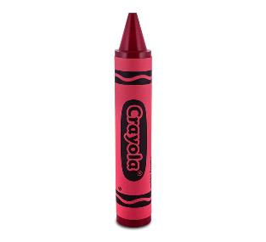
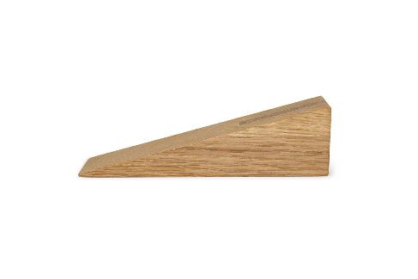
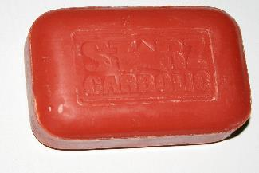
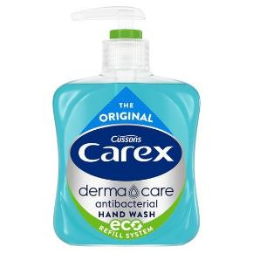
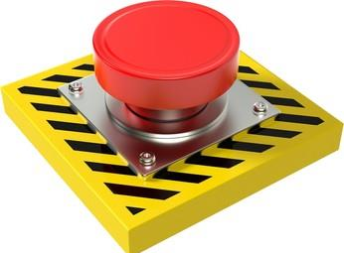
Florence Nightingale
today
1.
2.
3.
4.

Slide 9
Florence Nightingale
today
1.
2.
3.
4.
It’s soap!

Slide 10
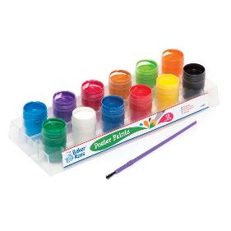
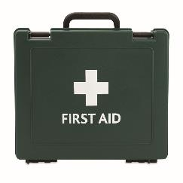
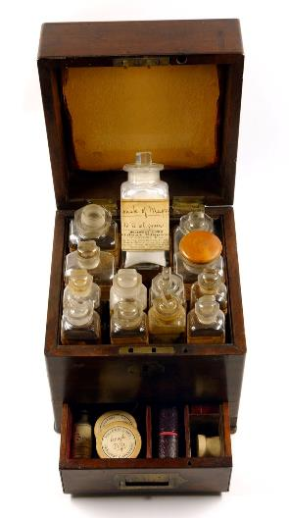
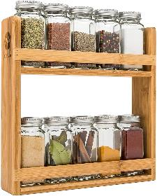
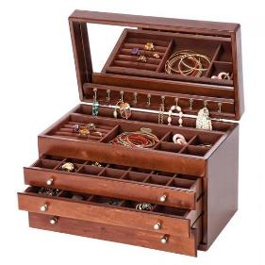
Florence Nightingale
today
1.
2.
3.
4.
© Florence Nightingale Museum

Slide 11
Florence Nightingale
today
1.
2.
3.
4.
It’s a First Aid box.
© Florence Nightingale Museum

Slide 12
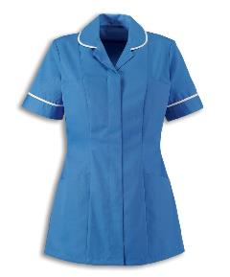


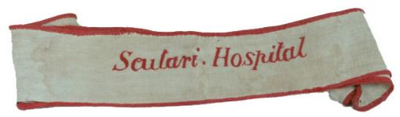
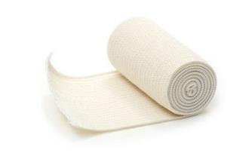
Florence Nightingale
today
1.
2.
3.
4.
© Florence Nightingale Museum

Slide 13
Florence Nightingale
today
1.
2.
3.
4.
© Florence Nightingale Museum
It’s part of the nurse’s uniform.

Slide 14
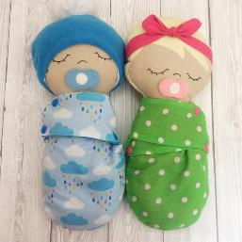
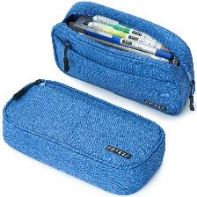
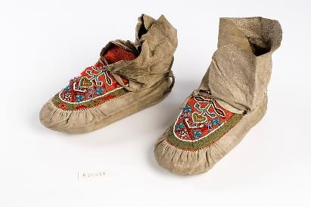
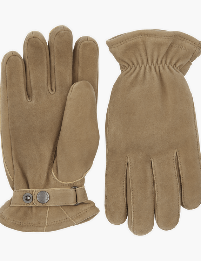
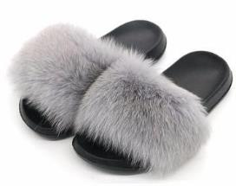
Florence Nightingale
today
1.
2.
3.
4.
© Wellcome Collection

Slide 15
Florence Nightingale
today
1.
2.
3.
4.
© Wellcome Collection
They are moccasins (a type of shoe).

Slide 16
Thanks everyone!

