Slide 1
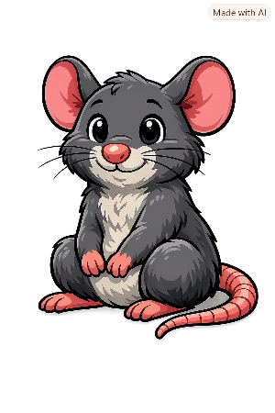
Old and New
Great fire of London

Slide 2
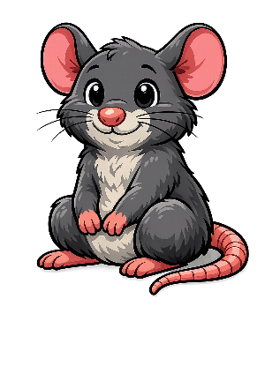
Hello I’m Pele!
My family and I have been found all over the world and throughout history.
I’ve noticed that some of the things you use today, were used in the past.

Slide 3
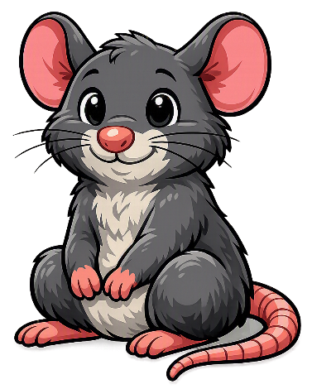
Pele’s Challenge
Can you match the picture of the object from the Great Fire of London to the one we use today?

Slide 4
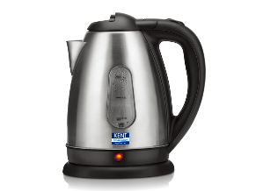
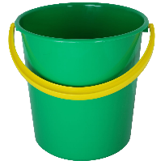
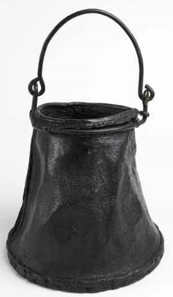
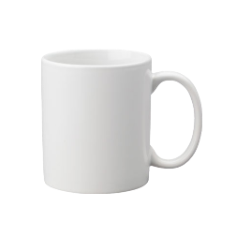
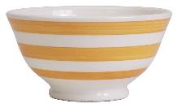
Great fire of London
today
1.
2.
3.
4.
© Museum of London

Slide 5
Great fire of London
today
1.
2.
3.
4.
© Museum of London
It’s a leather bucket!

Slide 6
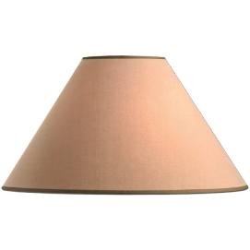
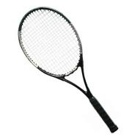
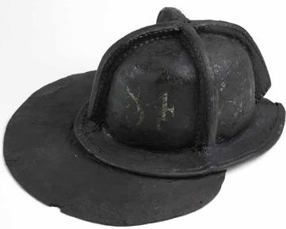
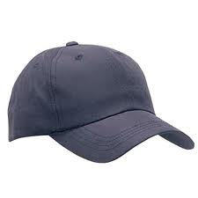
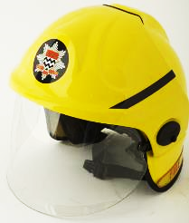
Great fire of London
today
1.
2.
3.
4.
© Museum of London

Slide 7
Great fire of London
today
1.
2.
3.
4.
© Museum of London
It’s a fireman’s helmet!

Slide 8
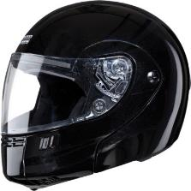
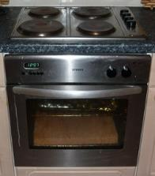
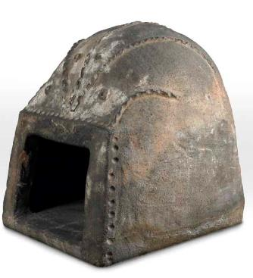
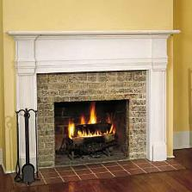
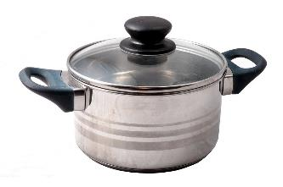
Great fire of London
today
1.
2.
3.
4.
© Museum of London

Slide 9
Great fire of London
today
1.
2.
3.
4.
© Museum of London
It’s a bread oven.

Slide 10
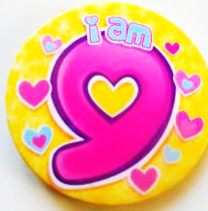
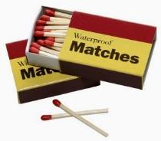
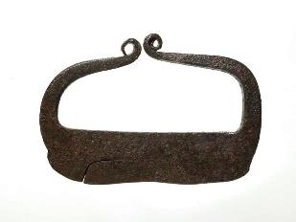

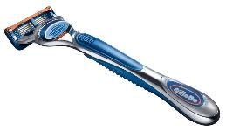
Great fire of London
today
1.
2.
© Museum of London
3.
4.

Slide 11
Great fire of London
today
1.
2.
© Museum of London
3.
4.
It’s a fire starter.

Slide 12
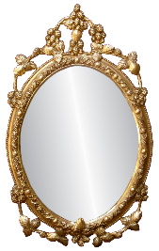
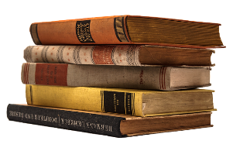
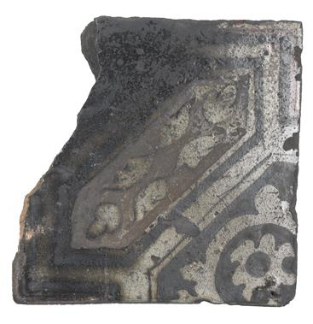
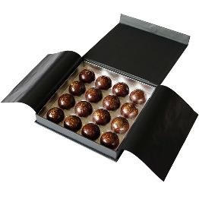
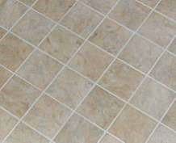
Great fire of London
today
1.
2.
3.
4.
© Museum of London

Slide 13
Great fire of London
today
1.
2.
3.
4.
© Museum of London
It’s a floor tile.

Slide 14
Thanks everyone!

