Slide 1
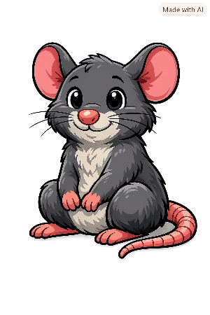
Old and New
James Cook

Slide 2
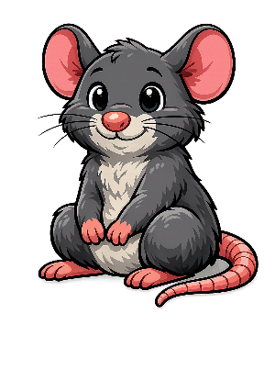
Hello I’m Pele!
My family and I have been found all over the world and throughout history.
I’ve noticed that some of the things you use today, were used in the past.

Slide 3

Pele’s Challenge
Can you match the picture of the object used by James Cook to the one we use today?

Slide 4
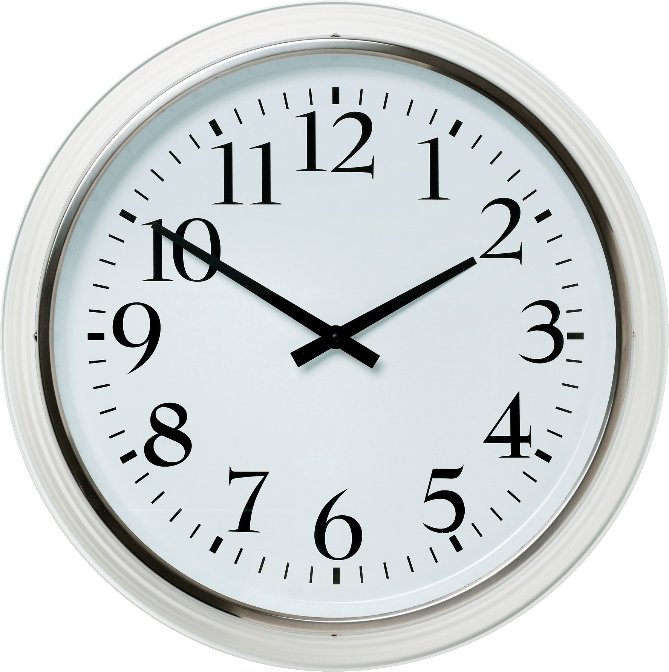
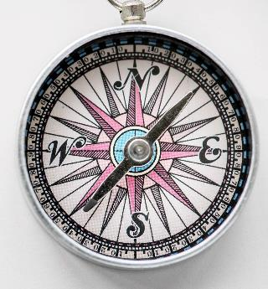
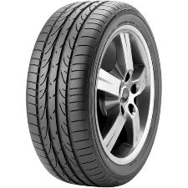
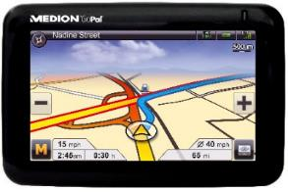
James Cook
today
1.
2.
3.
4.
This Photo by Unknown Author is licensed under CC BY-NC
Notes:
Plate: This Photo by Unknown Author is licensed under CC BY-NC
Clock: This Photo by Unknown Author is licensed under CC BY-NC
Satnav: This Photo by Unknown Author is licensed under CC BY-NC
Tyre: This Photo by Unknown Author is licensed under CC BY-NC

Slide 5
James Cook
today
1.
2.
3.
4.
It’s a compass.
This Photo by Unknown Author is licensed under CC BY-NC
Notes:
All photos: This Photo by Unknown Author is licensed under CC BY-NC

Slide 6
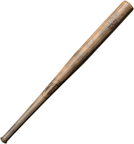
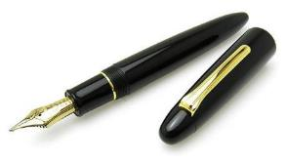
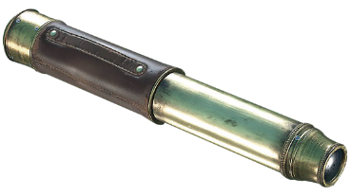
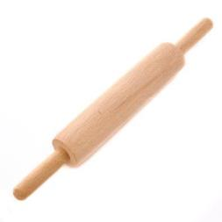
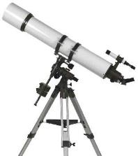
James Cook
today
1.
2.
3.
4.

Slide 7
James Cook
today
1.
2.
3.
4.
It’s a spyglass (telescope).

Slide 8
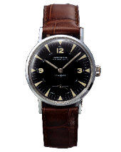
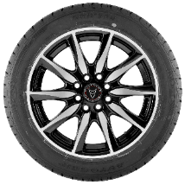
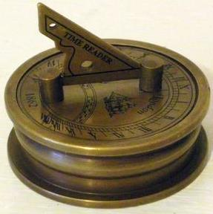
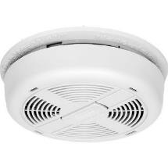
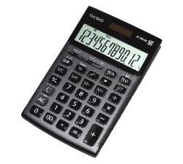
James Cook
today
1.
2.
3.
4.

Slide 9
James Cook
today
1.
2.
3.
4.
It’s a sundial.

Slide 10

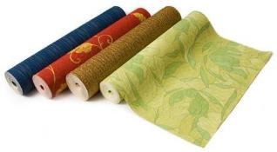
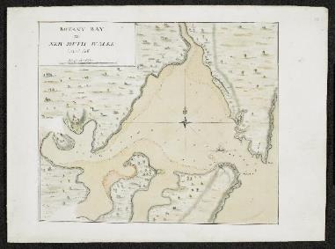
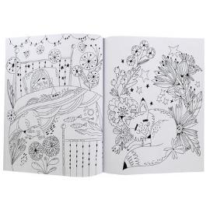

James Cook
today
1.
2.
3.
4.

Slide 11
James Cook
today
1.
2.
3.
4.
It’s a map.

Slide 12
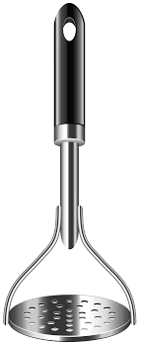
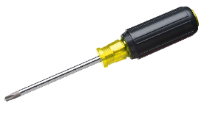
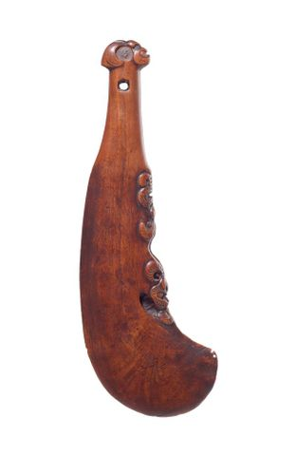
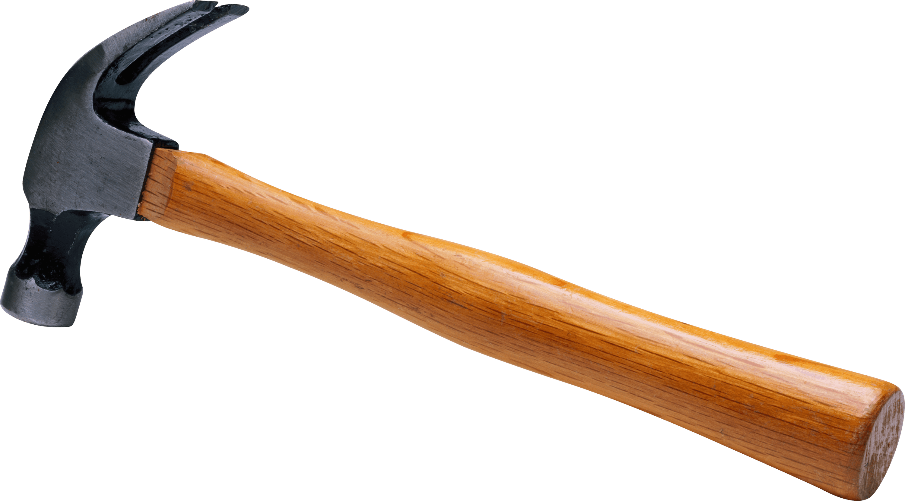
James Cook
today
1.
2.
3.
4.

Slide 13
James Cook
today
1.
2.
3.
4.
It’s a bat.

Slide 14
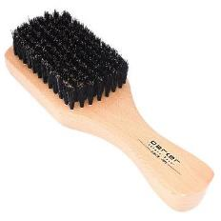
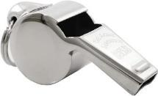
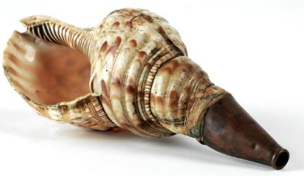
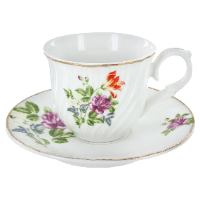
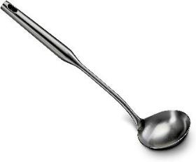
James Cook
today
1.
2.
3.
4.

Slide 15
James Cook
today
1.
2.
3.
4.
It’s a whistle (shell war trumpet).

Slide 16
Thanks everyone!

