Slide 1

Alien
Archaeology
Vikings

Slide 2
Hello! I’m Bob!
I’m an alien from a different planet!
I’ve come to see what it is like on Earth.
You have such strange objects that we don’t have on my planet. And I have no idea what you do with them!

Slide 3
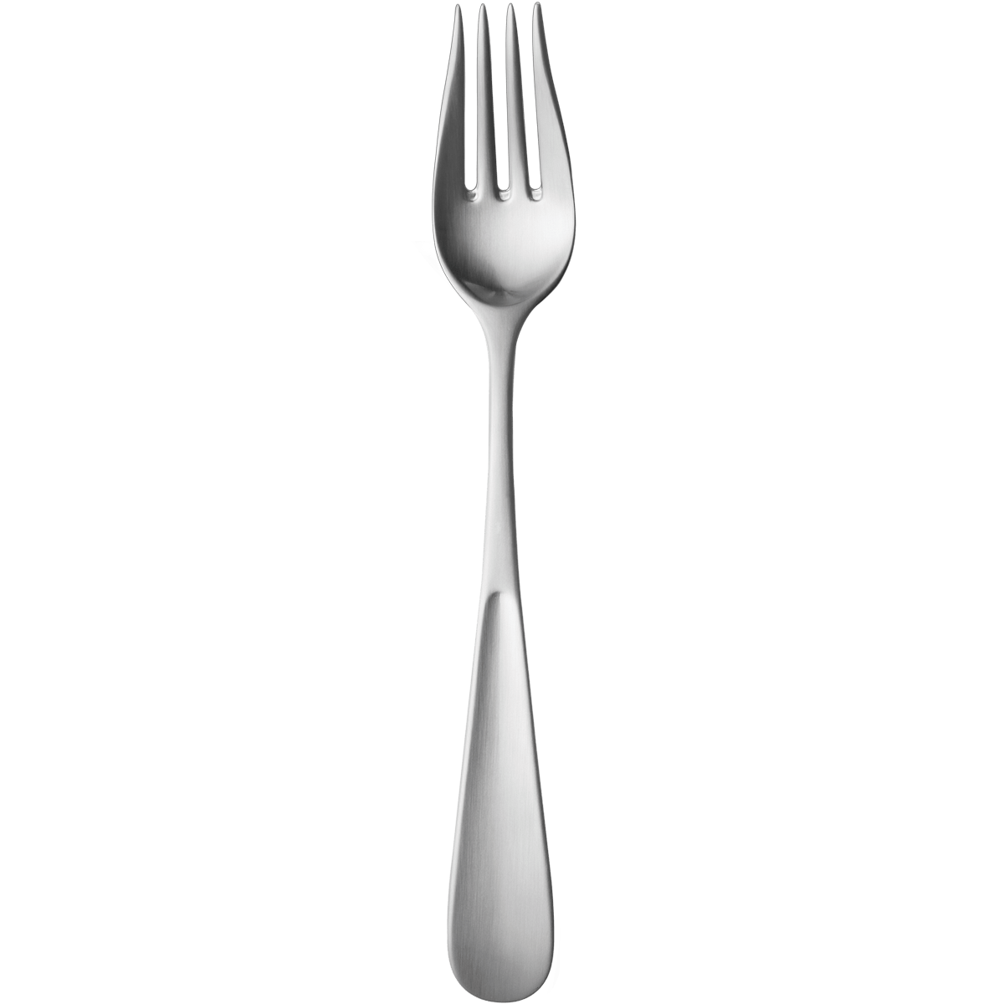
I mean, what is THIS?
What is it?
Where does it live?
How do you use it?
Who uses it?
Notes:
This Photo by Unknown Author is licensed under CC BY-NC

Slide 4
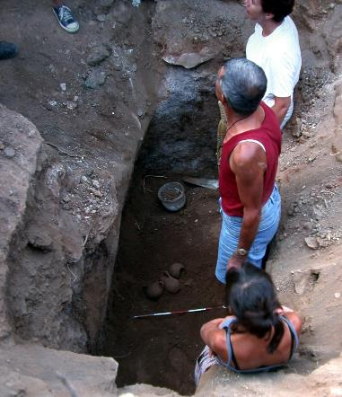
What do Archaeologists do?
Archaeologists dig up the remains of the past.
Sometimes, they don’t know what they have found.
Just like an alien looking at our objects, they have to figure out what it was used for.
"Archaeologists studying Carian tomb in Milas Becin" by Ms. Yasemin Polat is licensed under CC BY-SA 3.0.

Slide 5
The Vikings
The Vikings lived around 1000 years ago.
Many of the things they used every day, do not exist today.
Sometimes it can be difficult for archaeologists to work out what they are.

Slide 6

Boblet’s Challenge
Bob has found some objects used by the Vikings.
He has asked you to draw or write what you think they might be or how they are used.

Slide 7
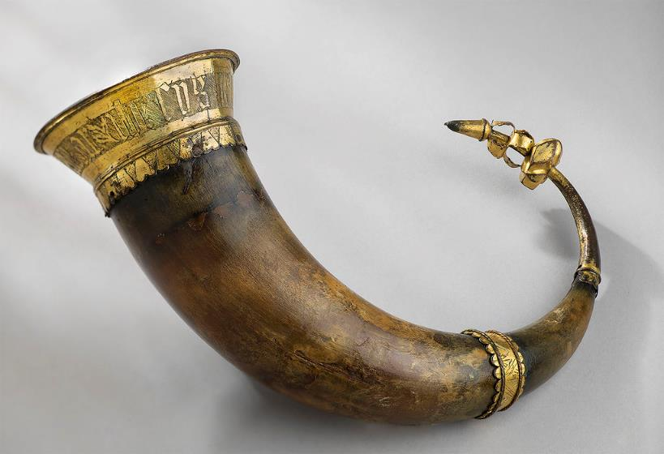
1.
Notes:
"Drikkehorn / Drinking horn" by NTNU Vitenskapsmuseet is licensed under CC BY 2.0.

Slide 8
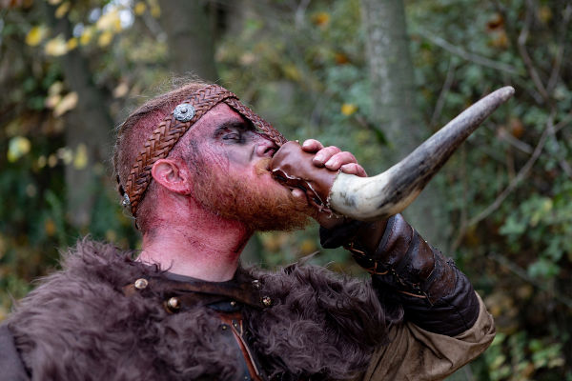
1. It’s a drinking horn!

Slide 9
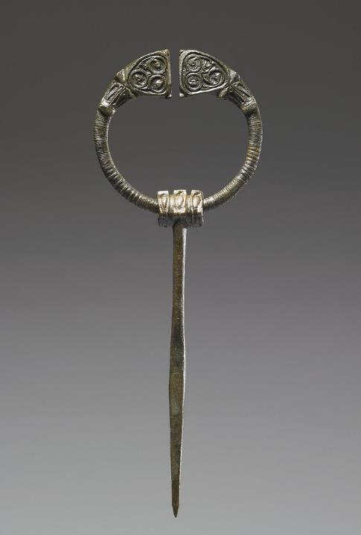
2.
Notes:
"Penannular Brooch 6th-7th century (Early Medieval)" by museado is marked with CC0 1.0.

Slide 10
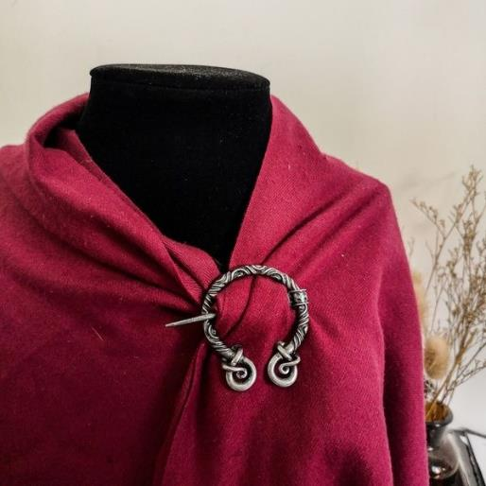
2. It’s a penannular brooch!

Slide 11
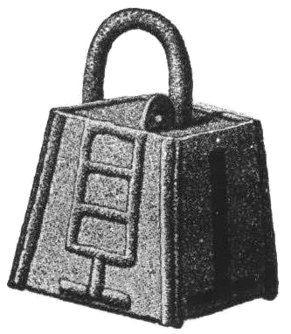
3.

Slide 12

3. It’s a padlock
Notes:
This Photo by Unknown Author is licensed under CC BY-NC

Slide 13
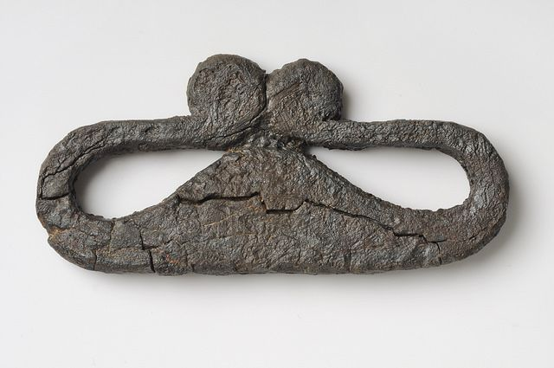
4.
Notes:
"Object from the exhibition We call them Vikings produced by The Swedish History Museum" by The Swedish History Museum, Stockholm is licensed under CC BY 2.0.

Slide 14
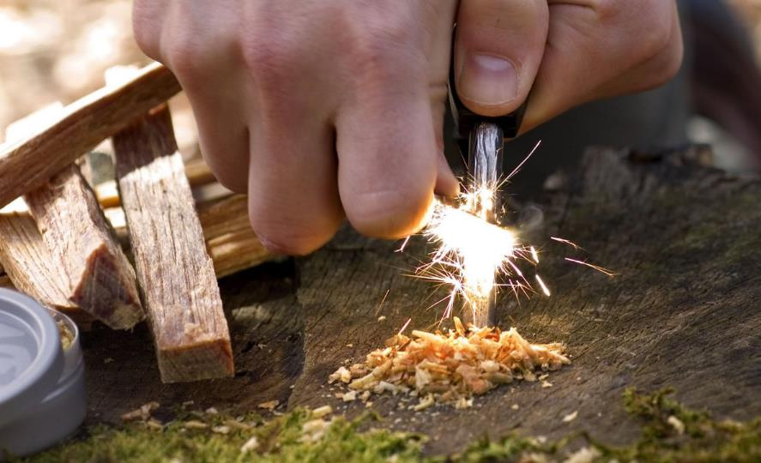
4. It’s a strike-a-light (to hit against flint to create a fire).

Slide 15
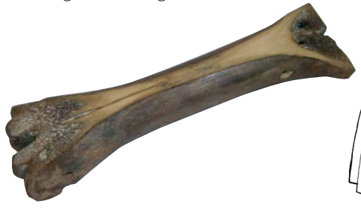
5.

Slide 16
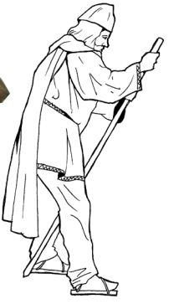
5. It’s an ice skate

Slide 17
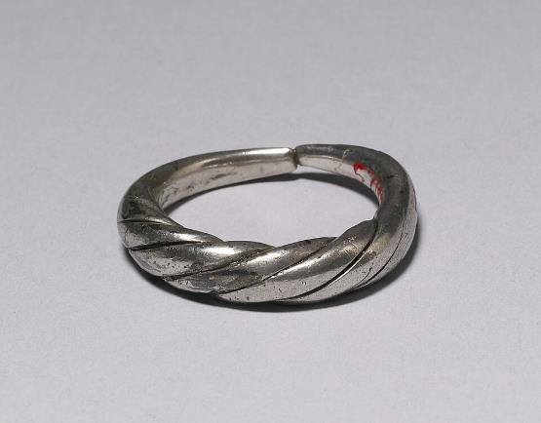
6.

Slide 18
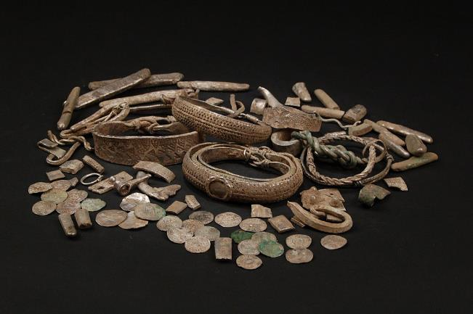
6. It’s ring money (and jewellery)
Notes:
Portable Antiquities Scheme, CC BY-SA 2.0 <https://creativecommons.org/licenses/by-sa/2.0>, via Wikimedia Commons

Slide 19
Thanks everyone!

