Slide 1

Alien
Archaeology
Medieval England

Slide 2
Hello! I’m Bob!
I’m an alien from a different planet!
I’ve come to see what it is like on Earth.
You have such strange objects that we don’t have on my planet. And I have no idea what you do with them!

Slide 3
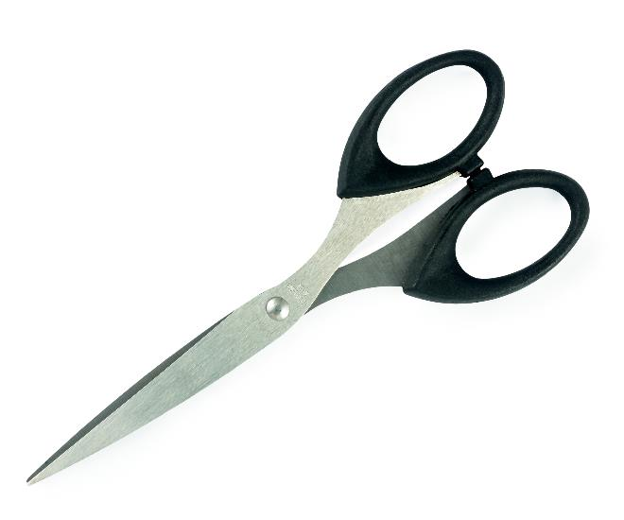
I mean, what is THIS?
What is it?
Where does it live?
How do you use it?
Who uses it?
This Photo by Unknown Author is licensed under CC BY-SA

Slide 4
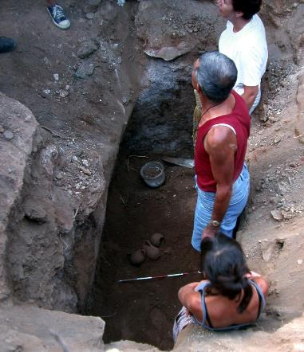
What do Archaeologists do?
Archaeologists dig up the remains of the past.
Sometimes, they don’t know what they have found.
Just like an alien looking at our objects, they have to figure out what it was used for.
"Archaeologists studying Carian tomb in Milas Becin" by Ms. Yasemin Polat is licensed under CC BY-SA 3.0.

Slide 5
Medieval England
Medieval England dates from 1154 – 1485AD.
Many of the things they used every day, do not exist today.
Sometimes it can be difficult for archaeologists to work out what they are.

Slide 6

Bob’s Challenge
Bob has found some objects used by the people in medieval England.
He has asked you to draw or write what you think they might be or how they are used.

Slide 7
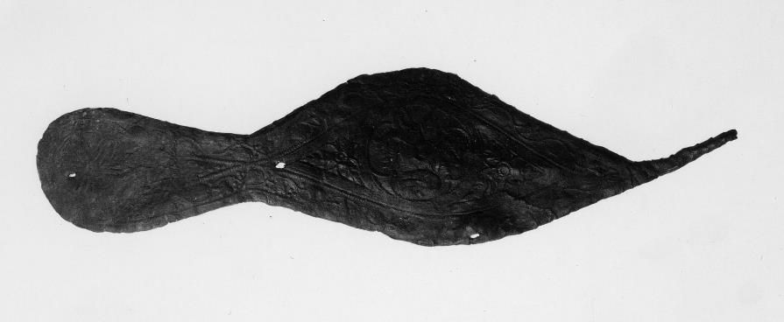
1.
Notes:
© The Trustees of the British Museum. Shared under a Creative Commons Attribution-NonCommercial-ShareAlike 4.0 International (CC BY-NC-SA 4.0) licence.

Slide 8
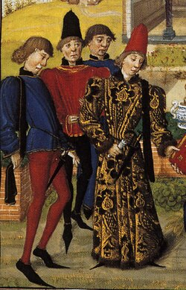
1. It’s a poulaine ( a long pointed shoe for men).
Notes:
By Jean Hennecart - http://employees.oneonta.edu/farberas/ARTH/arth214_folder/burgundy_intro.html, Public Domain, https://commons.wikimedia.org/w/index.php?curid=1811431

Slide 9
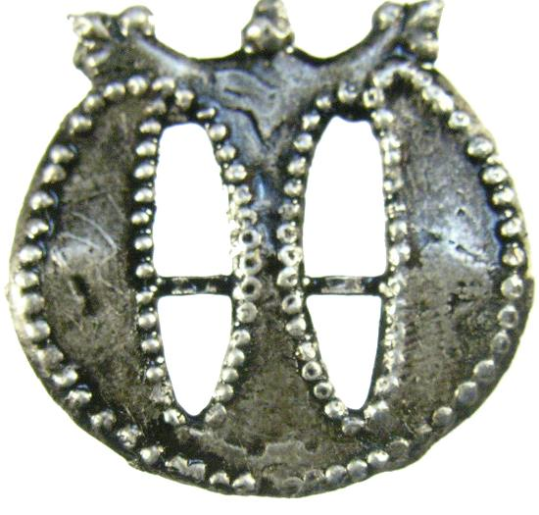
2.
Notes:
"<div class='fn'> Medieval pilgrim badge</div>" by Museum of London, Kath Creed, 2012-01-18 15:07:44 is licensed under CC BY-SA 2.0.

Slide 10
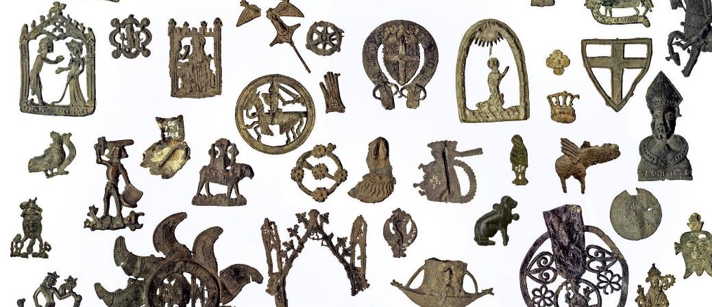
2. It’s a pilgrim’s badge (a souvenir pin badge)

Slide 11
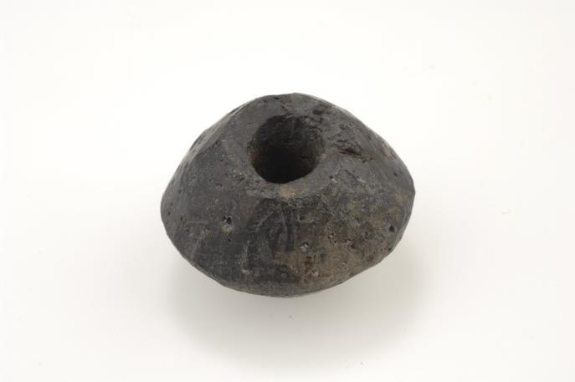
3.
Notes:
"Spindle whorle" by The Swedish History Museum, Stockholm is licensed under CC BY 2.0.

Slide 12
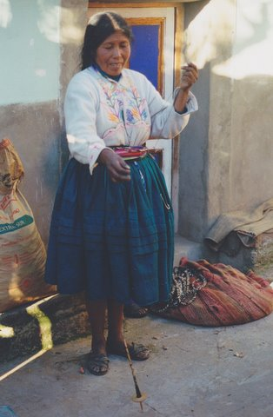
3. It’s a spindle whorl (for spinning wool).
Notes:
"Indian woman with spindle whorl in Peru" by Peter van der Sluijs is licensed under CC BY-SA 3.0.

Slide 13
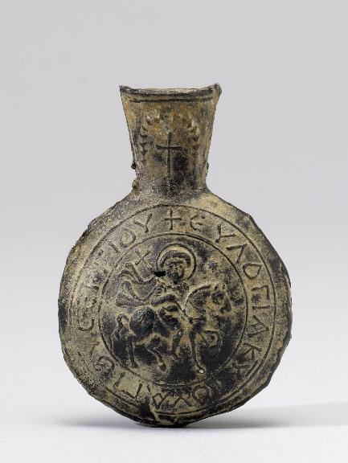
4.

Slide 14
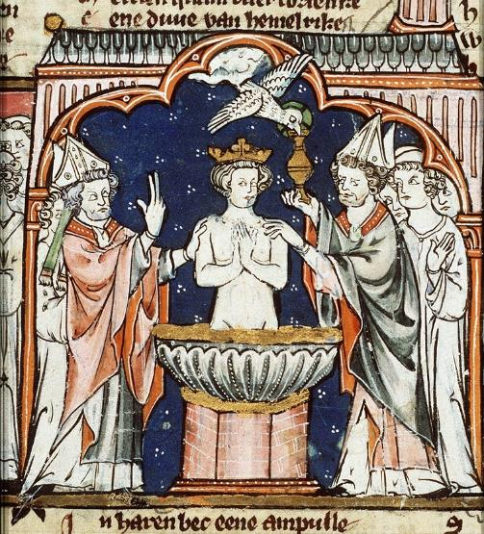
4. It’s an ampulla (container filled with holy water or oil from a pilgrimage).
Notes:
By Jacob van Maerlant - Jacob van Maerlant, Spieghel Historiael (dead link, see the archive copy at the Wayback Machine), Public Domain, https://commons.wikimedia.org/w/index.php?curid=10311623

Slide 15
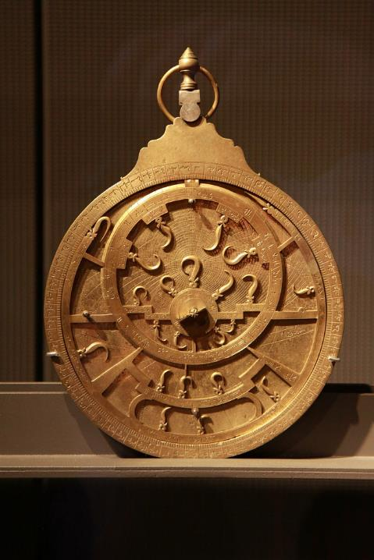
5.
Notes:
"astrolabe" by lewing is licensed under CC BY 2.0.

Slide 16
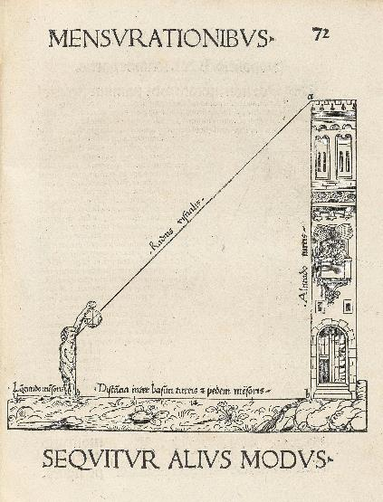
5. It’s an astrolabe (to make astronomical measurements)
Notes:
By Johannes Stöffler - http://christies.com/img/LotImages/2017/CKS/2017_CKS_14298_0349_000(stoffler_johannes_elucidatio_fabricae_usuque_astrolabii_ex_secunda_aut051338).jpgfromhttp://christies.com/lot/lot-stoffler-johannes-1452-1531-elucidatio-fabricae-usuque-astrolabii-6069643, Public Domain, https://commons.wikimedia.org/w/index.php?curid=108928273

Slide 17
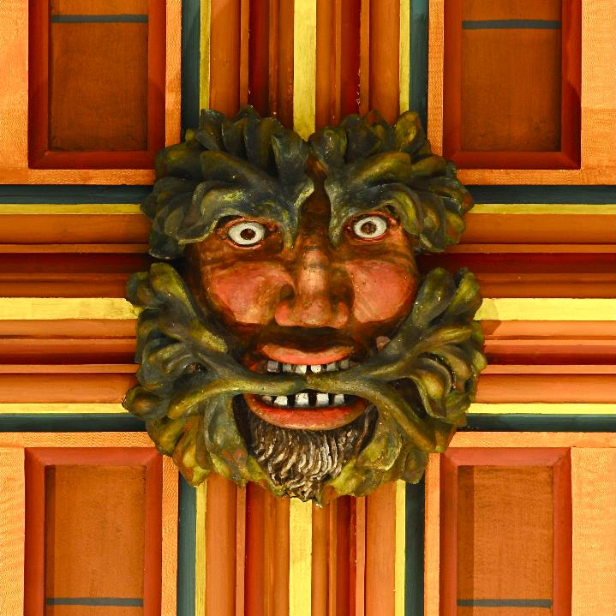
6.
Notes:
By Akoliasnikoff - Own work, CC BY-SA 4.0, https://commons.wikimedia.org/w/index.php?curid=3931741

Slide 18
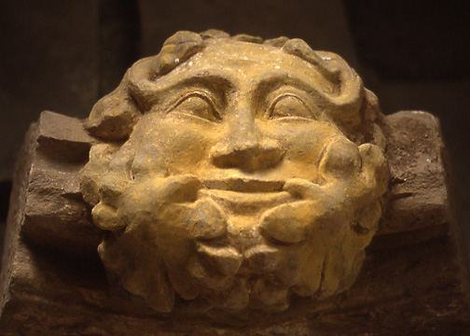
6. It’s the Green Man (stone carving in churches)

Slide 19
Thanks everyone!

