Slide 1

Alien
Archaeology
The Romans

Slide 2
Hello! I’m Bob!
I’m an alien from a different planet!
I’ve come to see what it is like on Earth.
You have such strange objects that we don’t have on my planet. And I have no idea what you do with them!

Slide 3
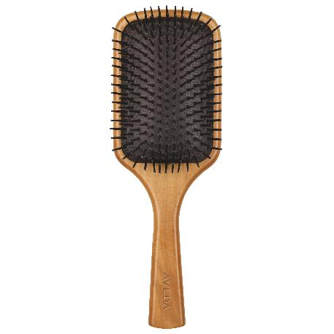
I mean, what is THIS?
What is it?
Where does it live?
How do you use it?
Who uses it?

Slide 4
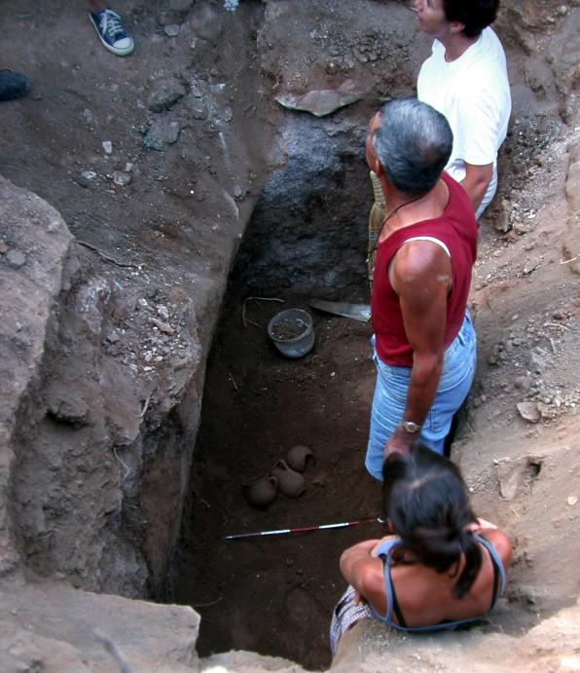
What do Archaeologists do?
Archaeologists dig up the remains of the past.
Sometimes, they don’t know what they have found.
Just like an alien looking at our objects, they have to figure out what it was used for.
"Archaeologists studying Carian tomb in Milas Becin" by Ms. Yasemin Polat is licensed under CC BY-SA 3.0.

Slide 5
The Romans
The Romans invaded Britain 43 AD and left in 410 AD.
Many of the things they used every day, do not exist today.
Sometimes it can be difficult for archaeologists to work out what they are.

Slide 6

Bob’s Challenge
Bob has found some objects from the Stone Age.
He has asked you to draw or write what you think they might be or how they are used.

Slide 7
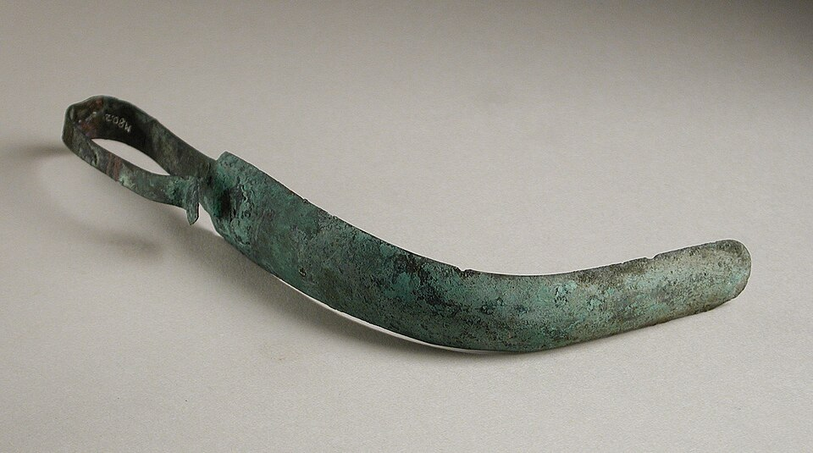
1.

Slide 8
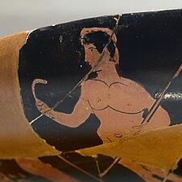
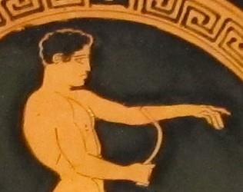
1. It’s a strigil! (to clean skin)

Slide 9
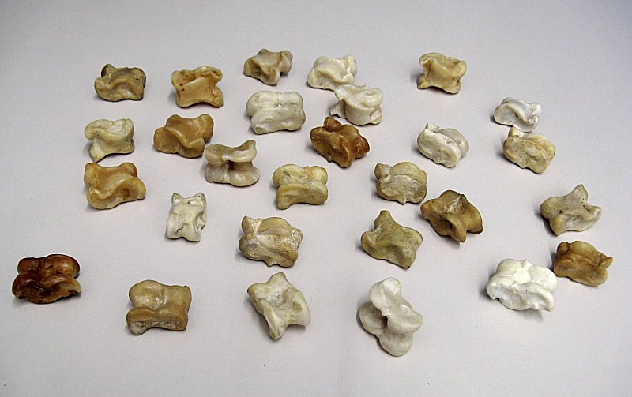
2.

Slide 10
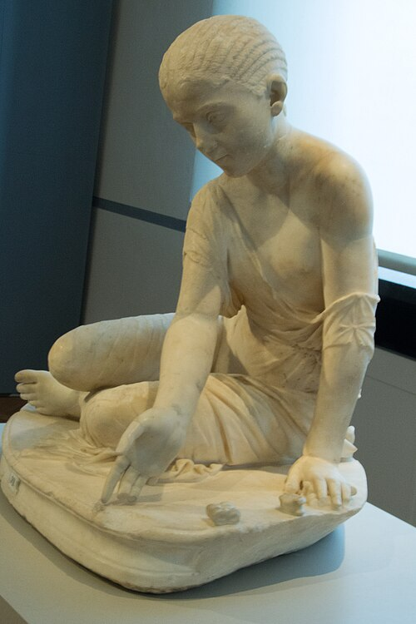
2. They are knucklebones! (a game)

Slide 11
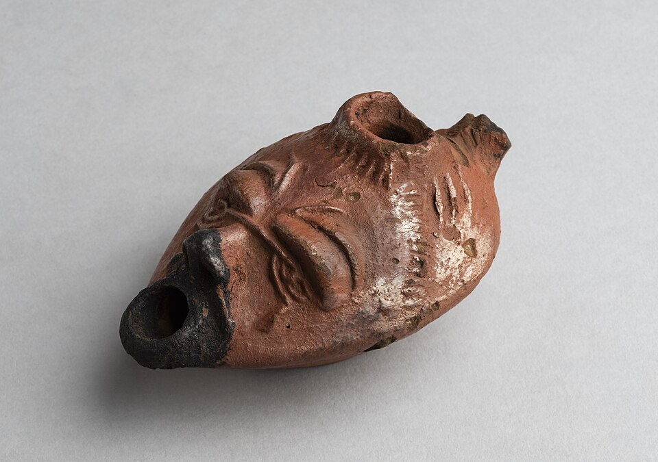
3.

Slide 12
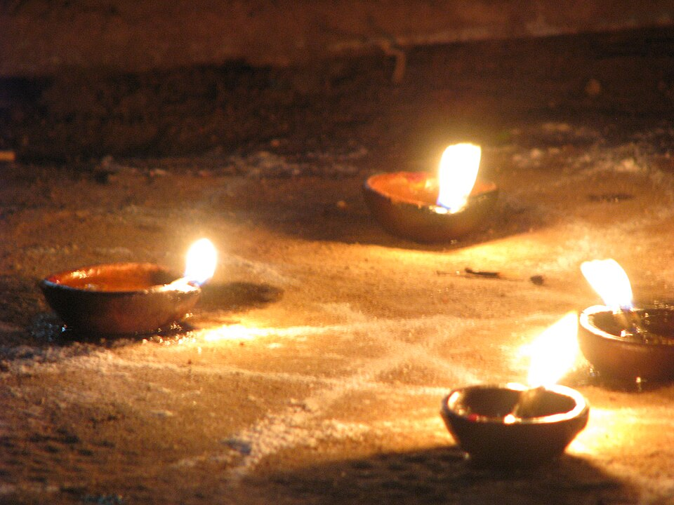
3. It’s an oil lamp.

Slide 13
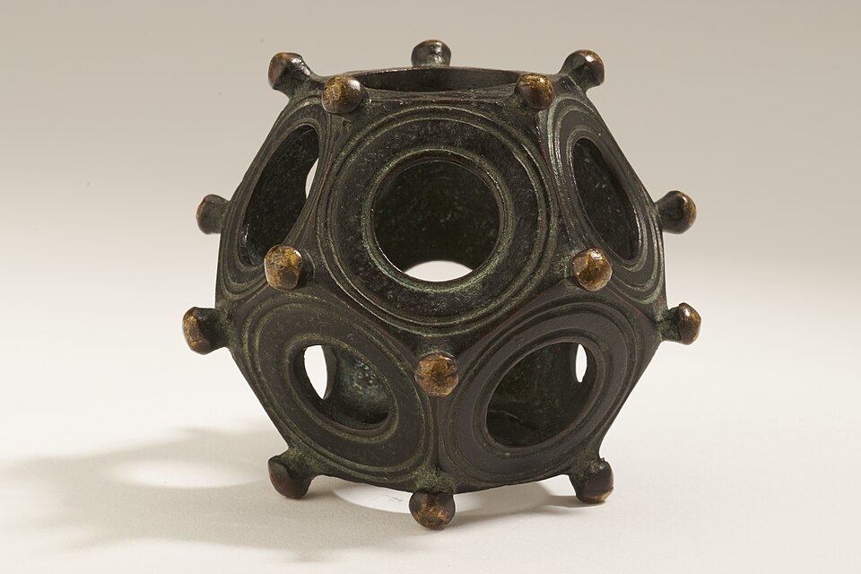
4.

Slide 14
4. copper alloy dodecahedron
Er…. We don’t know what this is for either!
It’s a mystery!

Slide 15
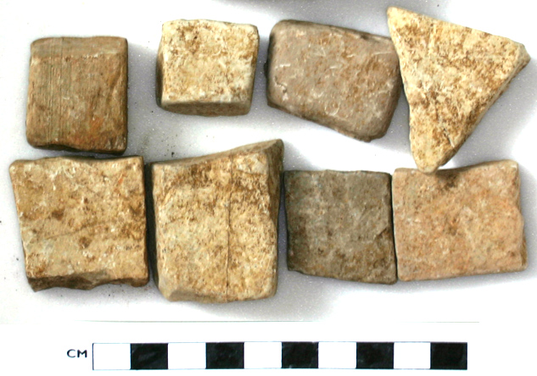
5.

Slide 16
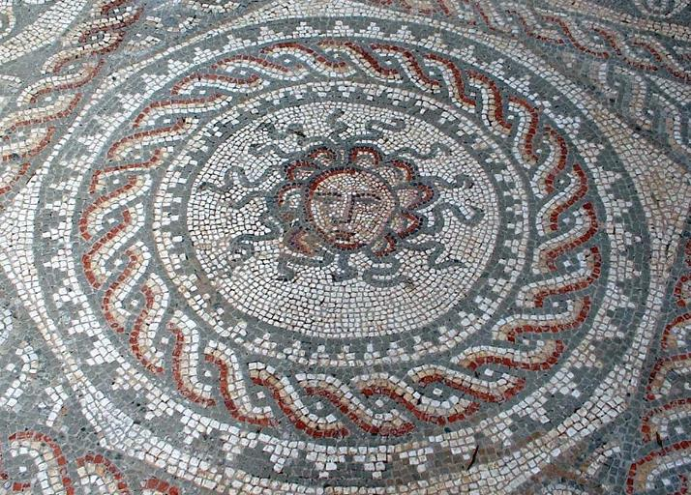
5. They’re mosaic tiles

Slide 17
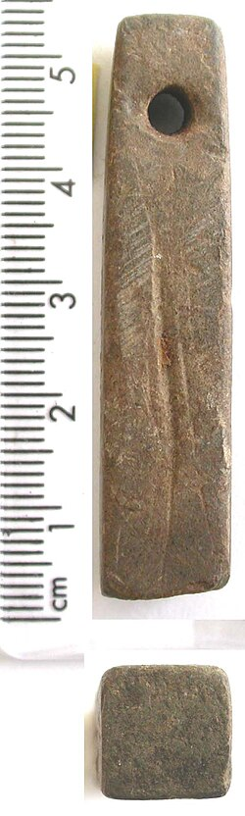
6.

Slide 18
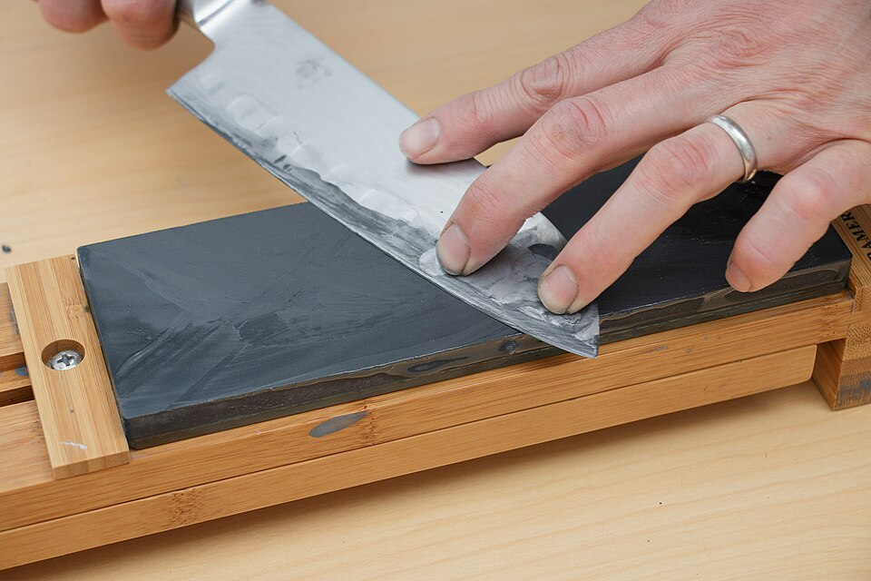
6. It’s a whetstone. (For sharpening knives)

Slide 19
Thanks everyone!

