Slide 1
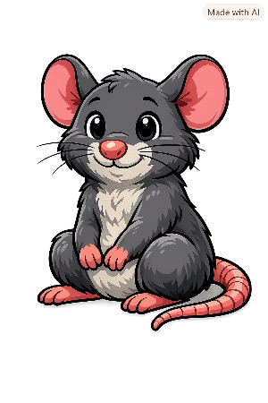
Old and New
Pirates

Slide 2
Hello I’m Pele!
My family and I have been found all over the world and throughout history.
I’ve noticed that some of the things you use today, were used in the past.

Slide 3
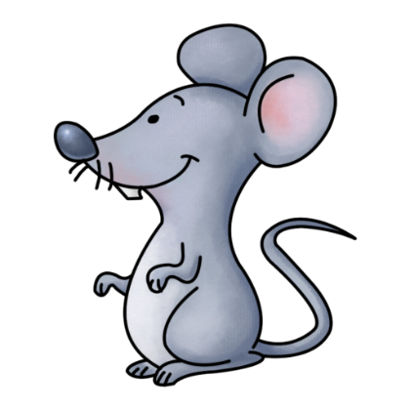
Pele’s Challenge
Can you match the picture of the object from the Age of Pirates to the one we use today?

Slide 4
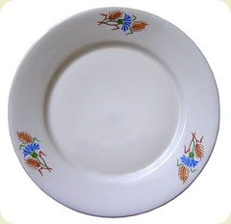

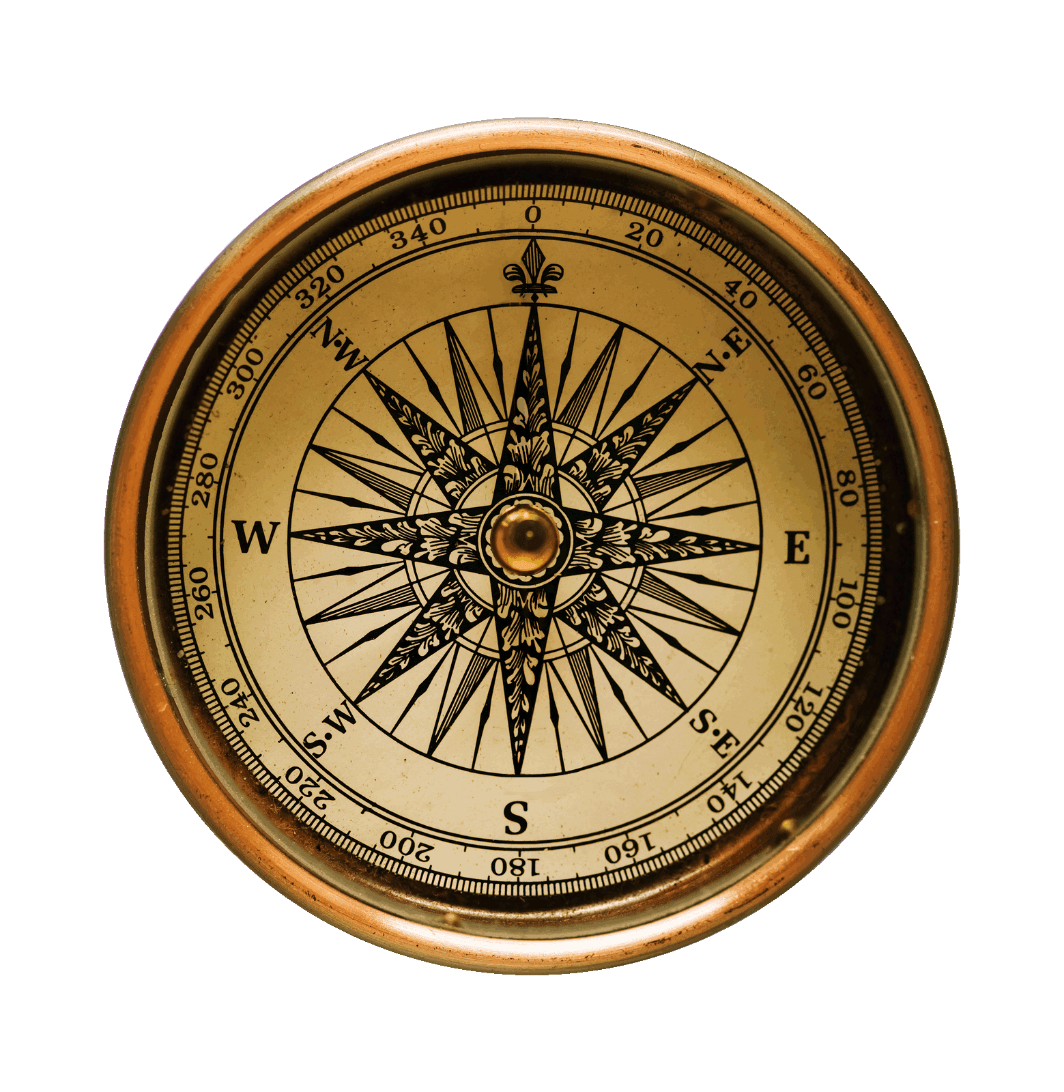
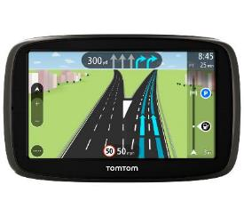
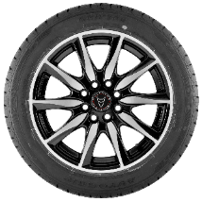
Age of Pirates
today
1.
2.
3.
4.

Slide 5
Age of Pirates
today
1.
2.
3.
4.
It’s a compass.

Slide 6
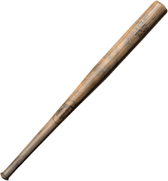
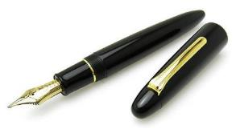
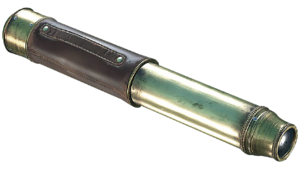
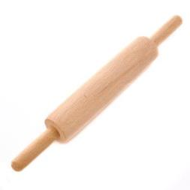
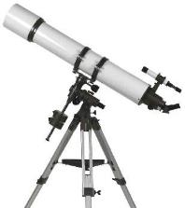
Age of Pirates
today
1.
2.
3.
4.

Slide 7
Age of Pirates
today
1.
2.
3.
4.
It’s a spyglass (telescope).

Slide 8
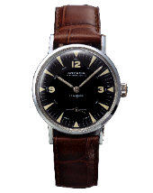
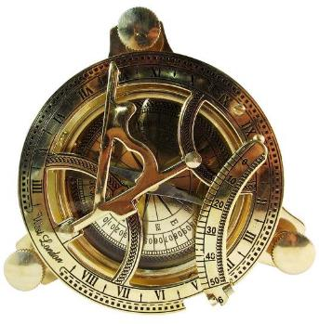

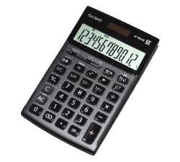
Age of Pirates
today
1.
2.
3.
4.

Slide 9
Age of Pirates
today
1.
2.
3.
4.
It’s a sundial.

Slide 10
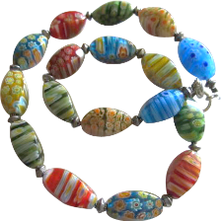
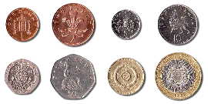
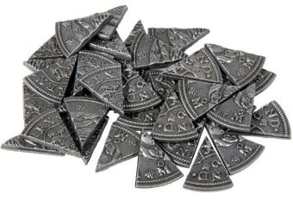

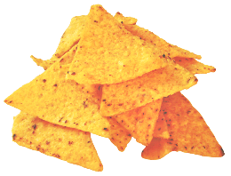
Age of Pirates
today
1.
2.
3.
4.

Slide 11
Age of Pirates
today
1.
2.
3.
4.
They are pieces of eight (money).

Slide 12

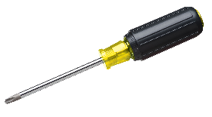
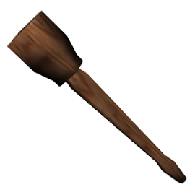
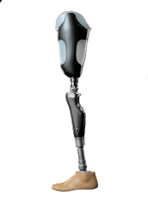
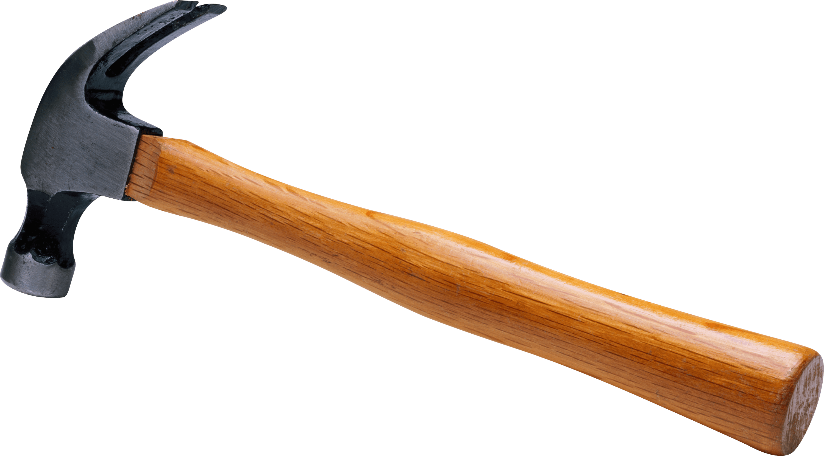
Age of Pirates
today
1.
2.
3.
4.

Slide 13
Age of Pirates
today
1.
2.
3.
4.
It’s a wooden leg.

Slide 14
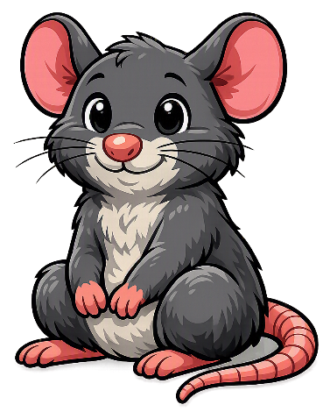
Thanks everyone!

