Slide 1

Alien
Archaeology
Victorian Britain

Slide 2
Hello! I’m Bob!
I’m an alien from a different planet!
I’ve come to see what it is like on Earth.
You have such strange objects that we don’t have on my planet. And I have no idea what you do with them!

Slide 3
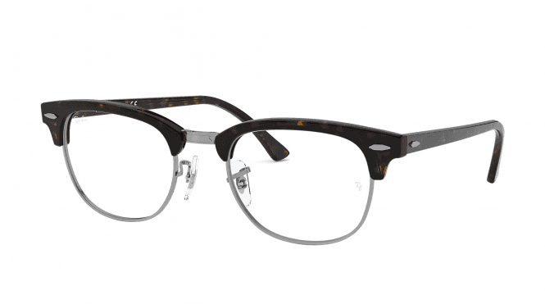
I mean, what is THIS?
What is it?
Where does it live?
How do you use it?
Who uses it?

Slide 4
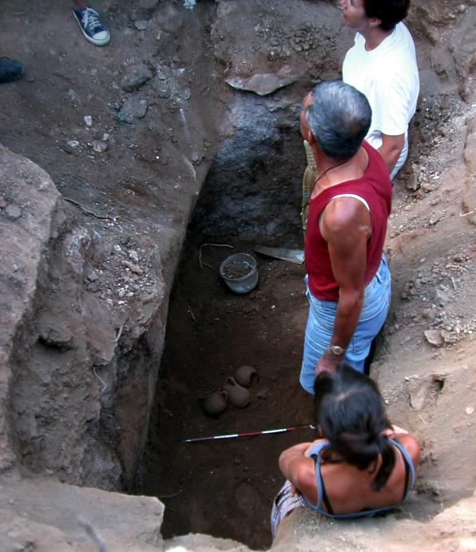
What do Archaeologists do?
Archaeologists dig up the remains of the past.
Sometimes, they don’t know what they have found.
Just like an alien looking at our objects, they have to figure out what it was used for.
"Archaeologists studying Carian tomb in Milas Becin" by Ms. Yasemin Polat is licensed under CC BY-SA 3.0.

Slide 5
The Victorians
The Victorians existed between AD1837 and 1901.
Many of the things they used every day, do not exist today or have changed.
Sometimes it can be difficult for archaeologists and historians to work out what they are.

Slide 6

Bob’s Challenge
Bob has found some objects used by the Victorians.
He has asked you to draw or write on a whiteboard what you think they might be or how they are used.

Slide 7
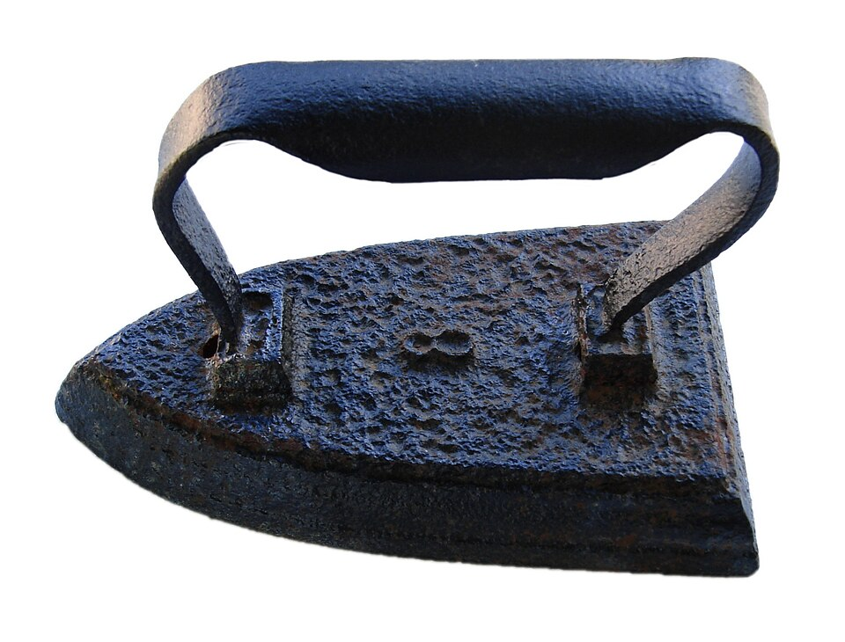
1.

Slide 8
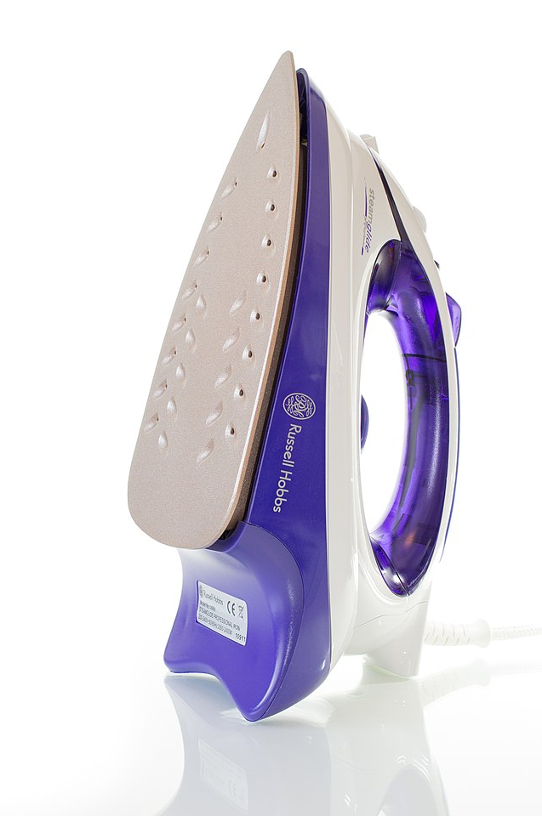
1. It’s a flat iron!

Slide 9
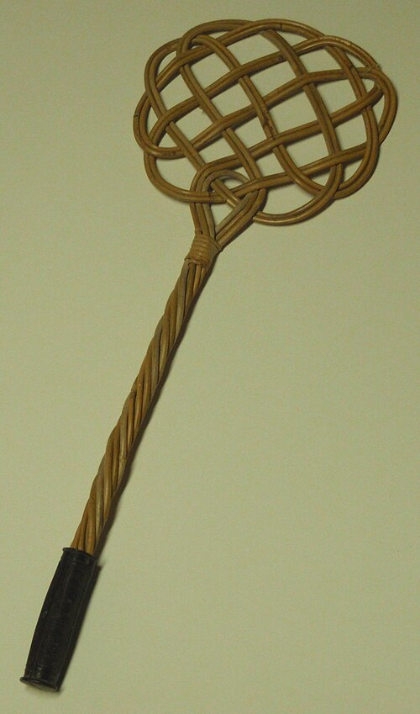
2.

Slide 10
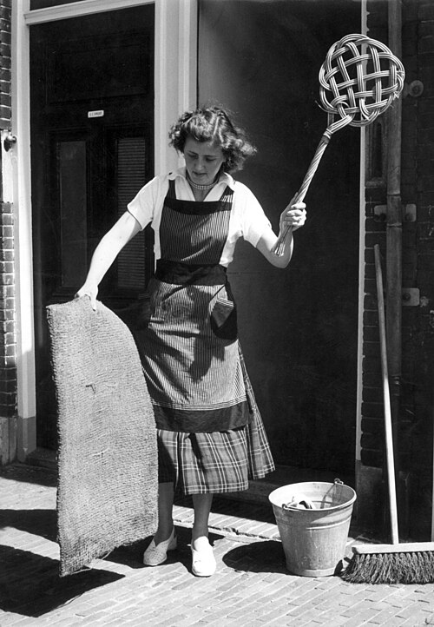
2. It’s a carpet beater!

Slide 11
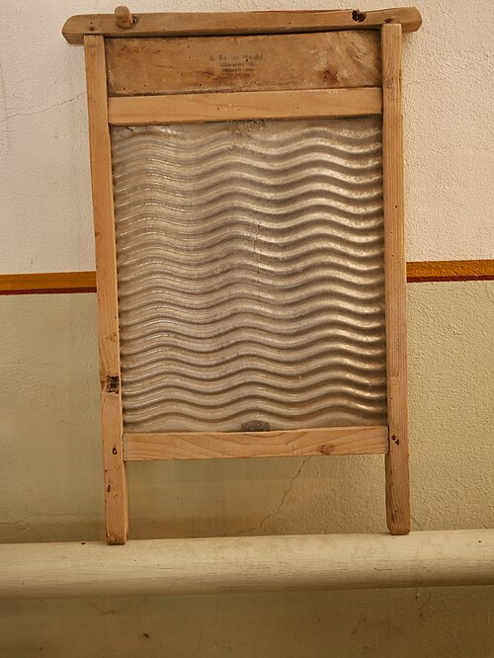
3.

Slide 12
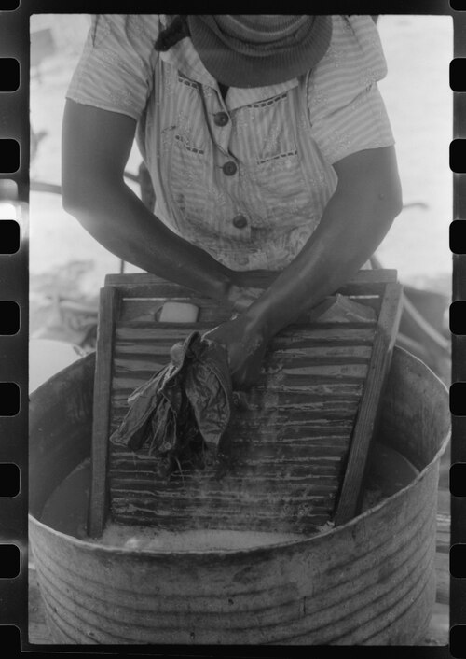
3. It’s a washboard

Slide 13
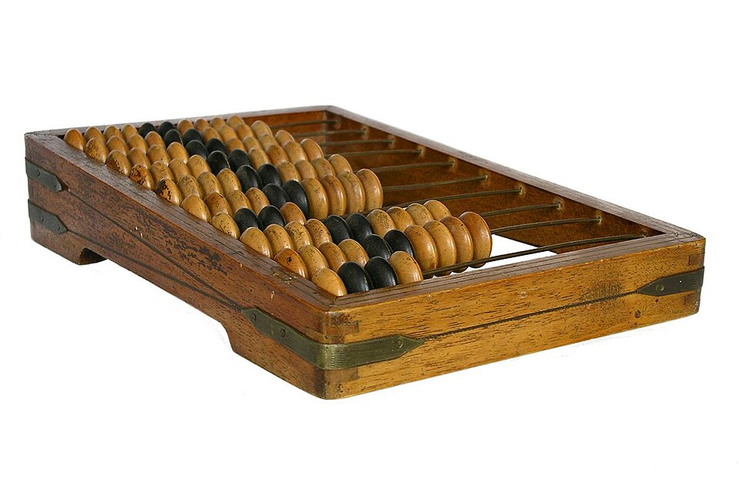
4.

Slide 14
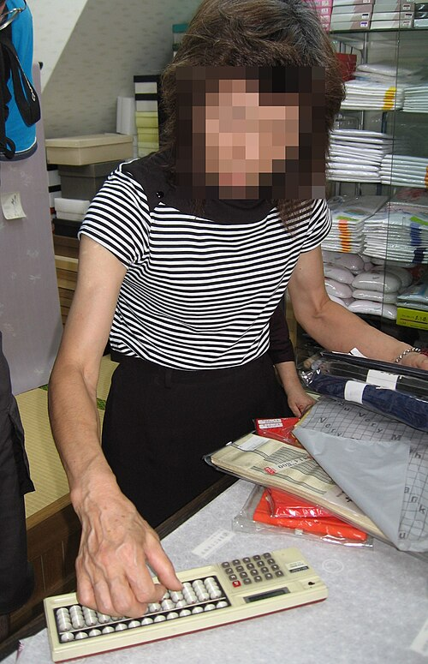
4. It’s an abacus (a calculator).

Slide 15
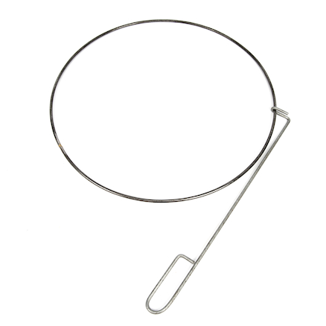
5.

Slide 16
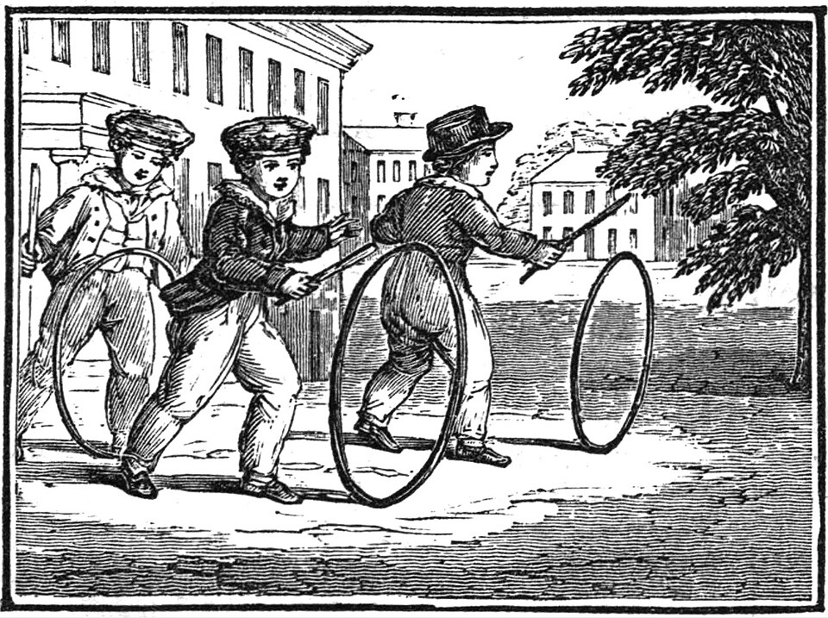
5. It’s a hoop and stick toy

Slide 17
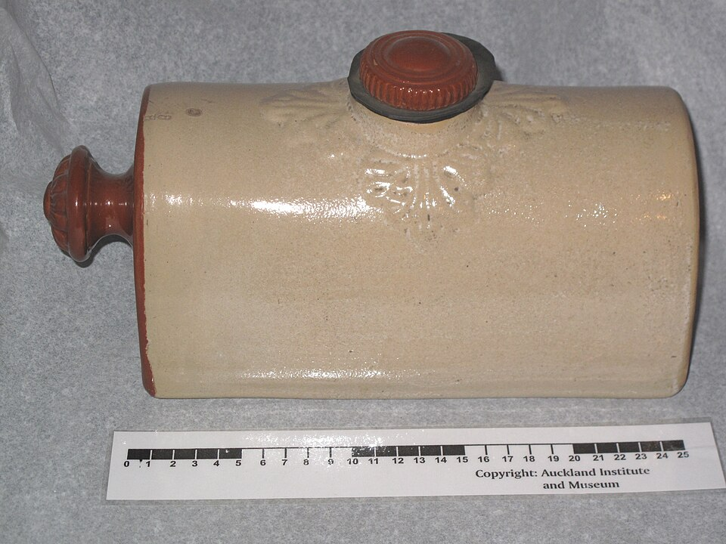
6.

Slide 18
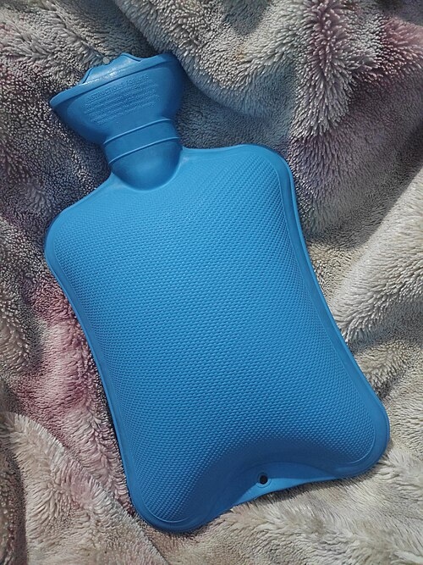
6. It’s a hot water bottle (made of clay)

Slide 19
Thanks everyone!

