Slide 1

Alien
Archaeology
Second World War

Slide 2
Hello! I’m Bob!
I’m an alien from a different planet!
I’ve come to see what it is like on Earth.
You have such strange objects that we don’t have on my planet. And I have no idea what you do with them!

Slide 3
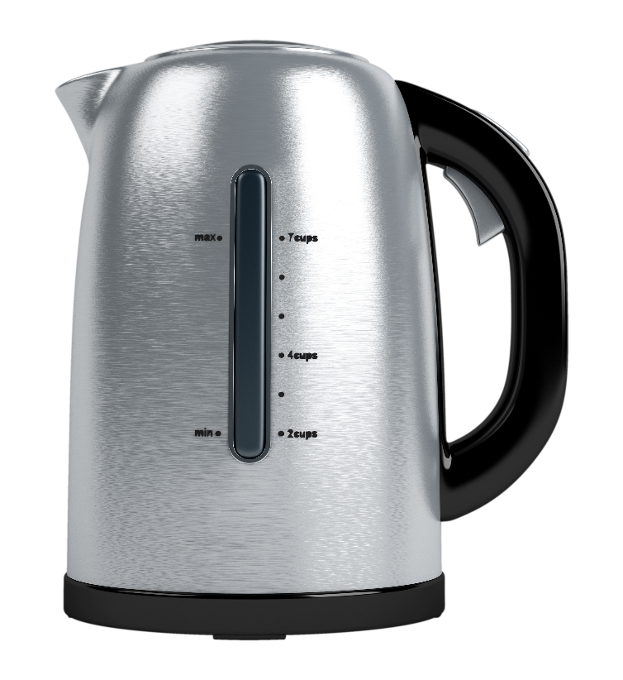
I mean, what is THIS?
What is it?
Where does it live?
How do you use it?
Who uses it?

Slide 4
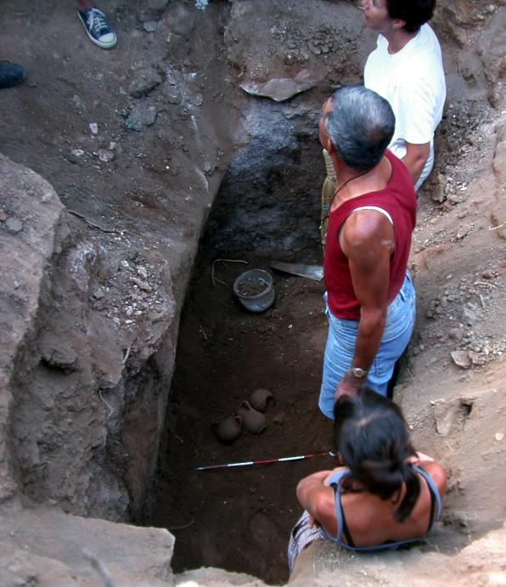
What do Archaeologists do?
Archaeologists dig up the remains of the past.
Sometimes, they don’t know what they have found.
Just like an alien looking at our objects, they have to figure out what it was used for.
"Archaeologists studying Carian tomb in Milas Becin" by Ms. Yasemin Polat is licensed under CC BY-SA 3.0.

Slide 5
The Second World War
The Second World War happened between 1939-1945 AD.
Many of the things they used every day, do not exist today.
Sometimes it can be difficult for archaeologists to work out what they are.

Slide 6

Bob’s Challenge
Bob has found some objects used during the Second World War.
He has asked you to draw or write what you think they might be or how they are used.

Slide 7
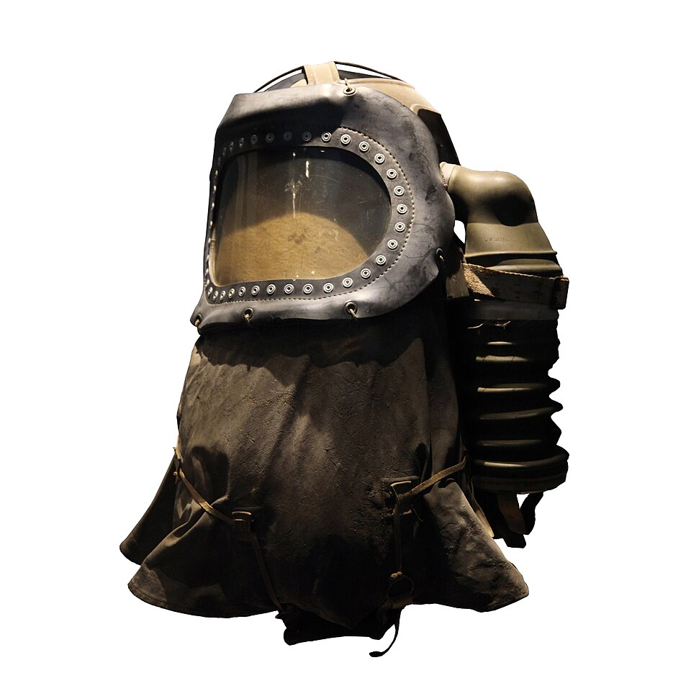
1.

Slide 8
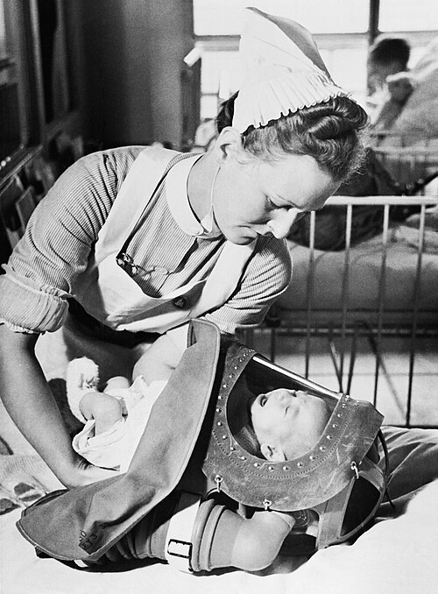
1. It’s a gas mask for a baby!
© IWM

Slide 9
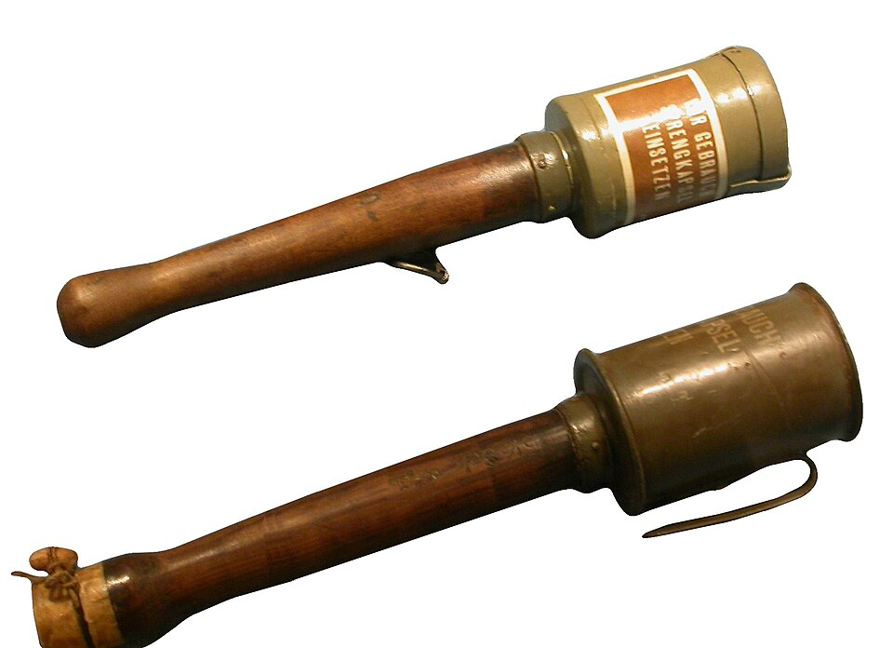
2.

Slide 10
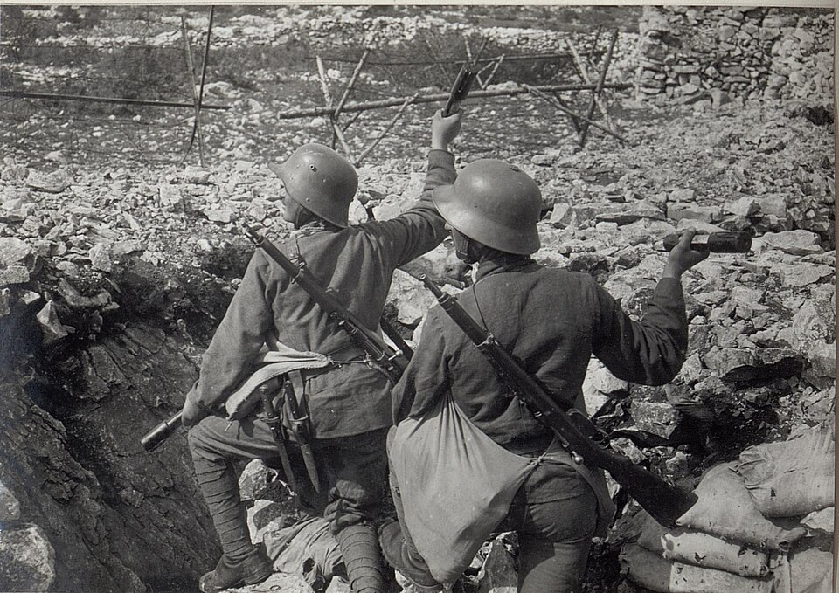
2. It’s a grenade (German).

Slide 11
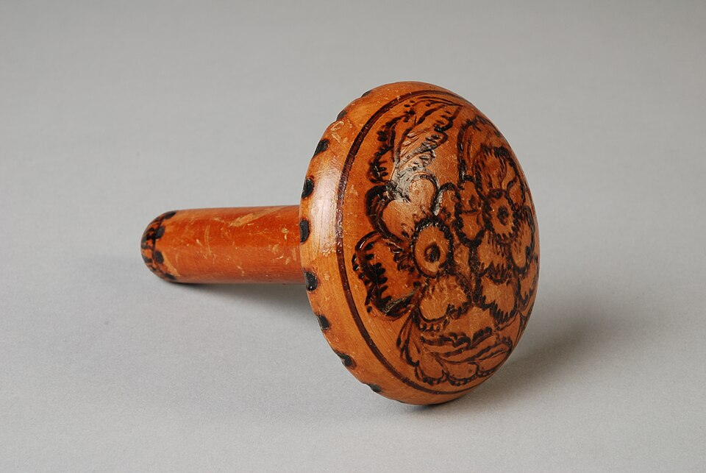
3.

Slide 12
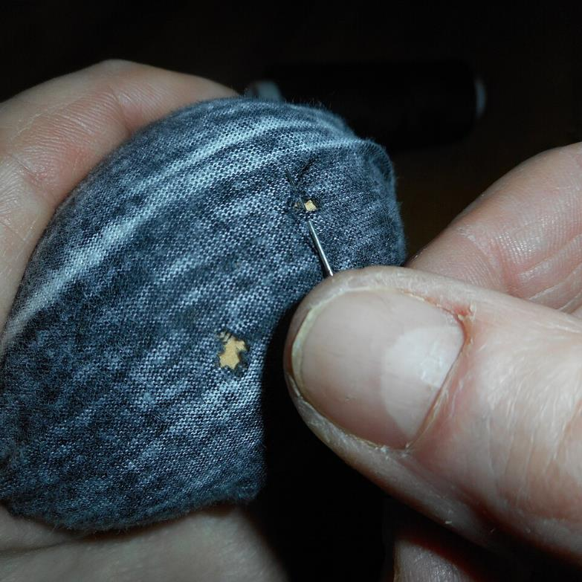
3. It’s a darning mushroom (to help mend holes in clothes).

Slide 13
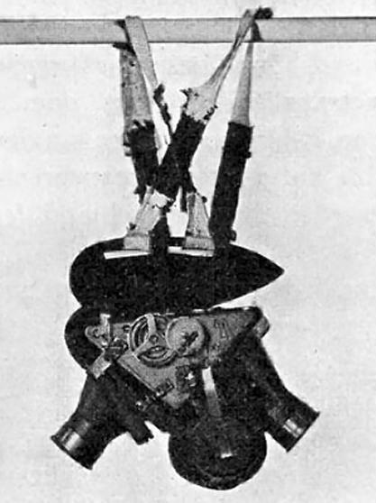
4.

Slide 14
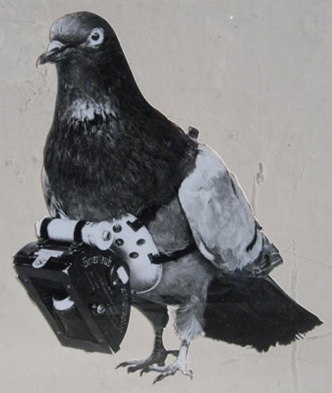
4. It’s a pigeon camera used by spies

Slide 15
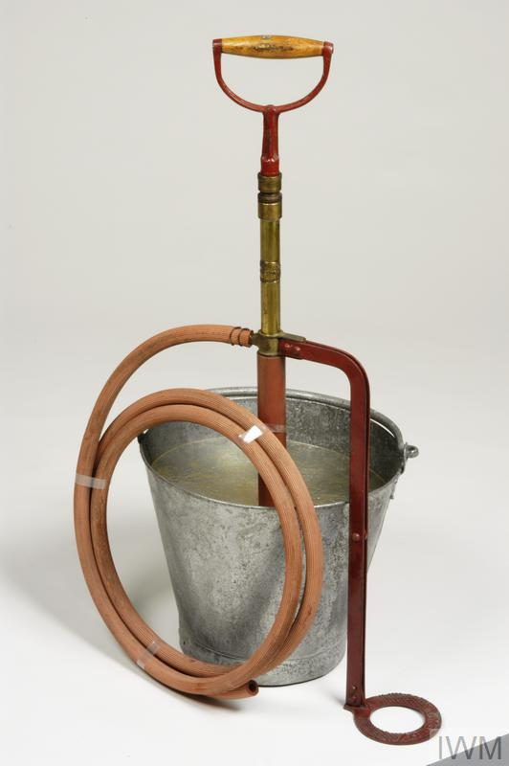
5.

Slide 16
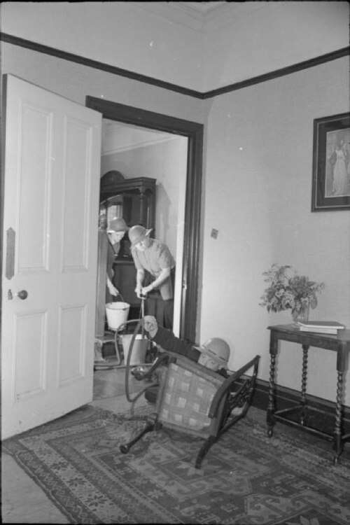
5. It’s a stirrup pump (fire extinguisher).

Slide 17
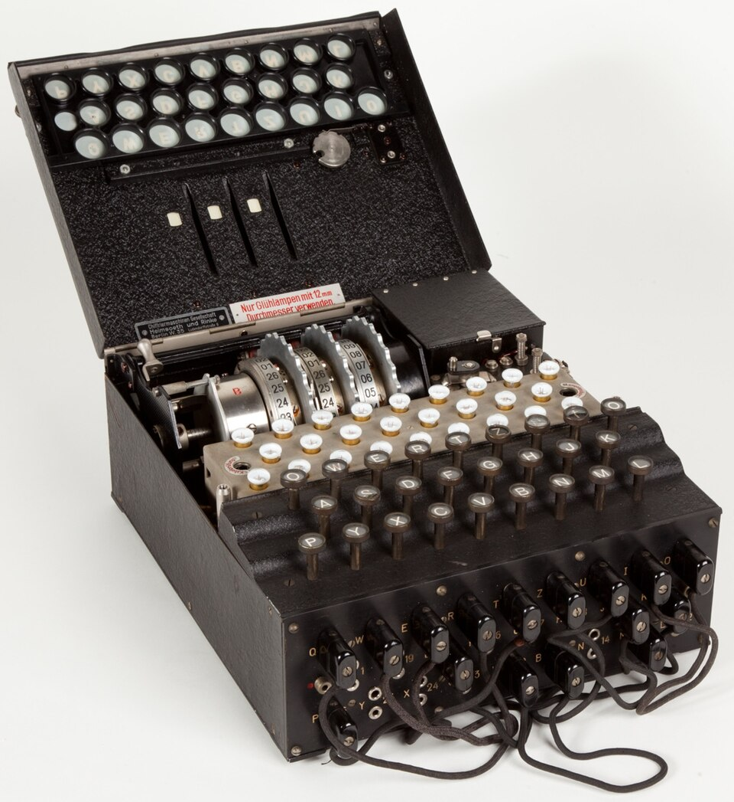
6.

Slide 18
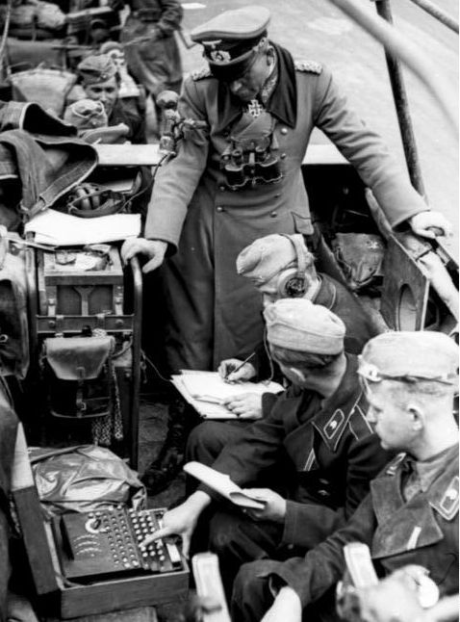
6. It’s an enigma machine. Used by the Germans to create secret messages.

Slide 19
Thanks everyone!

