Slide 1

Alien
Archaeology
Tudor England

Slide 2
Hello! I’m Bob!
I’m an alien from a different planet!
I’ve come to see what it is like on Earth.
You have such strange objects that we don’t have on my planet. And I have no idea what you do with them!

Slide 3
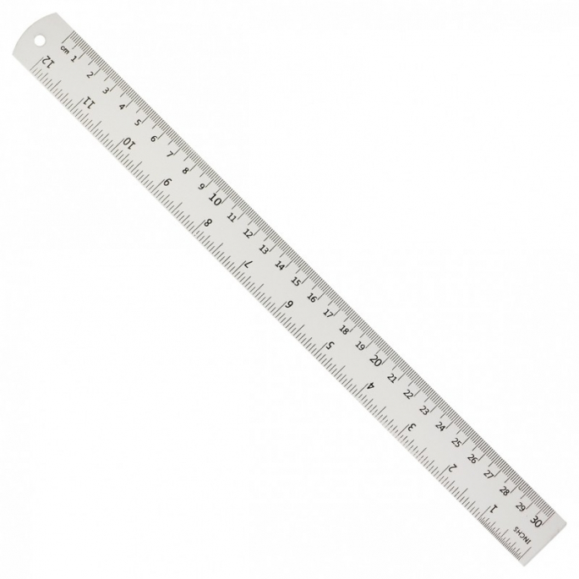
I mean, what is THIS?
What is it?
Where does it live?
How do you use it?
Who uses it?

Slide 4
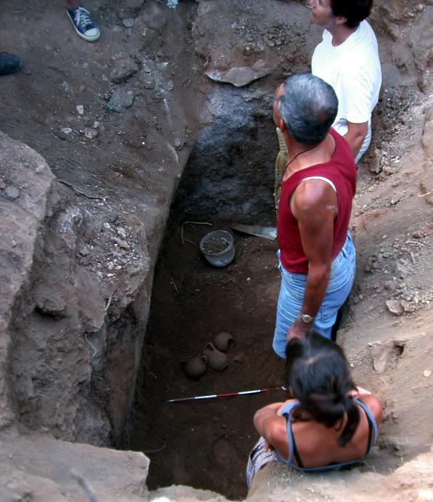
What do Archaeologists do?
Archaeologists dig up the remains of the past.
Sometimes, they don’t know what they have found.
Just like an alien looking at our objects, they have to figure out what it was used for.
"Archaeologists studying Carian tomb in Milas Becin" by Ms. Yasemin Polat is licensed under CC BY-SA 3.0.

Slide 5
The Tudors
Tudor England dates from 1485 – 1603AD.
Many of the things they used every day, do not exist today.
Sometimes it can be difficult for archaeologists and historians to work out what they are.

Slide 6

Bob’s Challenge
Bob has found some objects used by the people in Tudor England.
He has asked you to draw or write what you think they might be or how they are used.

Slide 7
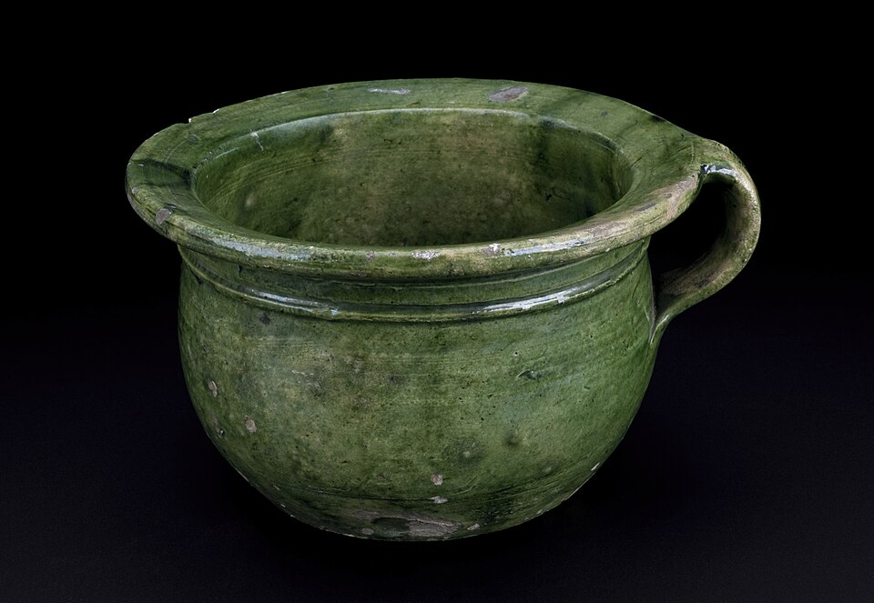
1.
© Wellcome Images

Slide 8
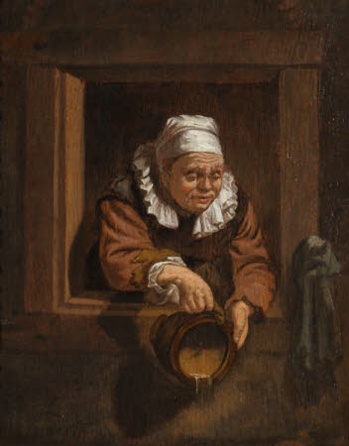
1. It’s a chamber pot (a toilet).
An Old Woman at a Window emptying a Chamber Pot ('Sleazy Bess’) © National Trust

Slide 9
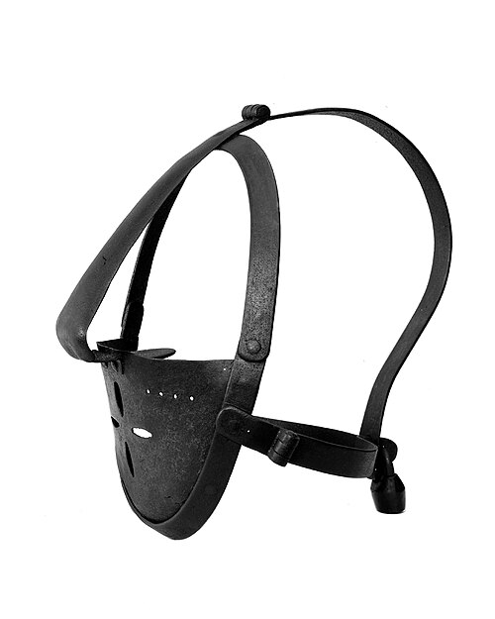
2.
© Wellcome Images

Slide 10
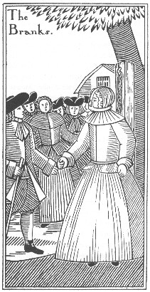
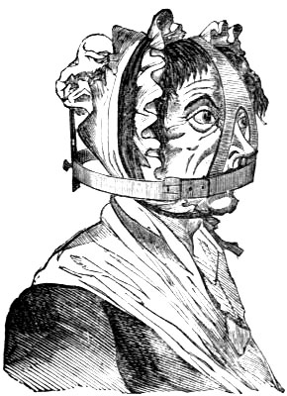
2. It’s a ‘scold's bridle’ or Brank (to punish people for gossiping).

Slide 11
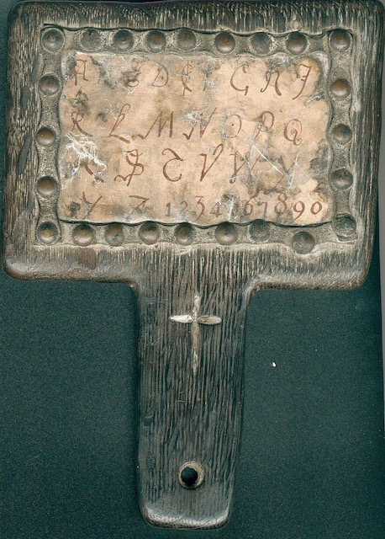
3.

Slide 12
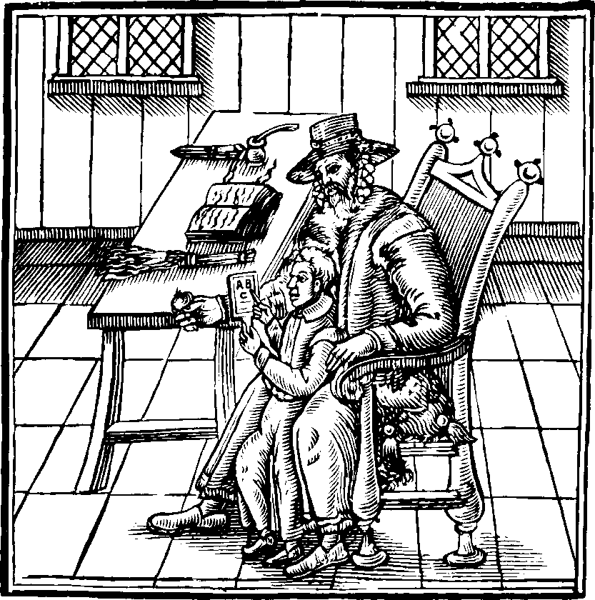
3. It’s a horn book to help with learning letters (like a whiteboard)

Slide 13
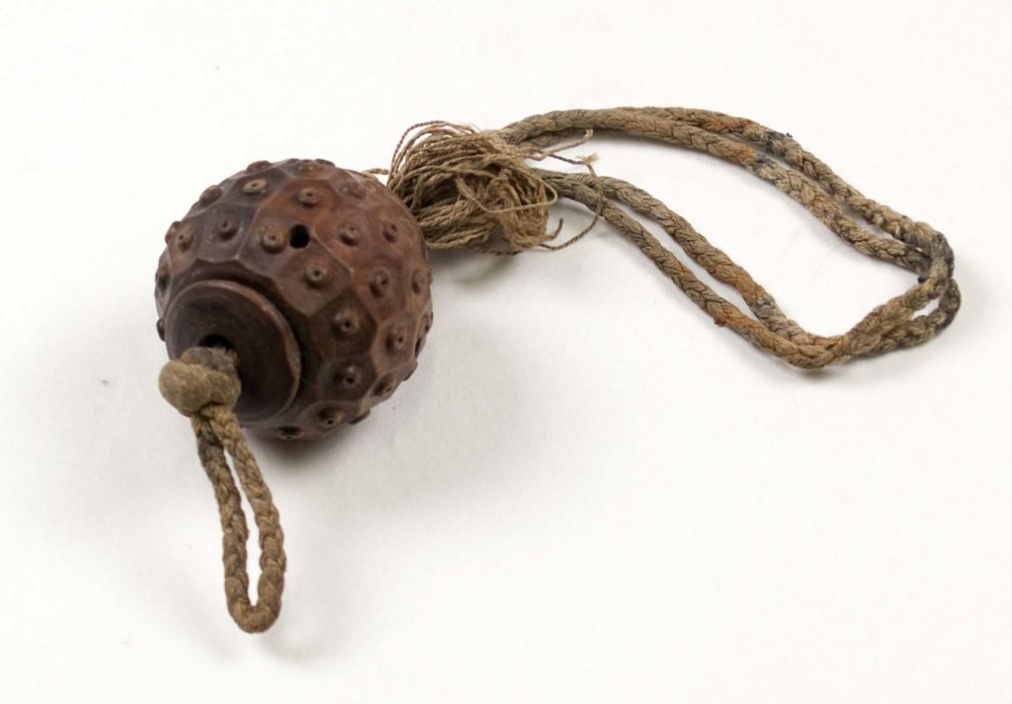
4.
© Mary Rose Trust

Slide 14
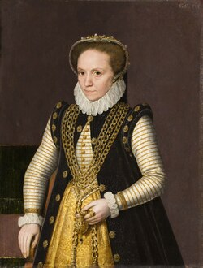
4. It’s a pomander (filled with spices for you to smell).

Slide 15
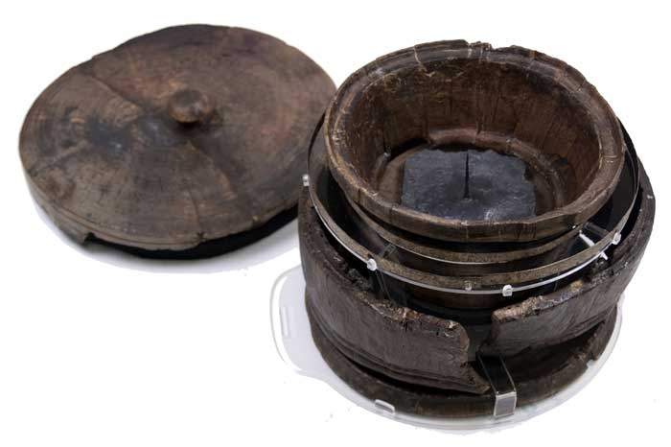
5.
© Mary Rose Trust

Slide 16
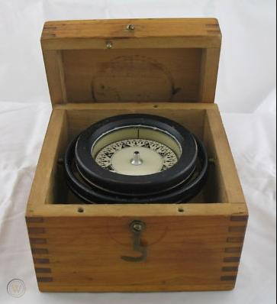
5. It’s a compass (from the Mary Rose)
© Mary Rose Trust

Slide 17
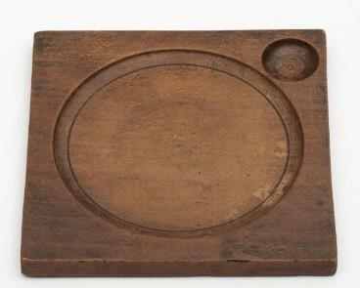
6.
© V&A Museum

Slide 18
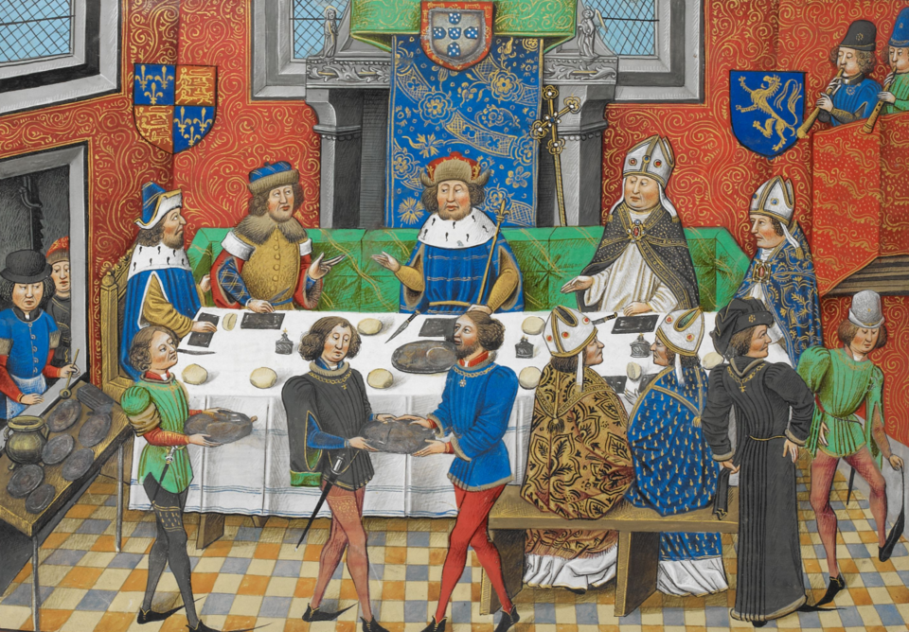
6. It’s a trencher – a wooden plate

Slide 19
Thanks everyone!

