Slide 1

Black History Month
Black Romans
Vocabulary
grave goods Roman Empire migration
evidence archaeologist

Slide 2
When was the Romans in Britain?
Today
Roman Britain
AD 43-410
200 BC
100 BC
AD 1
AD 100
AD 200
AD 300
AD 400
AD 500
AD 600
AD 700
AD 800
AD 900
AD 1000
AD 1100
AD 1200
AD 1300
AD 1400
AD 1500
AD 1600
AD 1700
AD 1800
AD 1900
AD 2000

Slide 3
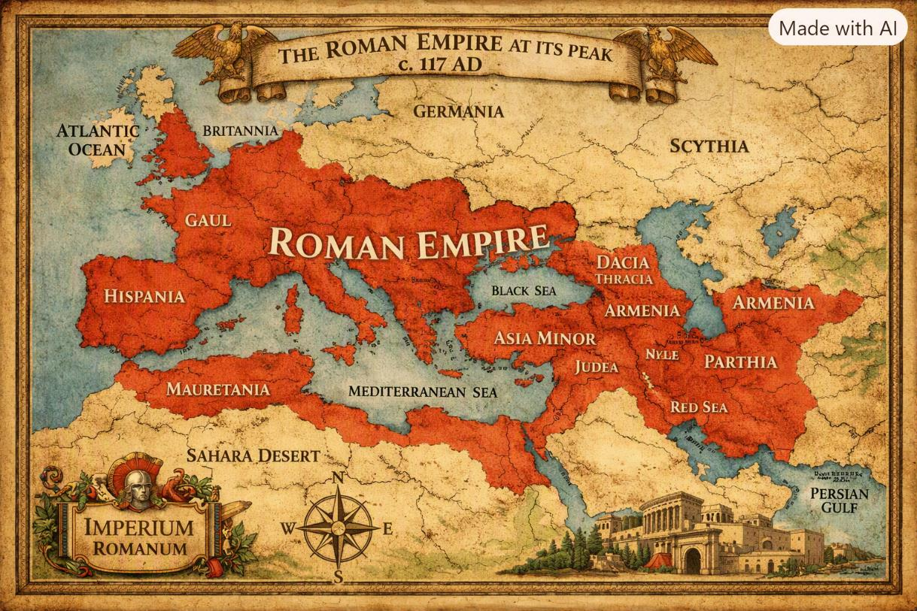
Africans first came to Britain with the Roman Empire. Britain became part of the empire of Rome, which stretched across Europe, North Africa and the Middle East.

Slide 4
Why were the Romans in Britain?
1. Britain had lots of goods which the Romans wanted.
• Lead • Wood • Tin • Wool • Slaves • Gold • Silver • Corn
2. They wanted to show how powerful they were.
• Conquering more and more countries and making its empire bigger made Rome more powerful.
3. They wanted to 'civilise' the world.
• The Romans also believed it was their duty to ‘civilise’ the rest of the world in their image.

Slide 5
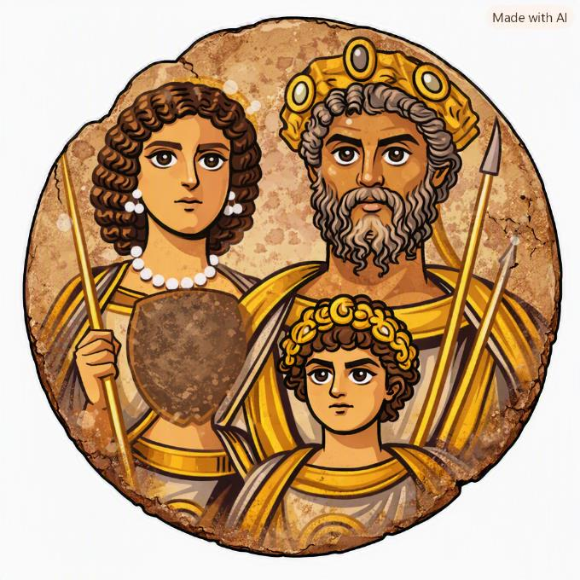
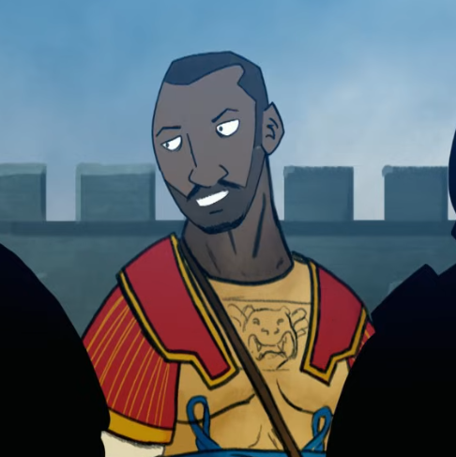
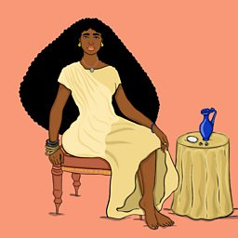
There were Black Romans in all levels of society in Roman Britain.
From soldiers…
… to the rich…
© BBC Teach via YouTube
… to the Emperor of Rome!
@wildsuga

Slide 6
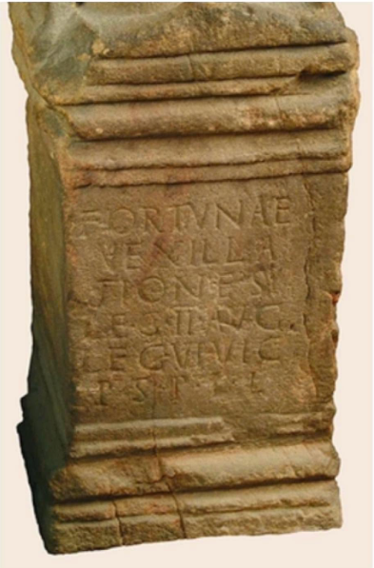
Black Roman Soldiers
The Aurelian Moors were a military unit of North Africans named after Emperor Marcus Aurelius. 'Moors' were what the Romans called people from North Africa. They lived and worked along Hadrian's Wall with their families.
There is an altar stone with writing carved into it, dedicating it to the god Jupiter which mentions the Aurelian Moors.

Slide 7
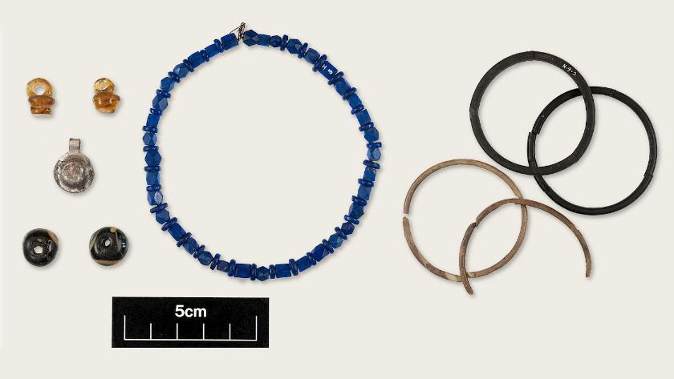
Ivory Bangle Lady
In 1901, a Roman grave was found in York. Inside were the remains of a young woman, which were dated to the late fourth century AD. She was buried in a stone coffin, called a sarcophagus, and with a variety of grave goods. She was called the Ivory Bangle Lady after one of the items of jewellery found in her grave.
© York Museums Trust

Slide 8
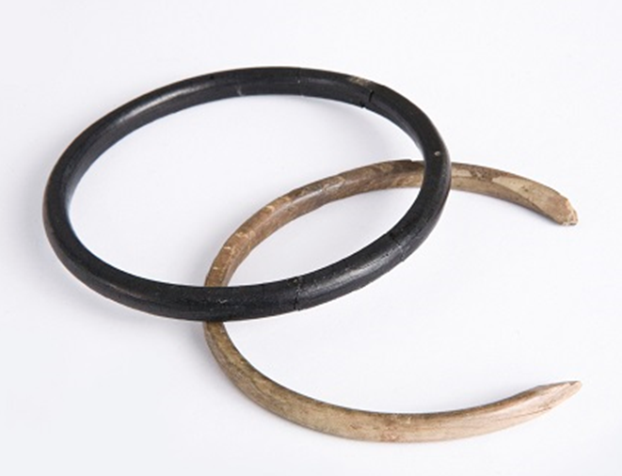
Grave Goods
The Ivory Bangle Lady was found with many grave goods. These are objects placed into a burial for the afterlife or as an offering to the gods.
She was buried with several bangles, including one made from jet and one made from ivory. The ivory, made from an elephant’s tusk, would have come from North Africa.
The bangle made from jet (black stone) probably came from Whitby and may have been sold in York market.
© York Museums Trust

Slide 9
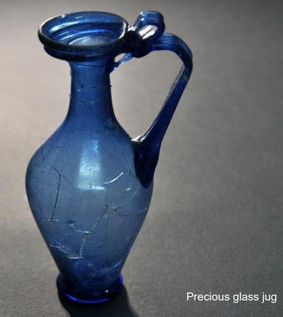
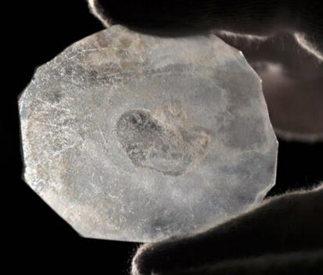
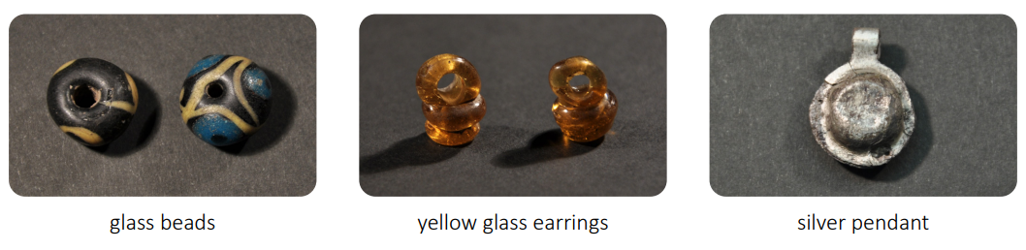
A precious flask made from blue glass was also found in the grave. The flask may have held wine or perfume.
The mirror found in her grave was made from polished glass.
She was also buried wearing a bracelet of blue glass beads, silver and bronze pendants, two yellow-glass earrings and a series of colourful glass beads.
What do you think these objects suggest about the lady buried in the grave?
All images © York Museums Trust

Slide 10
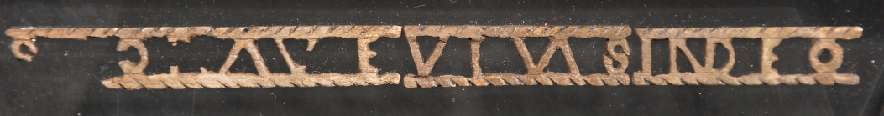
This is a bone plaque. Some of the Latin writing has survived, and it should read 'SOROR AVE VIVAS IN DEO' which translates to ‘Hail sister, may you live in God’.
© York Museums Trust
It is a Christian blessing. This may have been decoration from a wooden box that is now lost.
What do you think this object suggests about the lady buried in the grave?

Slide 11
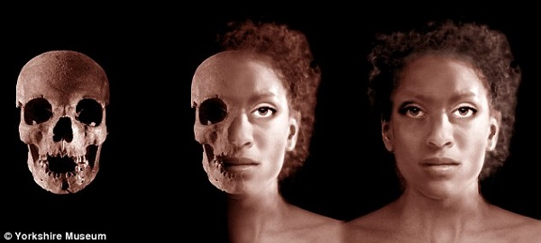
Her Skeleton
When the grave was found in 1905, archaeologists identified the skeleton as from a young woman dating to late 4th Century AD (about 380 AD).
In 2010, scientists were able to discover that she was aged between 18-23 years old. She was between 152-160cm (4.9-5.2ft) tall. The evidence suggests that she had a lot of fish in her diet, which was typical for rich people in Roman Britain.
They also discovered that she had North African ancestry, meaning at least one of her parents was from North Africa. A facial reconstruction from her skull shows her to have Black facial features.

Slide 12
Why don’t we know her name?
Unfortunately, we do not know her name. Although she was found in a stone coffin, there was no grave stone (or it has been destroyed in the past). There is very little written evidence from Roman Britain, so her name is lost in time.

Slide 13
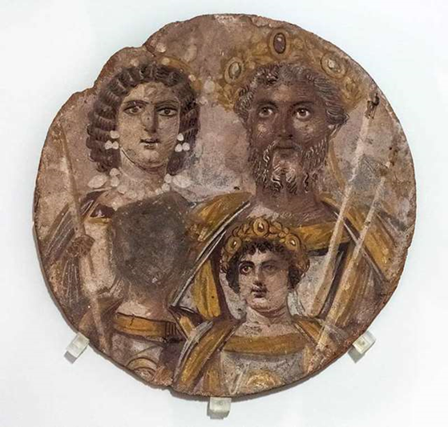
Septimius Severus - Emperor of Rome
Septimius Severus was the Emperor (ruler) of Rome. He was born in Libya, North Africa.
He came to England in AD 208 to try and conquer Scotland. He brought with him 50,000 men.
© Adam Eastland / Alamy Stock Photo

Slide 14
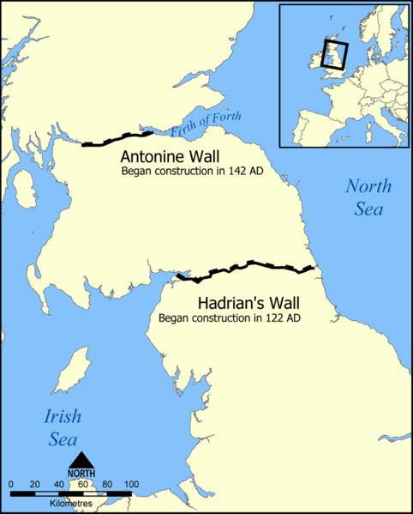
Septimius and his army were able to go beyond Hadrian's Wall, past the Antonine Wall (that had been abandoned) and push towards the Firth of Forth.
It was the furthest into Scotland any Emperor would conquer.
© NormanEinstein
While in Britain, Septimius fell ill. He was taken to York where he died in AD 211.

Slide 15
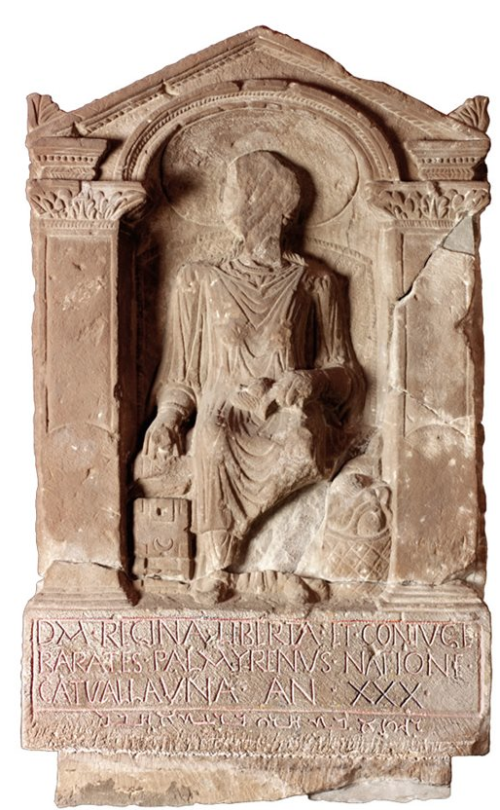
Other Black Romans
This tombstone, from Arbeia in South Shields, is for a woman called Regina. She was a freedwoman (former slave) and died aged 30. Her husband, Barathes was from Syria, in the Middle East. Regina was a British woman from a tribe in southern England.
© Tyne and Wear Museums

Slide 16
Suggested Activities
Draw detailed sketches of the grave goods of the Ivory Bangle Lady.
Learn how to read Latin (or write your name).
Design an altar stone or tombstone.

