Slide 1

Black History Month
Olaudah Equiano
Vocabulary
slave trade autobiography merchant
plantation abolitionist expedition

Slide 2
When was Olaudah Equiano alive?
Olaudah Equiano
1745-1797
Today
200 BC
100 BC
AD 1
AD 100
AD 200
AD 300
AD 400
AD 500
AD 600
AD 700
AD 800
AD 900
AD 1000
AD 1100
AD 1200
AD 1300
AD 1400
AD 1500
AD 1600
AD 1700
AD 1800
AD 1900
AD 2000

Slide 3
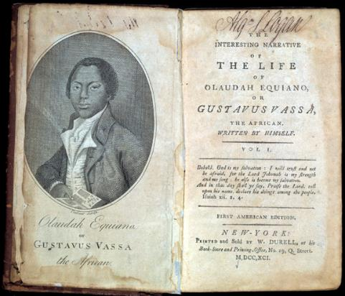
How do we know about Olaudah Equiano?
We know about Olaudah's life because he wrote a book (autobiography) called 'The interesting Narrative of the life of Olaudah Equiano or Gustavus Vassa, the African.'
© Library Company of Philadelphia

Slide 4
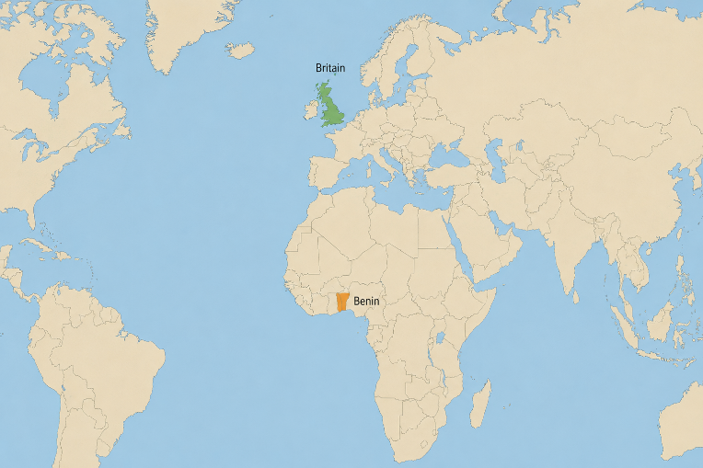
Who was Olaudah Equiano?
Olaudah was born in 1745 in the Kingdom of Benin.
Benin was in Africa and it is now part of Nigeria.

Slide 5
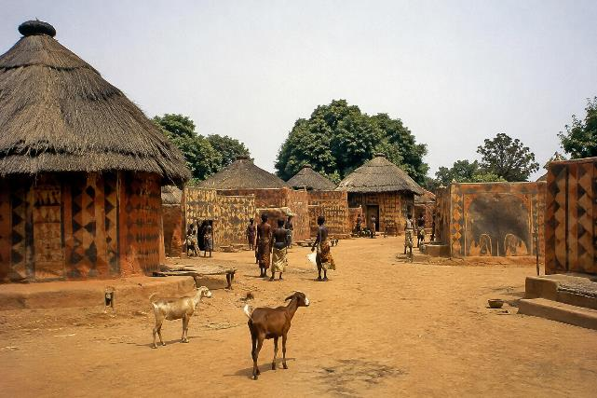
Olaudah's father was an 'embrenche', or village chief. They made rules and settled arguments and punished crimes. As the chief's son, Olaudah would have expected to become chief when he was older.
This is what the village may have looked like.

Slide 6
When Olaudah was 11 years old, he and his sister were kidnapped.
In his book, Olaudah describes being kidnapped:
"One day, when all our people were gone out to their works as usual, and only I and my dear sister were left to mind the house, two men and a woman got over our walls, and in a moment seized us both, and, without giving us time to cry out, or make resistance, they stopped our mouths, and ran off with us into the nearest wood."

Slide 7
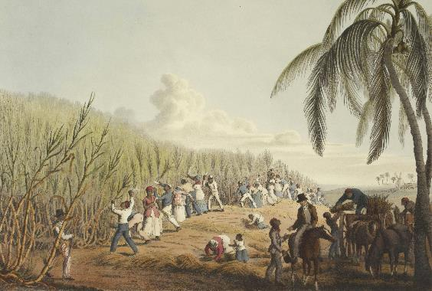
Olaudah and his sister were being sold into the slave trade.
This is where people were sold (like objects) and forced to work for no money. People from Africa were kidnapped from their homes, sold and put onto ships to work in different countries. Most never saw their families again.
© British Library on Unsplash

Slide 8
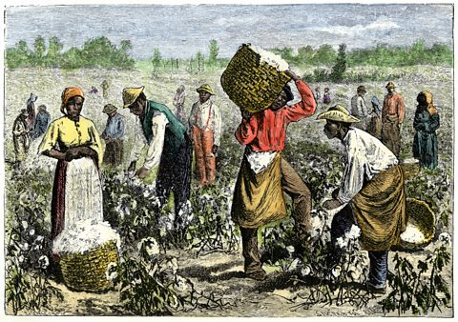
Olaudah was separated from his sister and was taken to Barbados where he was sold again to a plantation owner in Virginia, America.
© BBC
A plantation is a large farm. These used slaves to the hard work and did not pay them. The owners could also be cruel to their slaves and that was not against the law.

Slide 9
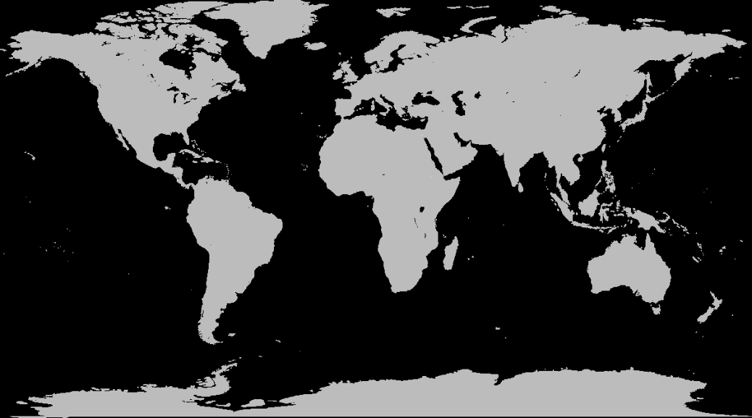
Olaudah’s journey so far: 1756
Virginia
Benin
Barbados

Slide 10
While working on the plantation, he met a man called Michael Henry Pascal.
Captain Pascal was a lieutenant in the Royal Navy. Pascal liked Olaudah so much he bought him and took him to England.
Pascal also gave him a new name: Gustavus Vassa.
While I was on board this ship, my captain and master named me Gustavus Vassa. I [...] refused to be called so [...] and he still called me Gustavus; and when I refused to answer to my new name [...] it gained me many a cuff;

Slide 11
When Olaudah reached England, he was amazed at the sights around him.
"I was very much struck with the buildings and the pavement of the streets in Falmouth; and, indeed, any object I saw filled me with new surprise."

Slide 12
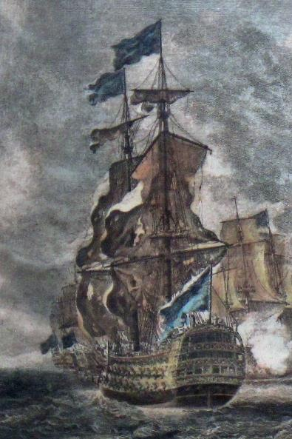
In 1758, England went to war with France over who controlled Canada.
Olaudah went with Captain Pascal on board the HMS Namur to Louisbourg, Canada.
After a long battle, the British won and returned back to England.

Slide 13
Olaudah’s journey so far: 1762
Louisbourg
Britain

Slide 14
Once in England, Olaudah believed that Captain Pascal would grant him his freedom (no longer a slave).
However, he was betrayed and Captain Pascal (who had always treated Olaudah with kindness), now sold him to the captain of another ship.
He was taken to Montserrat, a slave island in the Caribbean.
"At the sight of this land of [slavery], a fresh horror ran through all my frame, and chilled me to the heart."

Slide 15
During this time, Olaudah learnt to read and write. This was unusual for slaves, but this made Olaudah very valuable as he could do many different types of jobs.
He was sold to Mr Robert King who was a merchant (a person who buys and sells items). He let Olaudah travel to different islands in the Caribbean to buy and sell items for his business. He even allowed Olaudah to sell some items himself so he could earn some money.

Slide 16
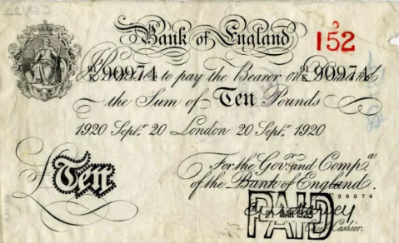
In 1765, Olaudah made a deal with his new Master: if he could raise £40 he could buy his own freedom. This was a lot of money. In today's money it is about £9,000.
The Master agreed £40 because it is what he paid for Olaudah and he believed it would take many years for Olaudah to make that amount of money.
1759 10 pound note © Governor and Company of the Bank of England
Olaudah managed to buy his freedom.
It only took him 1 year.

Slide 17
These are Olaudah's words about how he felt after buying his freedom:
"My feet scarcely touched the ground, for they were winged with joy...
Every one I met I told of my happiness, and blazed about the virtue of my amiable master and captain...
... before night, I who had been a slave in the morning, trembling at the will of another, was become my own master, and completely free."
He had been a slave for 10 years.

Slide 18
Olaudah’s journey so far: 1766
Britain
Montserrat

Slide 19
Olaudah was now a free man.
He travelled back to England but continued to work aboard ships where he could travel to new places.
He went to other islands in the Caribbean and even to the Mediterranean.
In 1773, Olaudah took part in an expedition to find a new route to Asia by going across the North Pole.

Slide 20
Olaudah’s journey so far: 1773
Arctic
Britain
Mediterranean

Slide 21
In London, Olaudah starts to meet people who want to abolish slavery (make it illegal).
Olaudah wanted to help and became an abolitionist, a person who wants slavery to end.
To help the cause, in 1789 he decided to write a book about his life and what had happened to him.
© Library Company of Philadelphia
His book was extremely popular, selling over 30,000 copies and was translated into Dutch, German and Russian. It was even sold in America.

Slide 22
Olaudah became a popular public speaker. He toured the whole of the UK reading from his book and promoting the abolition of slavery.
His voice was one of only a few who could explain what life was like for Africans in the slave trade.
People listened to his story and were shocked at what had happened to him.
His book helped to stop slavery in Great Britain.

Slide 23
Unfortunately, Olaudah died in 1797, aged 52 and did not get to see slavery abolished.
Slavery was not abolished until 1807 in the UK and 1833 when every slave in the British Empire was given their freedom.

Slide 24
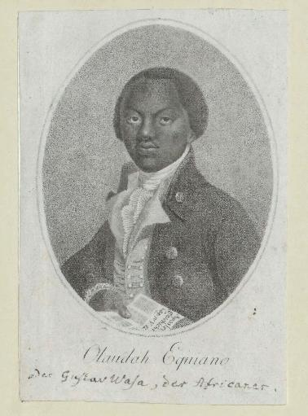
Why do we remember Olaudah Equiano?
Olaudah was not the only African who was taken from his family and sold into slavery. 12.5 million Africans were shipped across to places like America and the Caribbean.
But, by telling his story, Olaudah helped people understand how cruel slavery was and why it needed to end.
© Austrian National Library

Slide 25
Suggested Activities
Create a timeline of Olaudah’s life.
Map the journey of Olaudah.
Research about the Kingdom of Benin.
Compare Benin to 1700s England.

